Slide 1
JSON exchange format

Slide 2
Current GO annotation download options
Tab-separated
GAF
GPAD/GPI (not available yet)
XML
Pseudo RDF/XML (circa 2001)
Relational
MySQL dump (circa 2001)

Slide 3
The problem with tabular files
Mapping everything to simple TSVs hinders the evolution of the GO
Benefits of TSVs:
Ideal for simplified view of some subset of our data/knowledge
Problems with TSVs:
Ad-hoc syntax (e.g. multivalued columns) not good for robust software negineering
Bad fit for complex graph-like or nested representations (modular annotation, aka “lego”)

Slide 4
JSON as an alternative to TSVs
What is JSON?
Data exchange format for simple data structures
Allows nesting – crucial for modular annotations
De facto standard for web applications
Easy to use programmatically
JSON-LD
Magic that makes a JSON file also an RDF file
The JSON is ‘semantic’

Slide 5
Example (LEGO)
{ type: "GO:nnnn" , ## MF
part_of: { type: "GO:nnnn" }, ## BP
occurs_in: { type: "GO:nnnn" }, ## CC
enabled_by: { type: "UniProtKB:nnn"}, ## mandatory
describedBy: {
reference: "PMID:123456",
evidence: {
type: "ECO:0000001",
with: "XXXX"
}
}
}

Slide 6
Basic MF annotations
{ type: "GO:nnnn" , ## MF
part_of: { type: "GO:nnnn" }, ## BP
occurs_in: { type: "GO:nnnn" }, ## CC
enabled_by: { type: "UniProtKB:nnn"}, ## mandatory
describedBy: {
reference: "PMID:123456",
evidence: {
type: "ECO:0000001",
with: "XXXX"
}
}
}

Slide 7
Basic BP annotations
{ type: "GO:0003674" , ## MF
part_of: { type: "GO:nnnn" }, ## BP
occurs_in: { type: "GO:nnnn" }, ## CC
enabled_by: { type: "UniProtKB:nnn"}, ## mandatory
describedBy: {
reference: "PMID:123456",
evidence: {
type: "ECO:0000001",
with: "XXXX"
}
}
}

Slide 8
Nesting
{ type: "GO:nnnn" , ## MF
has_input: “CHEBI:nnnn”, ## (same as c16)
part_of: { type: "GO:nnnn" }, ## BP
occurs_in: { type: "GO:nnnn”, ## CC
part_of: { type: “CL:nnnnn”,
part_of: { type: “UBERON:nnnn” }}},
enabled_by: { type: "UniProtKB:nnn"}, ##
describedBy: {
reference: "PMID:123456",
evidence: {
type: "ECO:0000001",
with: "XXXX"
}
}
}

Slide 9
Connecting
{ id: “GOC:ann12345”,
type: "GO:nnnn" , ## MF
has_input: “CHEBI:nnnn”, ## (same as c16)
part_of: { type: "GO:nnnn" }, ## BP
occurs_in: { type: "GO:nnnn”, ## CC
part_of: { type: “CL:nnnnn”,
part_of: { type: “UBERON:nnnn” }}},
enabled_by: { type: "UniProtKB:nnn"}, ##
describedBy: {
reference: "PMID:123456",
evidence: {
type: "ECO:0000001",
with: "XXXX"
}
},
directly_activates: “GOC:ann9876”,
}

Slide 10
JSON-LD Schema: mapping to RDF
{ id: “GOC:ann12345”,
type: "GO:nnnn" , ## MF
has_input: “CHEBI:nnnn”, ## (same as c16)
part_of: { type: "GO:nnnn" }, ## BP
occurs_in: { type: "GO:nnnn”, ## CC
part_of: { type: “CL:nnnnn”,
part_of: { type: “UBERON:nnnn” }}},
enabled_by: { type: "UniProtKB:nnn"}, ##
describedBy: {
reference: "PMID:123456",
evidence: {
type: "ECO:0000001",
with: "XXXX"
}
},
directly_activates: “GOC:ann9876”,
}
{
“GO”: http://purl.obolibrary.org/obo/GO_,
“type”: “rdf:type”,
“has_input”: “RO:0002233”
“part_of”: “BFO:0000050”,
“occurs_in”: “BFO:0000066”,
}

Slide 11
JSON-LD Schema: mapping to RDF
{ id: “GOC:ann12345”,
type: "GO:nnnn" , ## MF
has_input: “CHEBI:nnnn”, ## (same as c16)
part_of: { type: "GO:nnnn" }, ## BP
occurs_in: { type: "GO:nnnn”, ## CC
part_of: { type: “CL:nnnnn”,
part_of: { type: “UBERON:nnnn” }}},
enabled_by: { type: "UniProtKB:nnn"}, ##
describedBy: {
reference: "PMID:123456",
evidence: {
type: "ECO:0000001",
with: "XXXX"
}
},
directly_activates: “GOC:ann9876”,
}
{
“GO”: http://purl.obolibrary.org/obo/GO_,
“type”: “rdf:type”,
“has_input”: “RO:0002233”
“part_of”: “BFO:0000050”,
“occurs_in”: “BFO:0000066”,
}
<owl:NamedIndividual rdf:about=”GOC:ann12345">
<rdf:type rdf:resource="http://purl.obolibrary.org/obo/GO_0005381"/>
<rdf:type>
<owl:Restriction>
<owl:onProperty rdf:resource="http://purl.obolibrary.org/obo/enabled_by"/>
<owl:someValuesFrom rdf:resource="http://purl.obolibrary.org/obo/PomBase_SPAC1F7.07c"/>
</owl:Restriction>
</rdf:type>
<rdfs:label rdf:datatype="http://www.w3.org/2001/XMLSchema#string">iron ion transmembrane transporter activity enabled by fip1</rdfs:label>
<obo:directly_activates rdf:resource=”GOC:ann987"/>
<obo:BFO_0000050 rdf:resource=FOC:ann456"/>
</owl:NamedIndividual>

Slide 12
Next steps
Develop spec further
http://viewvc.geneontology.org/viewvc/GO-SVN/trunk/experimental/lego/docs/lego-json.md
Write converters
Document and publish
That should be it for the next ten years

Slide 13
Ontology infrastructure update

Slide 14
GO and RHEA

Slide 15
Goals
Map to and align with RHEA
Leverage mappings
Generate CHEBI logical definitions
Derive mappings to other resources (e.g. EC)
Automate development of parts of MF ontology
Automate F->P links for reactions
TermGenie for catalytic activities

Slide 16
RHEA
Represents biochemical reactions
Up to 4 IDs
L->R
L<-R
L<->R
L ? R
Each side of the reaction is mapped to CHEBI
No hierarchy
Doesn’t do ‘generic’ reactions
Mapped to EC
No names/labels for reactions
Available as BioPAX

Slide 17
Generate mappings to RHEA
 |  | mapped | total
GO:0003824 | catalytic activity | 2738 | 6342 | 43%
GO:0005215 | transporter activity | 91 | 1042 | 8%
GO:0016209 | antioxidant activity | 13 | 24 | 54%

Slide 18
Mappings should be 1:1
Previously many RHEA mappings were ‘rough matches’
1 to many
many to 1
many to many
We need precise mappings to exploit reasoning
Becky cleaned these up
68 remaining
Make exception for NAD(P)H/+

Slide 19
Translation to OWL
Translate RHEA BioPAX to our OWL model
Challenge: bidirectionality
We can’t use has_input (RO:0002233) and has_output (RO:0002234)
We use direction-neutral
Challenge: stoichiometry
Difficult to represent explicitly
Represent each side of the reaction compositionality

Slide 20
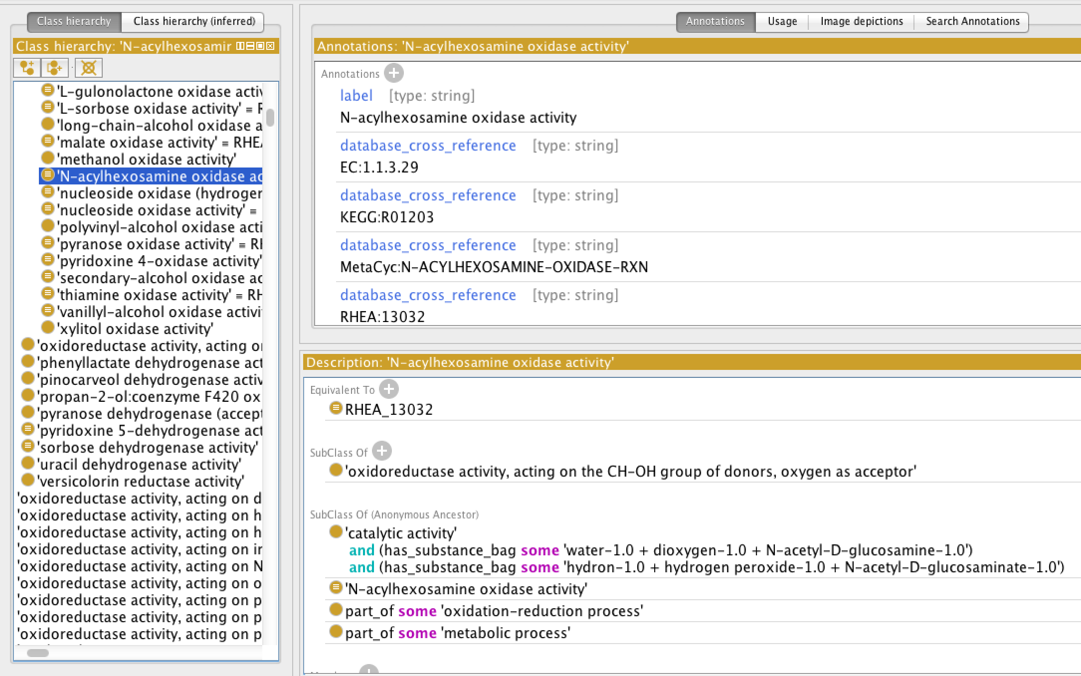

Slide 22
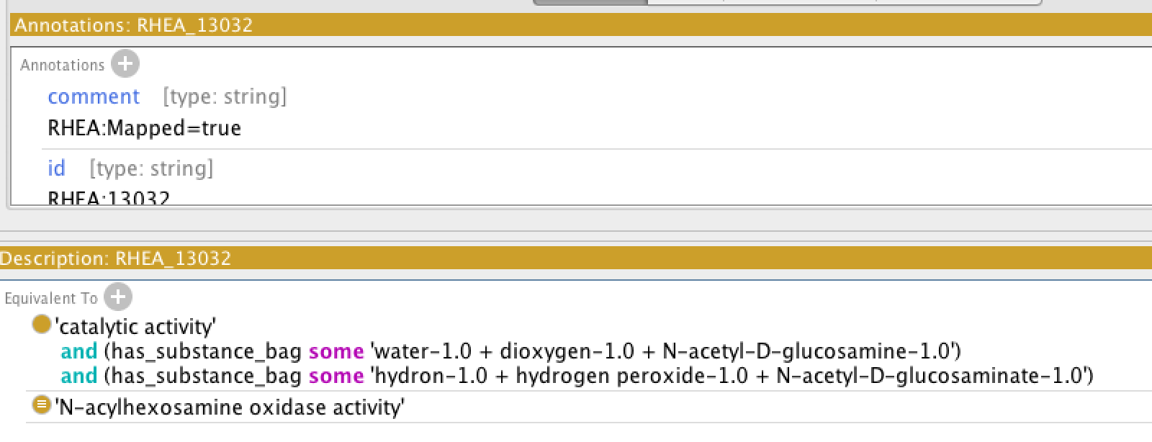

Slide 24
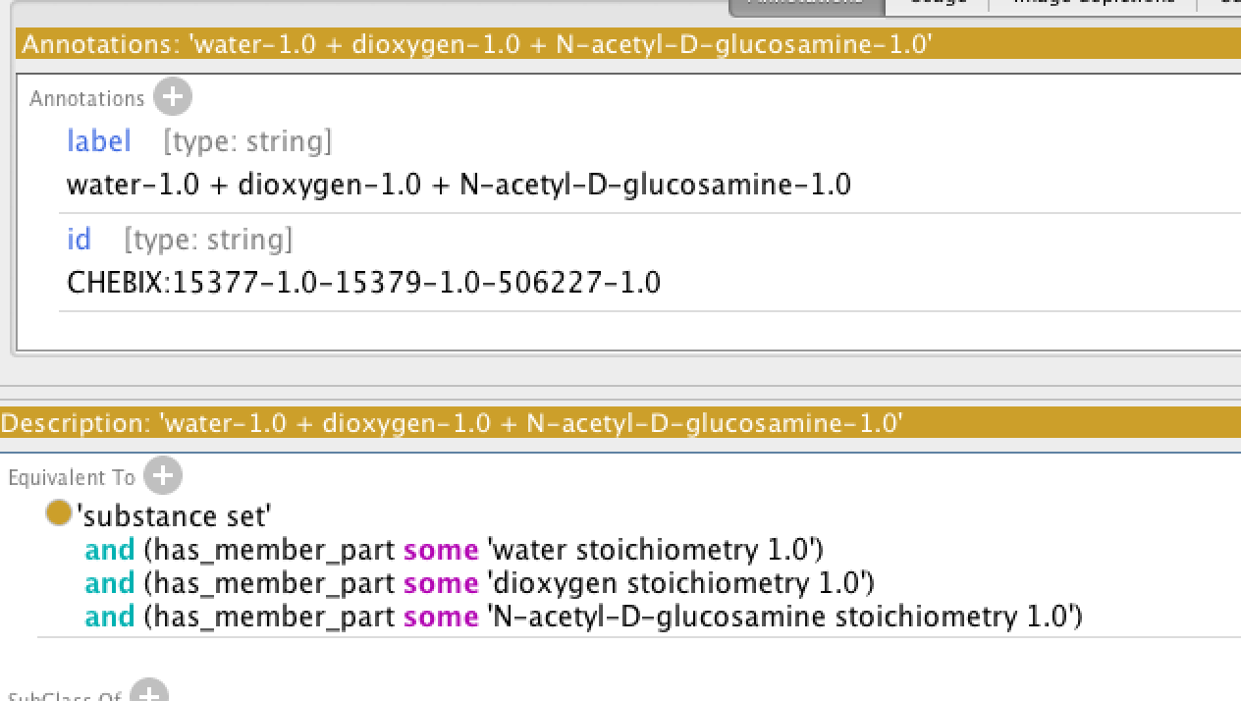

Slide 26
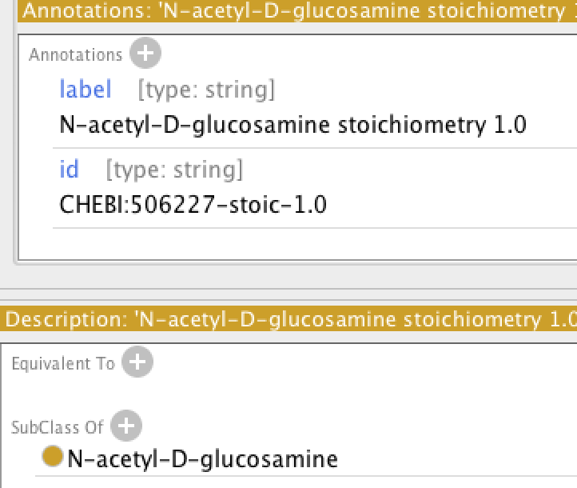

Slide 28
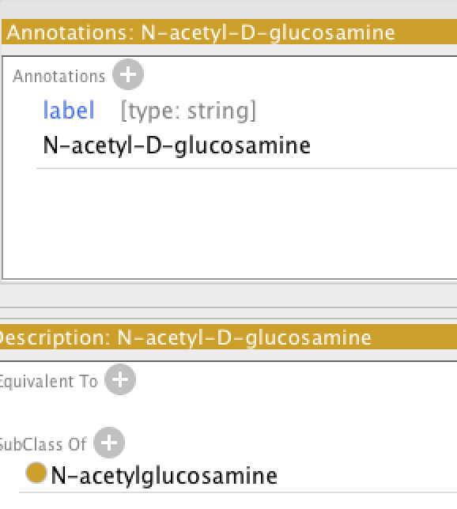

Slide 29
Proposed pipeline
New MF requests go via RHEA
Auto-generate GO term from RHEA
To be resolved: generating the name
Place term automatically in hierarchy using reasoning
Grouping classes in GO still need logical definitions

Slide 31
The road to modular annotations (aka LEGO): Are we there yet?
Bar Harbor 2013

Slide 32
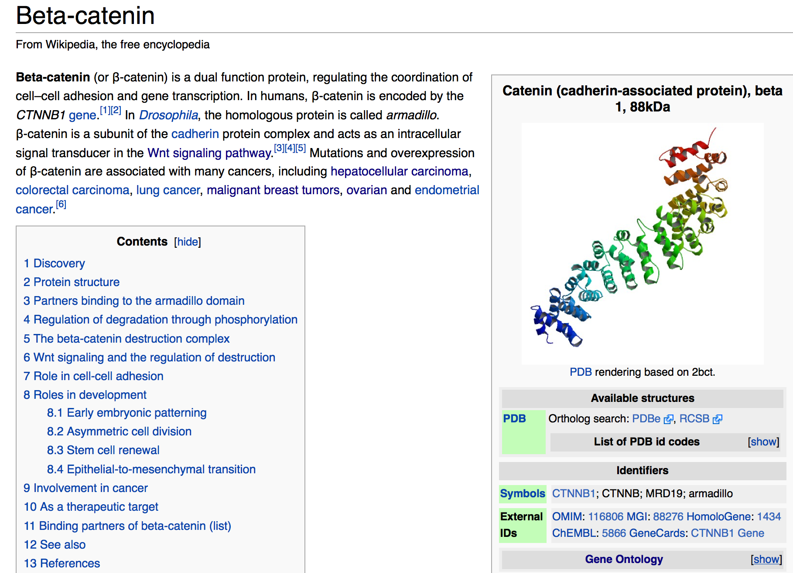

Slide 33
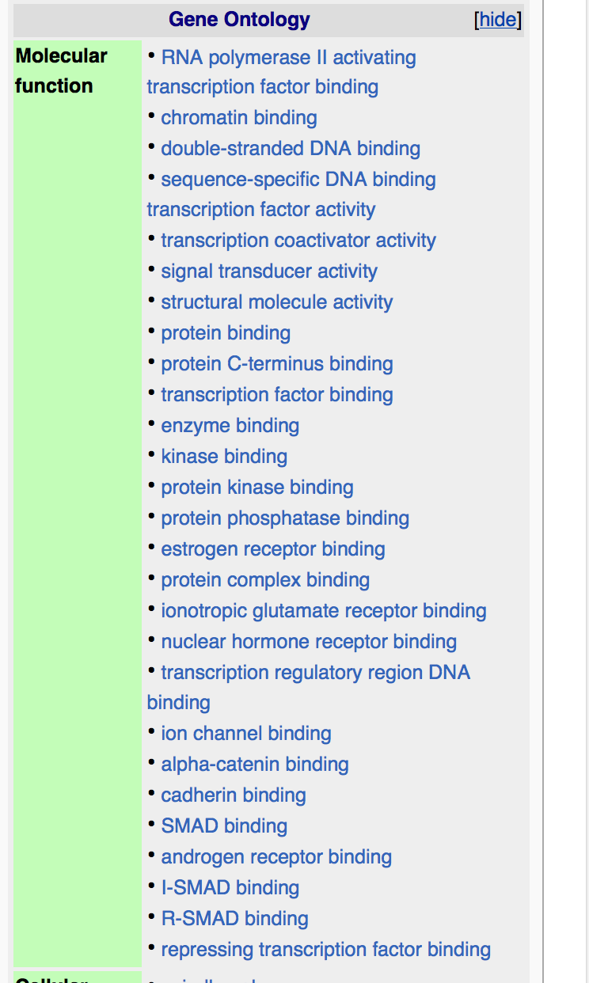

Slide 34
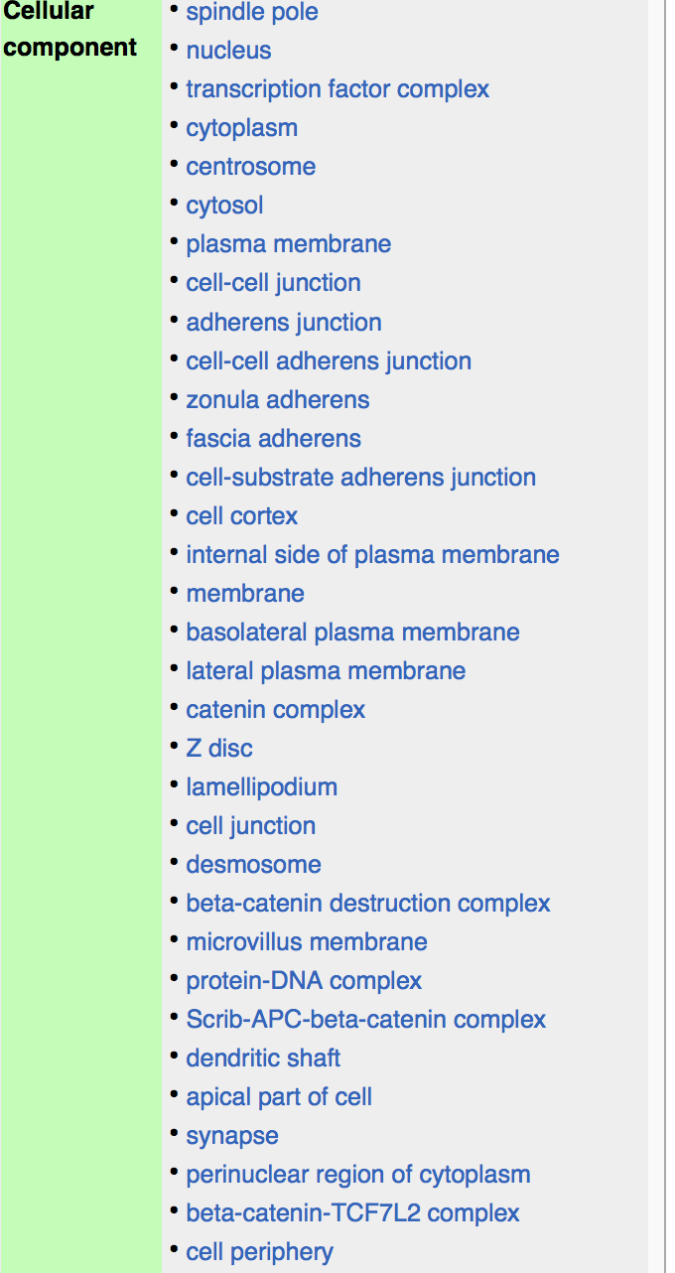

Slide 35
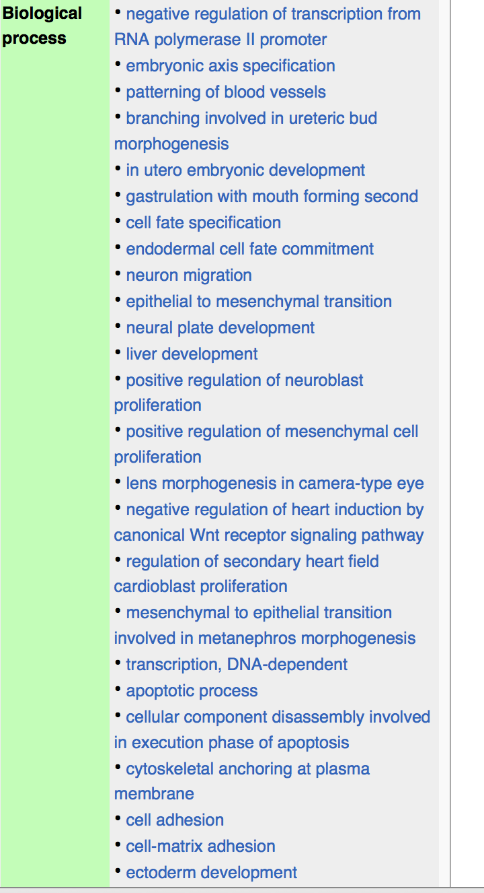

Slide 36
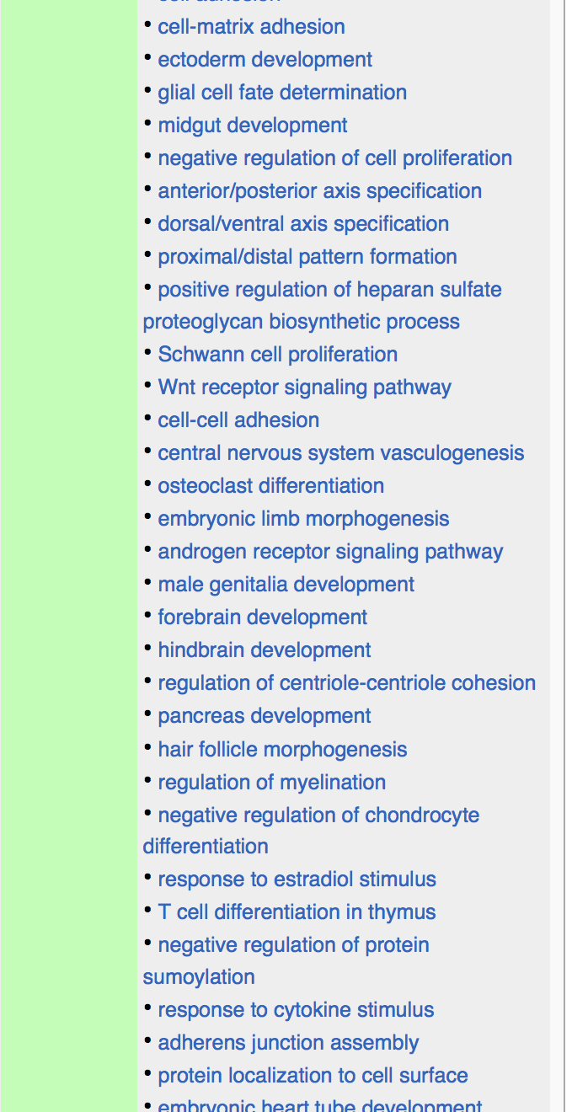

Slide 37
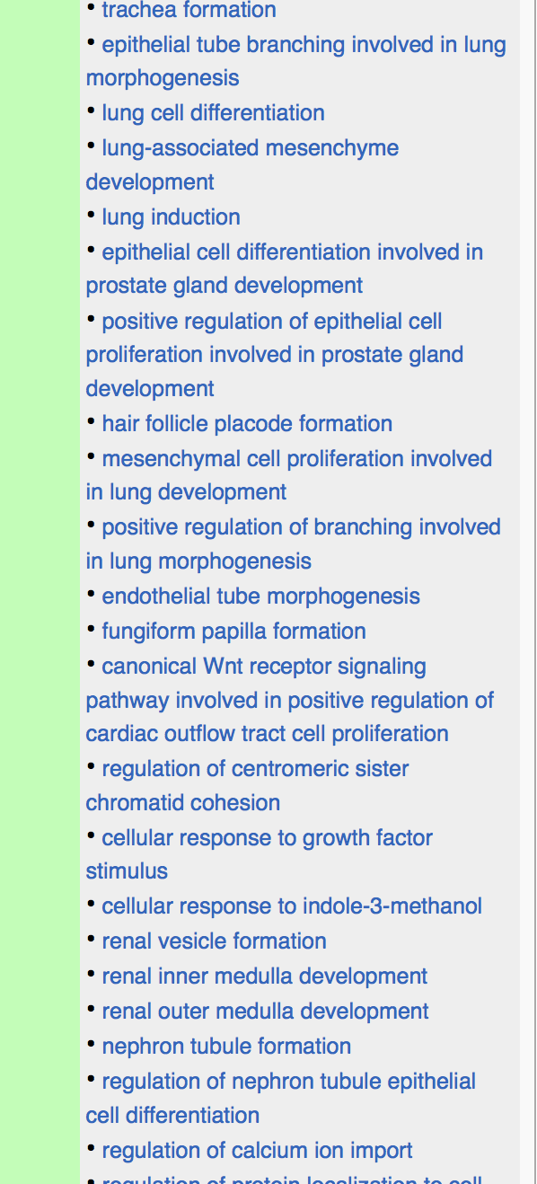

Slide 38
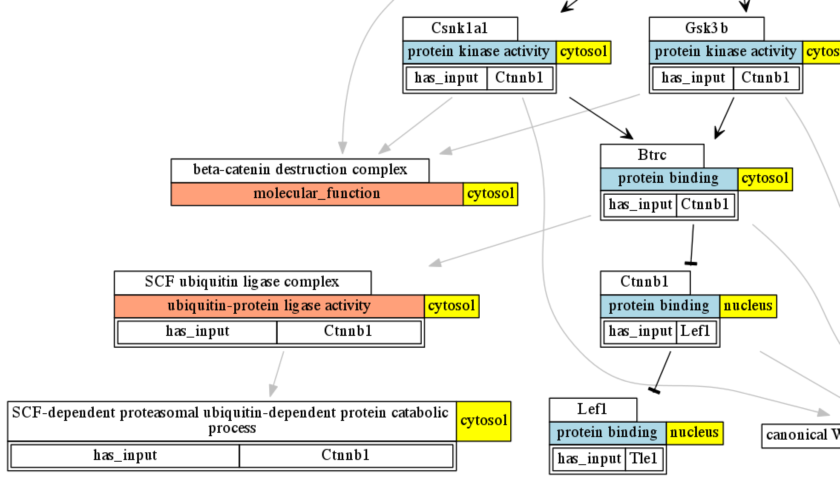
How do we get to here?

Slide 39
Brief overview: What is modular annotation (aka lego)?
We create instances of GO molecular function classes to represent the particular activities in a particular process
These are connected to other instances (triples) using the same relations used in the GO
Regulation, part_of, occurs_in, has_input, ..
Thus the model is fully ontological, and takes advantage of the ontology

Slide 40
Questions/Obstacles
How would users view the annotations?
How would annotators create the annotations?
How would we validate the annotations?
Which formats would tools use to exchange the annotations?
How can we seed a large enough set of annotations to be useful?
How does all this help biologists interpret their experimental data?

Slide 41
How would users view the annotations?
New browsing paradigm required
Not gene sets any more
Current progress:
http://amigo2.berkeleybop.org/cgi-bin/amigo2/amigo/search/complex_annotation
Tabular and network views

Slide 42
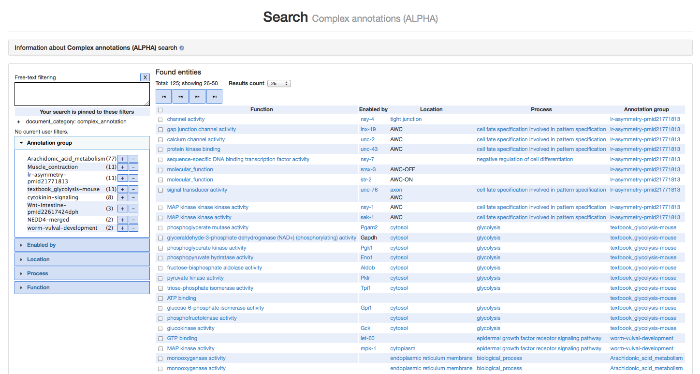
http://amigo2.berkeleybop.org/cgi-bin/amigo2/amigo/search/complex_annotation

Slide 43
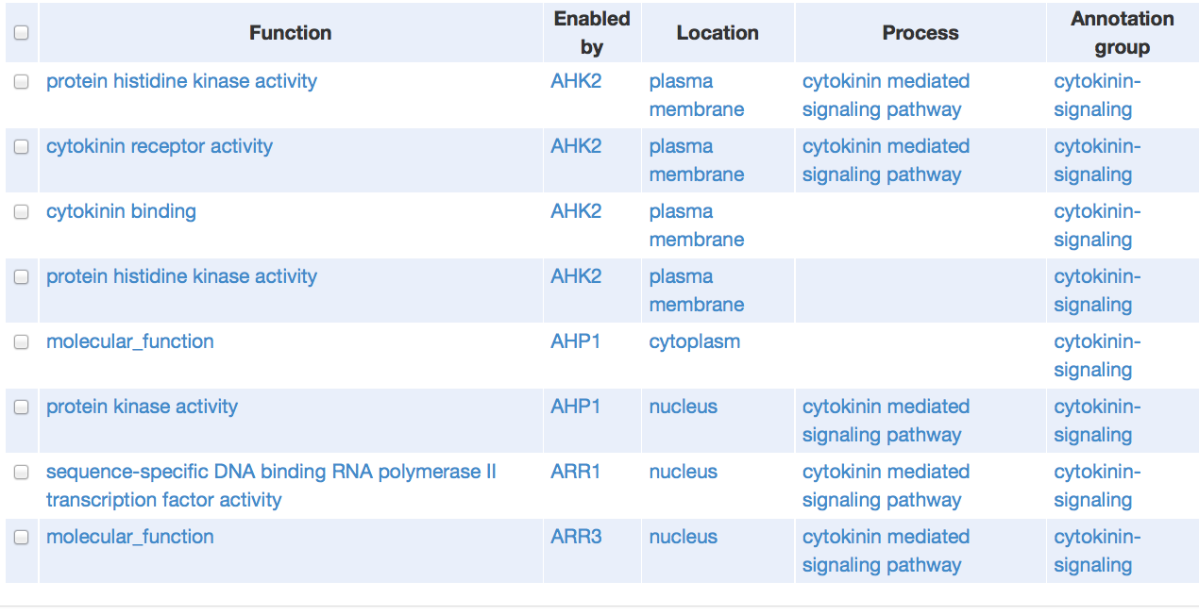
Functions are enabled / executed by a molecular entity, in a location, as part of a
cellular process, in some larger context

Slide 44
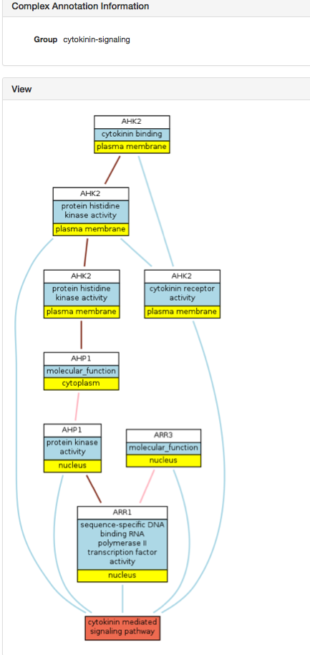
http://amigo2.berkeleybop.org/cgi-bin/amigo2/amigo/complex_annotation/cytokinin-signaling
Users can select an ‘annotation unit’ to see its connectivity
to other units in the process

Slide 45
Query by location
Locations can be specified at multiple levels of granularity

Slide 46
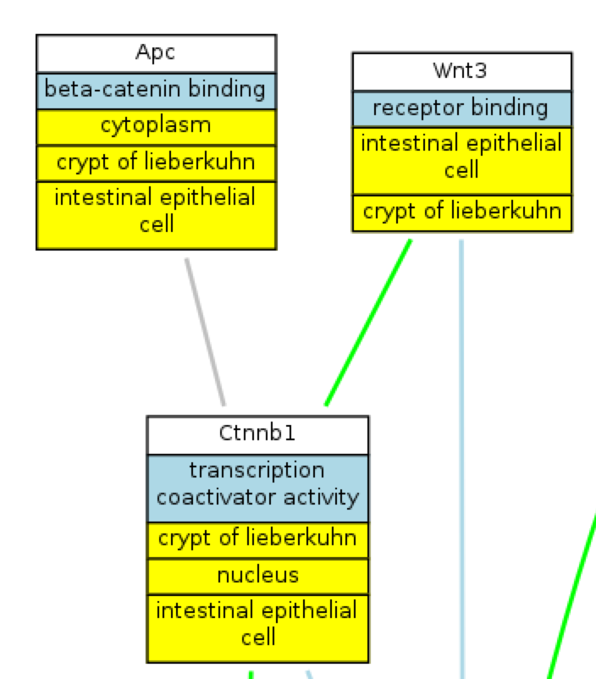
Query by location
Locations can be specified at multiple levels of granularity

Slide 47
Search and browsing: next steps
Current goals of alpha version in AmiGO 2
GOC internal use only
Loading subset of files in ‘experimental’ folder in SVN
Track progress on ‘LEGO’ project
Prototype eventual display for users
Modular Annotation GO working group
Wider release?
Will require
Larger number of high quality modular annotations
Ability to satisfy some analysis use case

Slide 48
How would annotators create the annotations?
Prototype phase (2012-2013):
Heiko’s LEGO Protégé 4 plugin
Progress: FEATURE FREEZE – not for general use
Next stage (proposed 2014-):
Visual web-based editor
Could be a plugin to Protein2GO
Or a standalone tool with a RDF triplestore backend
Current progress
Evaluating javascript frameworks
E.g. jsPlumb
Web cytoscape is Flash, so we won’t use

Slide 49
Modular annotation editor: Open questions
How should this be integrated with phylogeny-based editing?
Will a relational database be an appropriate backend or should we jump straight to an RDF triplestore?

Slide 50
How do we validate the annotations?
High degree of expressivity ➔ scope for errors and inconsistency
Q: How do we spot errors?
A: we use OWL reasoners
Lego is already layered on RDF/OWL, no additional translation required
Progress: Ontology editors have enriched the ontology with many constraints
E.g. (part_of some nucleus) DisjointWith (part_of some cytoplasm)
This has already proven useful in the prototyping phase

Slide 51
Which formats would tools use to exchange the annotations?
LEGO is just RDF/OWL
Express directly as RDF triples
See http://viewvc.geneontology.org/viewvc/GO-SVN/trunk/experimental/lego/owl/
Different syntaxes available (all use the same model):
RDF/XML
RDF-Turtle
What about simpler formats?

Slide 52
How can we seed a large enough set of annotations to get the ball rolling?
Strategies:
Translate pathway databases
Use the GO ontology and existing annotations
Text mining?

Slide 53
Generating complex annotations from BioPAX
All pathway databases export to BioPAX
BioPAX is RDF/XML, but different schema than Lego
We can implement transforms
Every bp:BiochemicalReaction ➔ GO MF instance (aka annotation unit)
Use participants to infer more specific GO MF
Progress: prototype implementation
Working on complexes

Slide 54
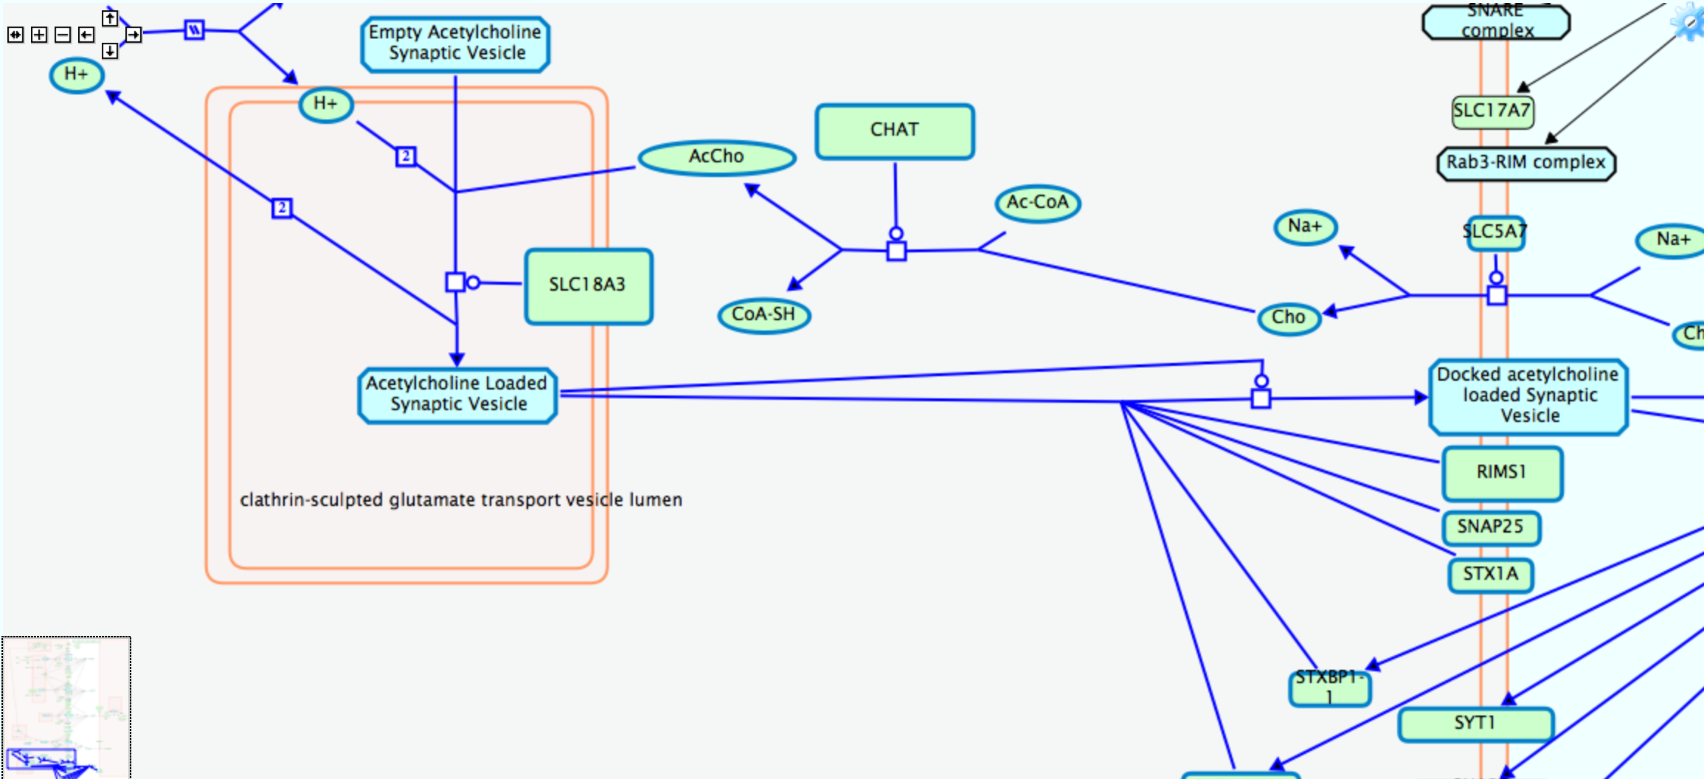
http://www.reactome.org/PathwayBrowser/#FOCUS_PATHWAY_ID=112310&ID=264642

Slide 55
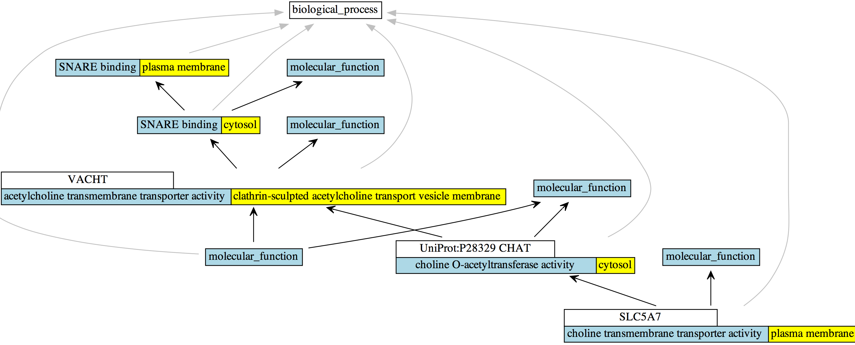
http://www.reactome.org/PathwayBrowser/#FOCUS_PATHWAY_ID=112310&ID=264642

Slide 56
http://www.reactome.org/PathwayBrowser/#FOCUS_PATHWAY_ID=397014&ID=390522

Slide 57
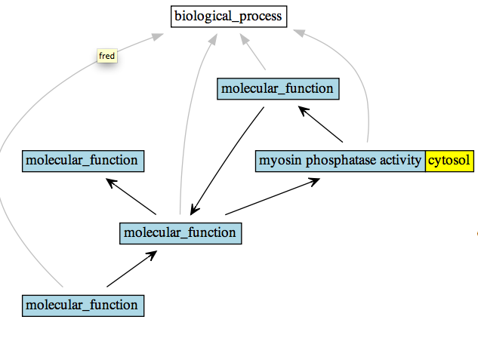
http://www.reactome.org/PathwayBrowser/#FOCUS_PATHWAY_ID=397014&ID=390522
FAIL!

Slide 58
Generating complex annotations from GAFs
Start with a BP in a species
Exclude grouping classes
Make use of axioms in ontology to decompose process into its necessary parts
E.g. every ‘iron assimilation by reduction and transport’ has_part some ‘iron ion transmembrane transport’
Take gene products for that BP
Rank most likely MF
Connect up to BP instances

Slide 59
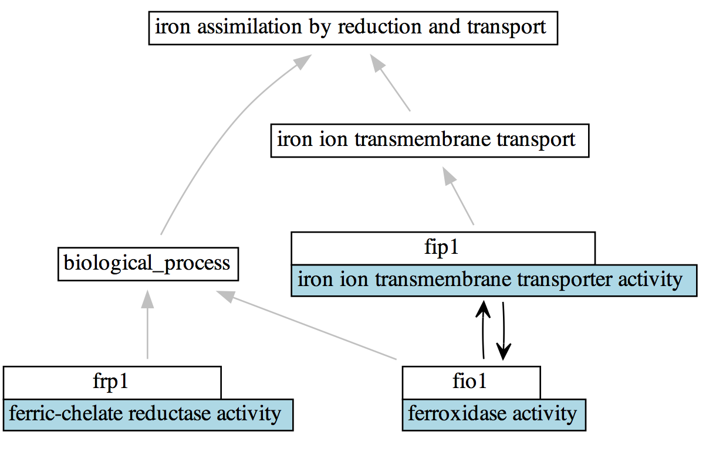

Slide 60
Has_part

Slide 61
Gene products involved
in process

Slide 62
Most likely functions to
be be part of process

Slide 63
Use annotation extensions
- include: translation of PPI
database (biogrid) to GAF

Slide 65
How does all this help biologists interpret their experimental data?

Slide 66
Next steps
MAGO-WG
Content meetings

Slide 68
Common Annotation Tool and LEGO

Slide 69
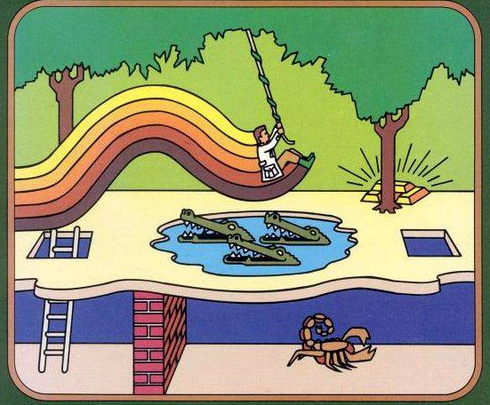
How do we get there?

Slide 70
Basic idea
Format should allow exchange of basic annotations
GAF 1
GAF 2 / GPAD
Extensible to complex annotations
Aka ‘LEGO’

