Slide 1
Migration of GO to GitHub
GO has migrated all trackers from SourceForge to GitHub
  No one should ever need visit SF again
GO has also migrated a lot of content to GitHub
  All Software (except protein2go), important project metadata
  But NOT GAFs or ontologies
New projects are using GitHub effectively
  E.g. synapse
We will be migrating more content to GitHub in the future
What is GitHub anyway?

Slide 2
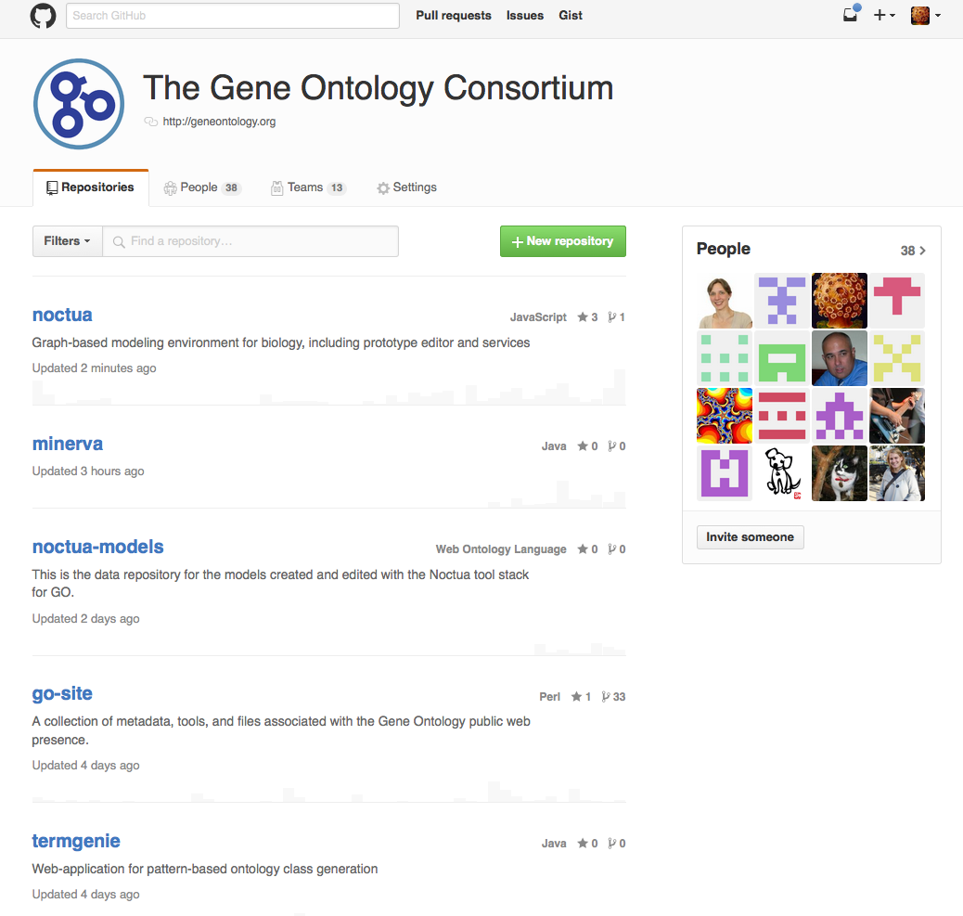
http://github.com/
geneontology

Slide 3
GitHub organization
repo1
repo2
repoN…
Files
Files
Files
Issues
Issues
Issues
wiki
wiki
wiki

Slide 4
http://github.com/geneontology
go-ontology
go-annotation
Other…
Files
Files
Files
Issues
Issues
Issues
wiki
wiki
wiki

Slide 5
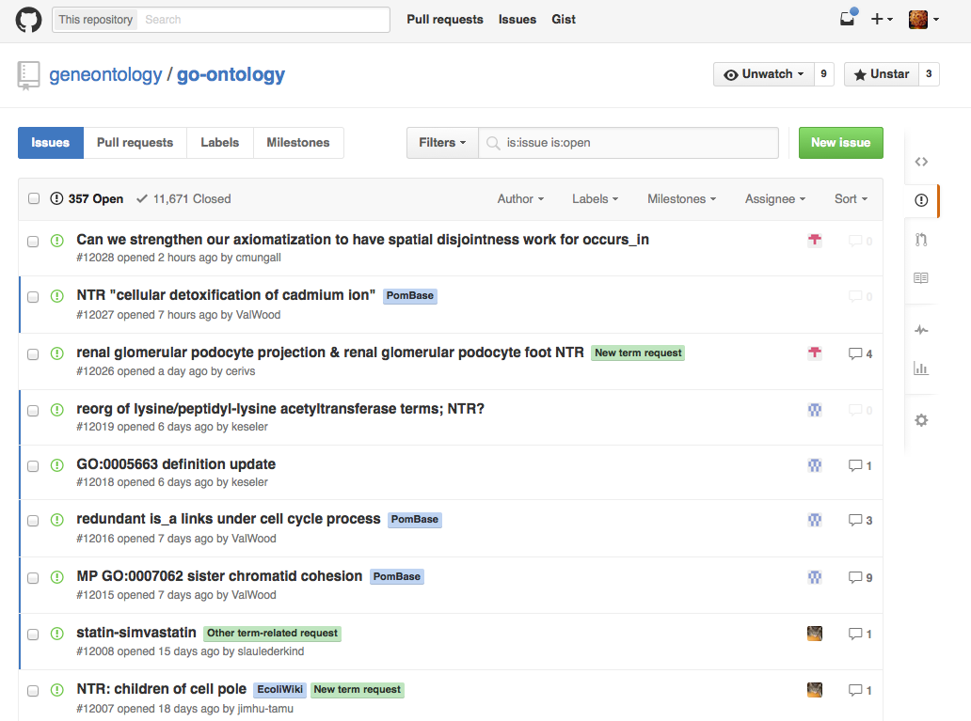
https://github.com/geneontology/go-ontology/issues

Slide 6
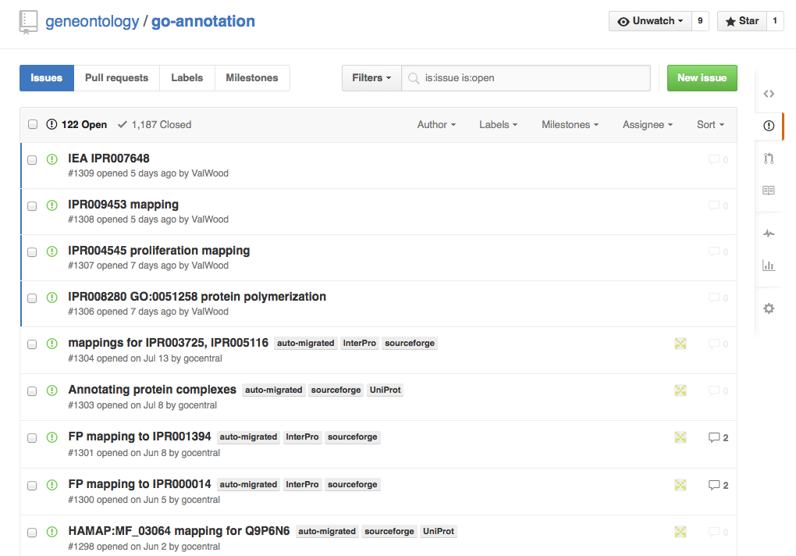

Slide 7
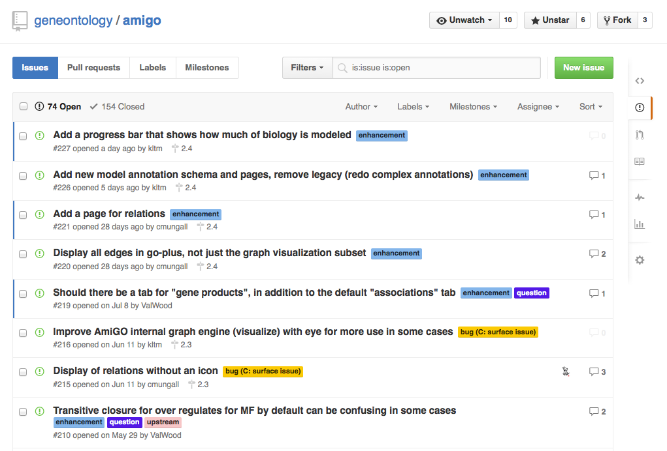

Slide 8
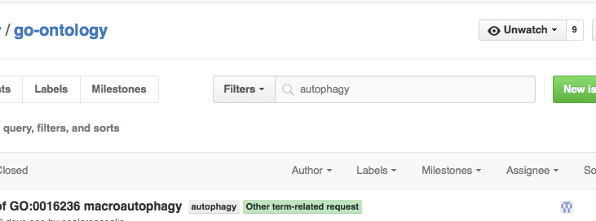
Issues can be searched

Slide 9
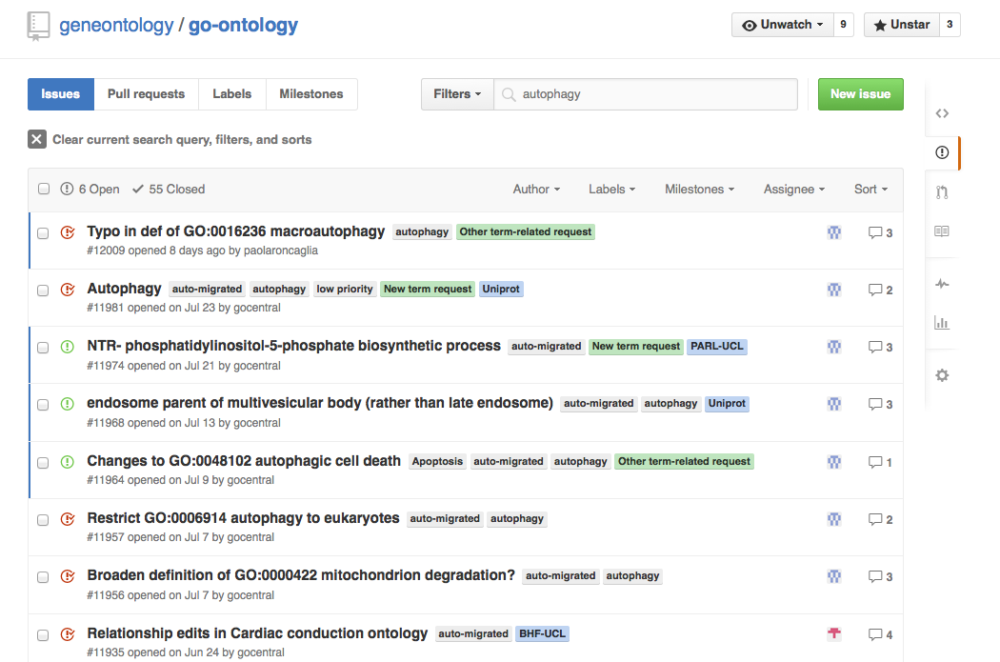

Slide 10
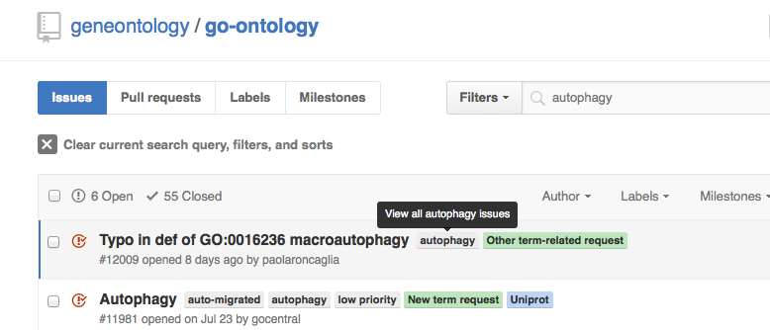

Slide 11
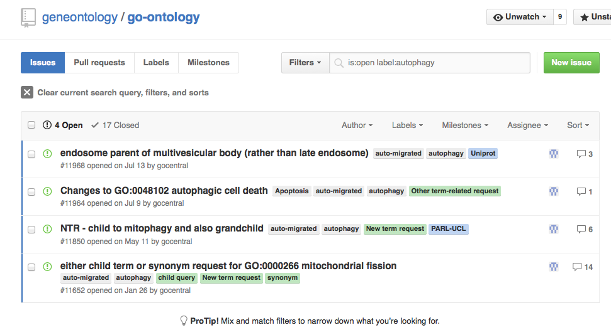
https://github.com/geneontology/go-ontology/labels/autophagy

Slide 12
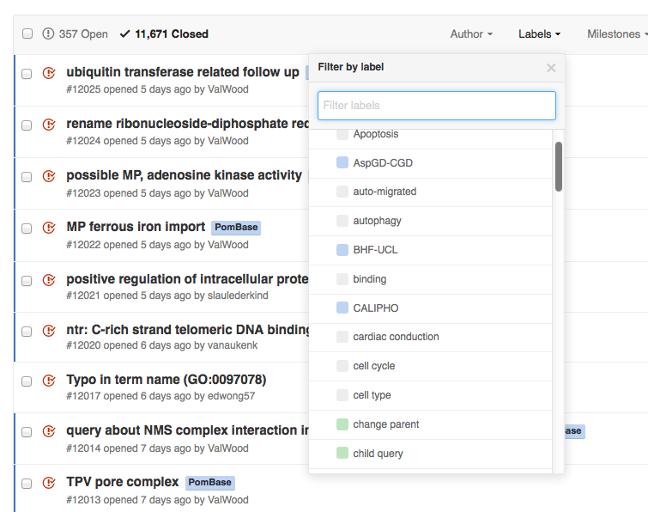

Slide 13
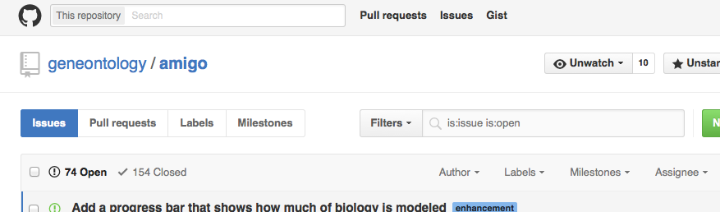
Notifications (per repo)

Slide 14
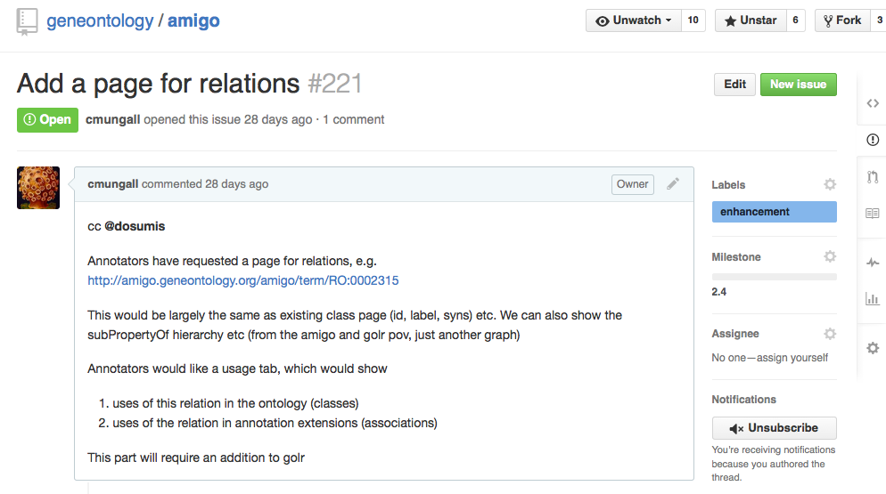
Notifications (per issue)

Slide 15
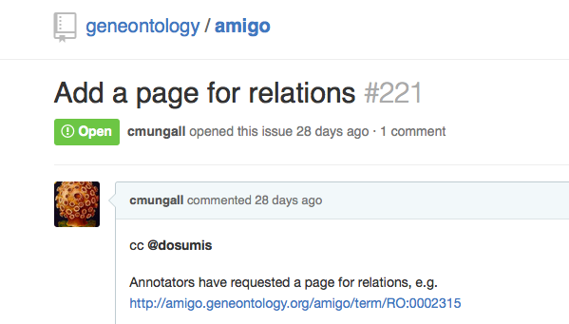
@mentioning

Slide 16
#referencing
Any ticket can be referenced by typing ‘#NUMBER’
  A bidirectional link is made
Tickets in other repositories can also be referenced using the full URL

Slide 17
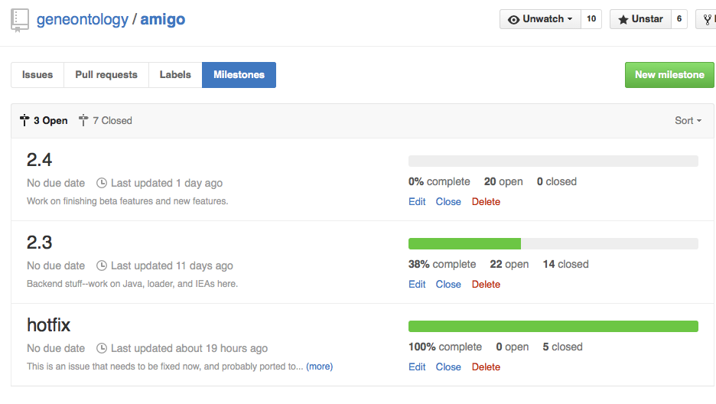
Milestones (per repo only)

Slide 18
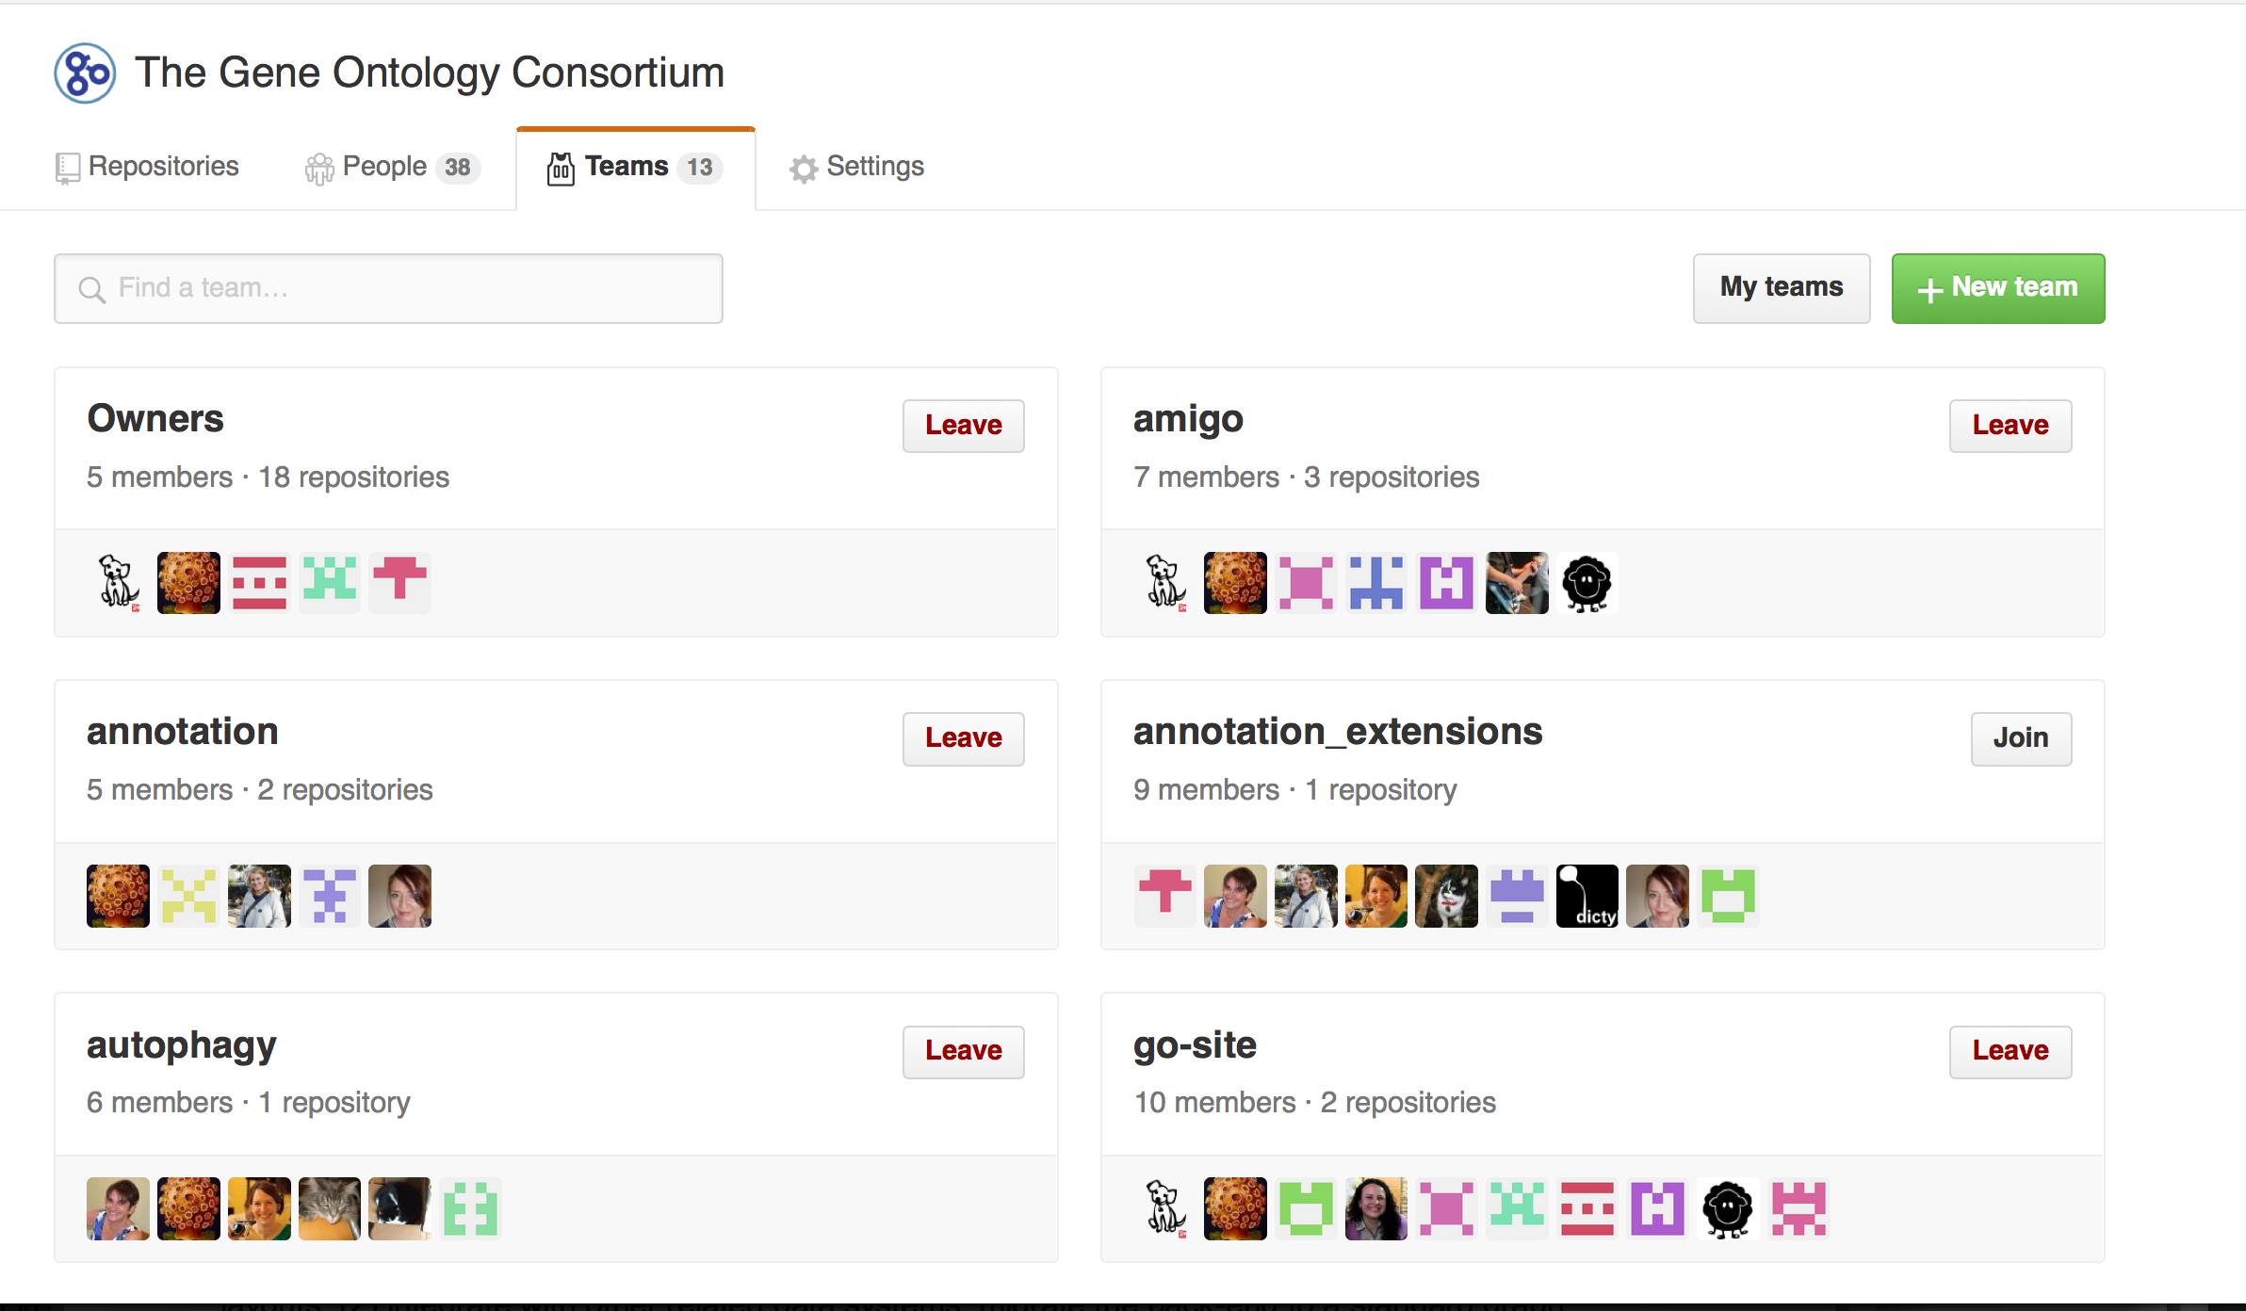
Teams

Slide 20
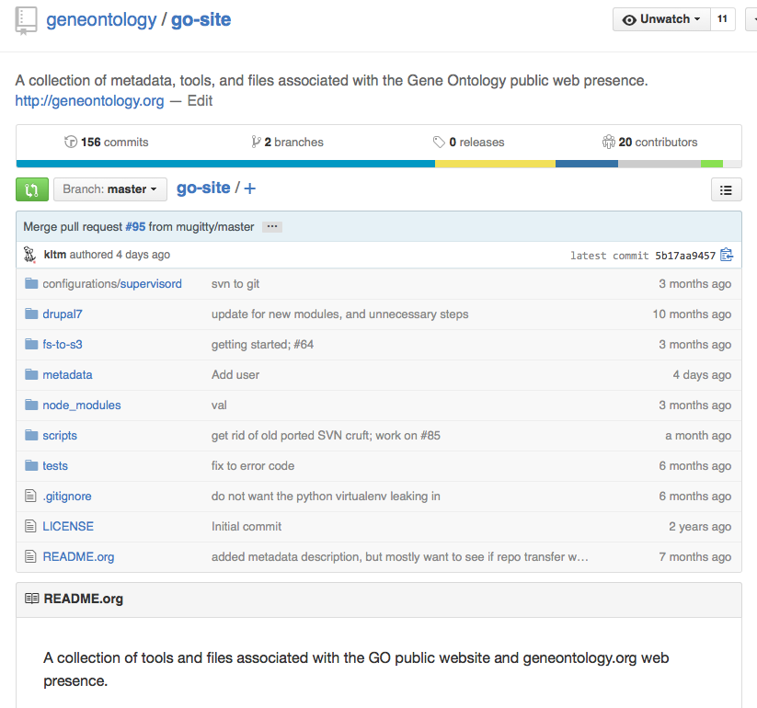

Slide 21
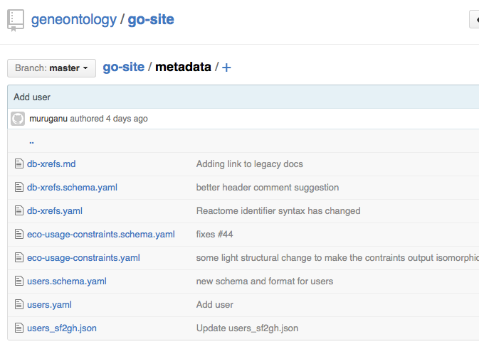

Slide 22
Database Prefixes used in GO
Replaces GO.xrf_abbs

Slide 23
Computable constraints
on ECO classes

Slide 24
Y’all

Slide 25
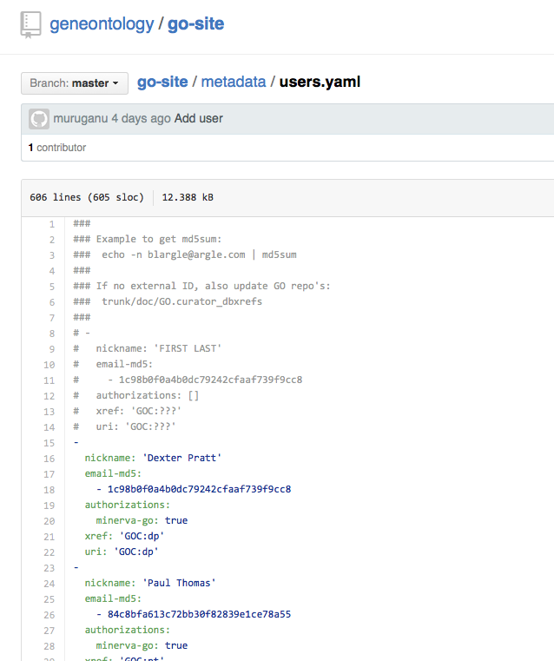

Slide 26
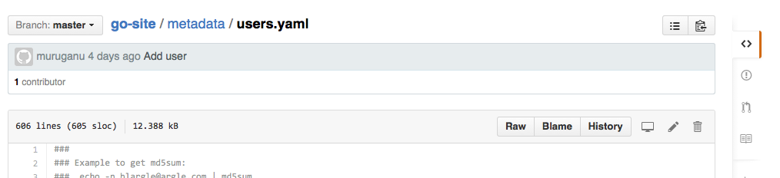
Authorized users commit to master;
Unauthorized users must make a Pull Request
Edits can be made online

Slide 27
Modifications to files in GitHub
Ways to edit or modify files:
  Using web browser
  Command line
    Similar to SVN (remember to push)
  Using a graphical client
    If you must, I recommend Sourcetree
Do I need to edit any of these files?
  Most GOC users: isolated edits to metadata and content files
  Ontology, software, content developers: yes!

Slide 28
Where do all the files live?
We are in the progress of migrating from SVN to GitHub
  Advantages in consolidation
  Files should be colocated with issue tracker
Status:
  LEGO annotations:
    On GitHub
  Metadata files:
    Most have moved (still to move GO_REFs)
  Planned:
    “Mikes scripts”
    Ontology
    Gene-associations
https://docs.google.com/document/d/1iyVY8kDBJIEydoWFLG9j5BoO4VmdIXES95fVhIkFXfk/edit#

Slide 30
Changes in GO Software and Data Architecture

Slide 31
History
V1 Architecture
  ‘Classic’ GO datamodel
  MySQL and Perl-based (AmiGO 1)
  OBO Files, OBO-Edit API
V2 Architecture
  Expressive enough for extensions, LEGO
  Golr (GO Solr) replaces MySQL (AmiGO 2)
  OWL stack for ontology-related operations
Problem:
  We have previously had both internal and external dependencies on V1 Architecture
  Supporting both consumes resources

Slide 32
V1 Phaseout
PAINT has switched from MySQL->Golr
  Last remaining internal dependency
What about external dependencies?
  Many GO answers e.g. on BioStars use MySQL
  Also convenient for some ad-hoc user queries
Plan:
  Reduce frequency of builds (2x a year)
  Provide alternative means for users to access GO data
  Ultimately phase out

Slide 33
Programmatic access to GO data
Services
Use Case
Golr
http
Faceted search using
Ontologies, ‘flat’ queries
Apache/Solr
Graph search and queries, esp. LEGO ; e.g. Return all MAP kinase subgraphs that regulate cell proliferation
SciGraph
http
Neo4J
k1
k2
k3
js
kinase
kinase
kinase
Files
python
GO
APIs
Arbitrary scriptable queries
Go.owl
Lego
Models.owl
(including translated GAFs)
java

Slide 34
GO Pipeline
Moving entirely to Jenkins
Move experimental GAF inference pipeline to production (Heiko)

Slide 36
Wikipedia/Wikidata

Slide 37
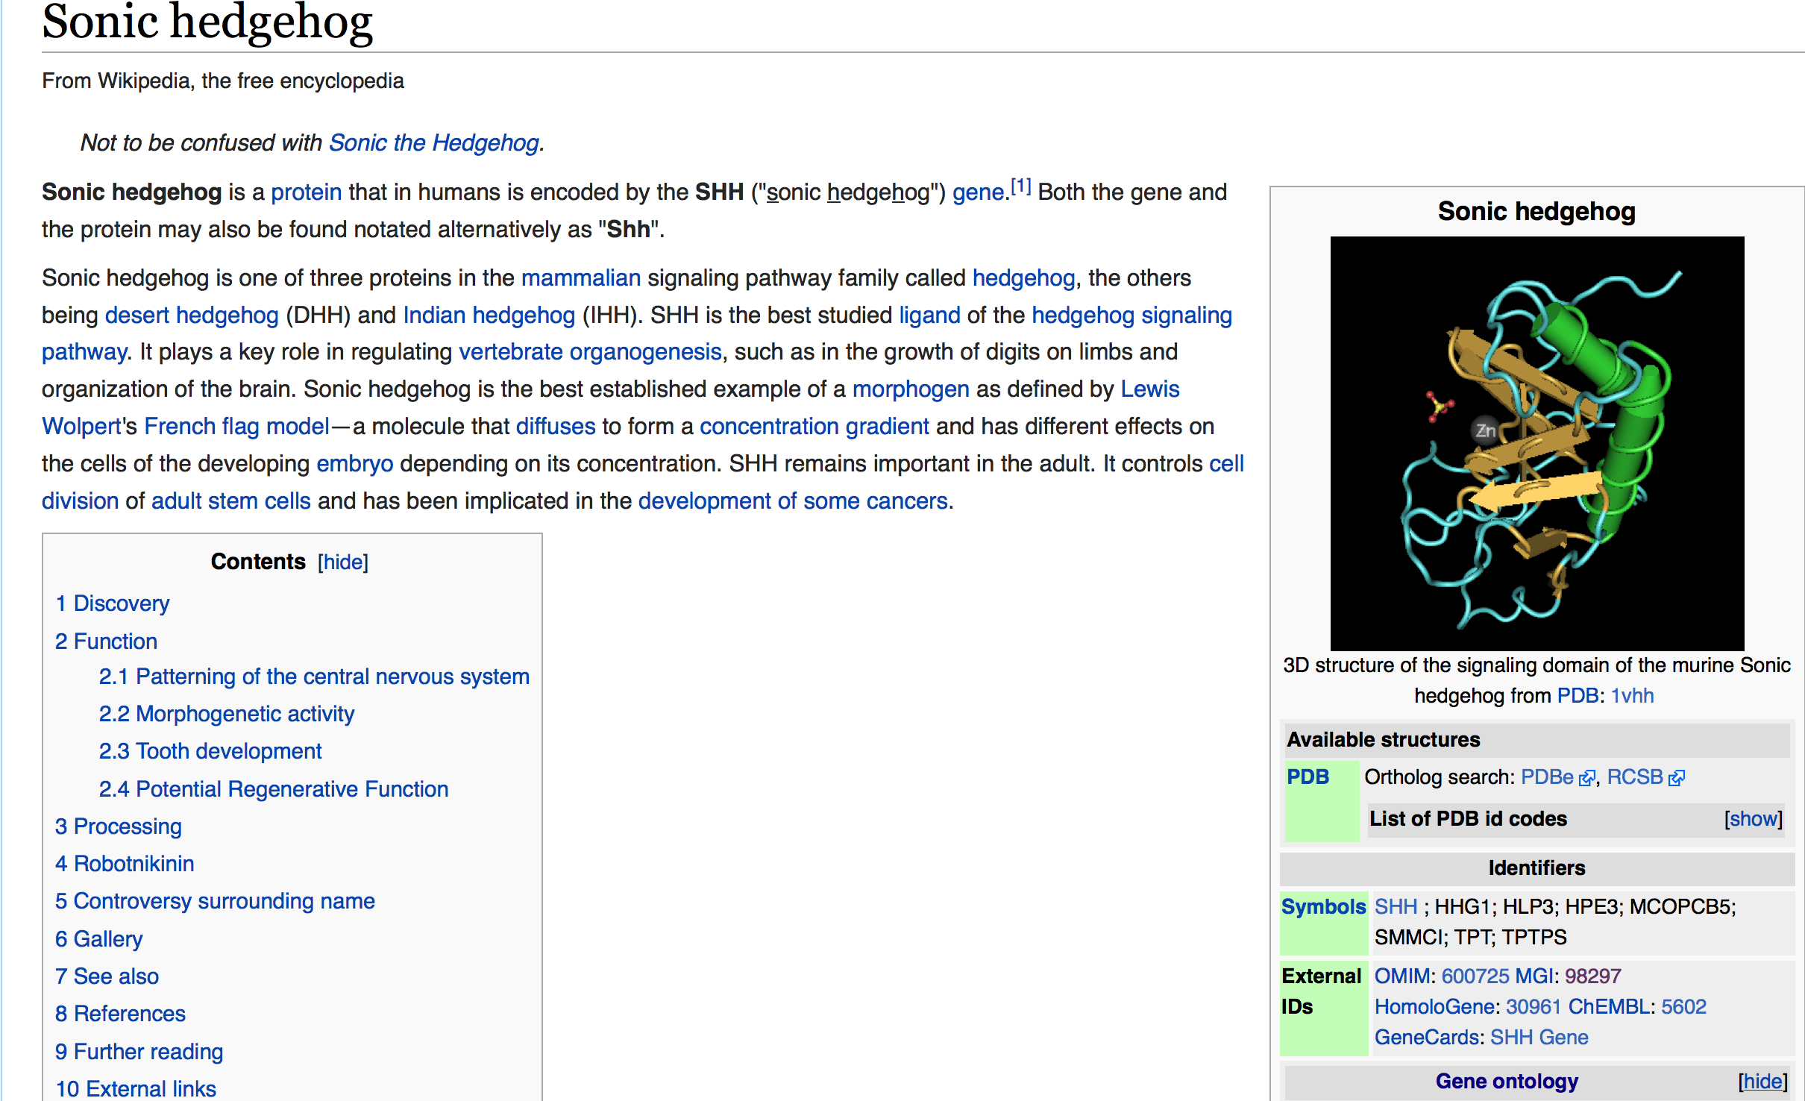

Slide 38
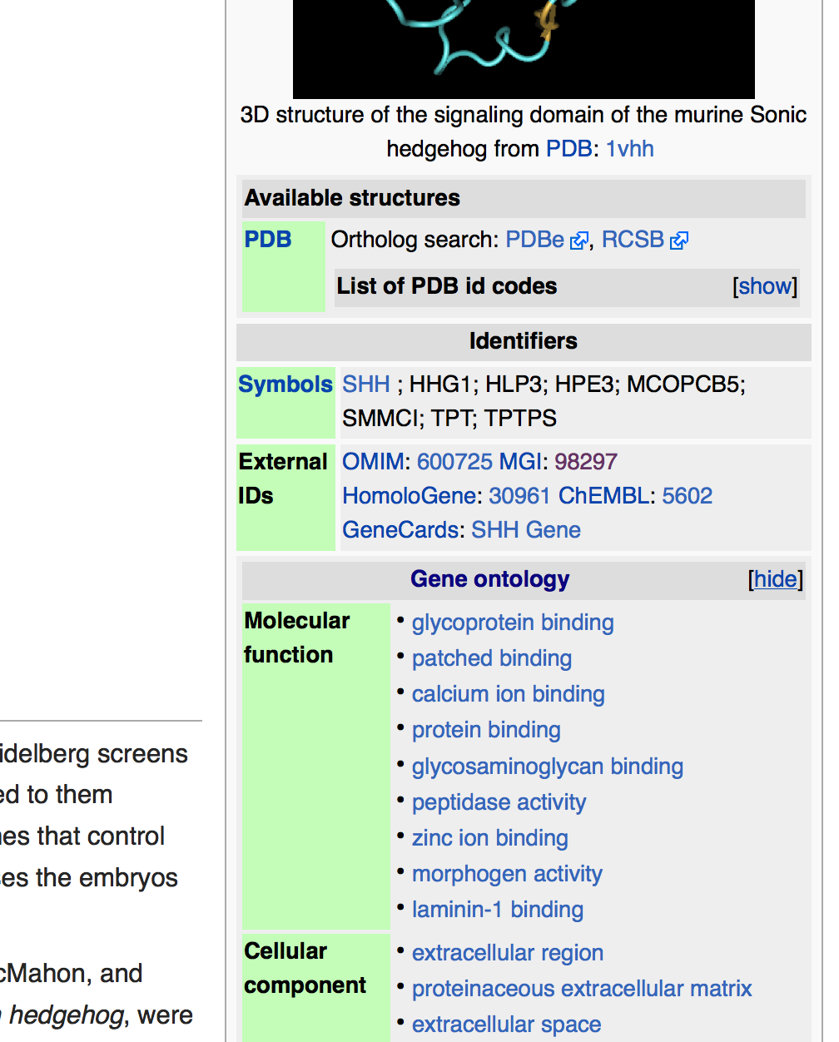

Slide 39
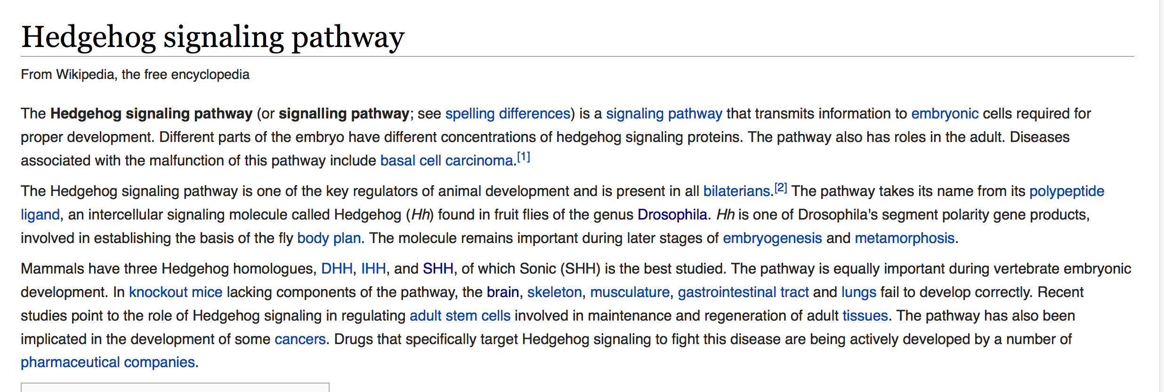
‘term’ pages lack infoboxes
We’re missing a trick here: should be linking to GO and even pulling information from GO

Slide 40
Goal: Add GO infoboxes for process, functions and components
How?
  Plugging in to an exciting new development in the wikipedia community: WikiData
WikiData:
  Giant ‘triplestore’ of every fact in the world
    ‘Smoothened signaling pathway’ is-a pathway
    ‘Shh’ involved-in ‘Smoothened signaling pathway’
  WD will ‘feed’ Wikipedia pages
Collaboration
  DavidOS, Melanie, Chris + Su group (Ben Good)
Status
  Initial Alignment
  Working with them to improve wikidata loaders
  Current work is very disease ontology centric

Slide 41
Noctua 2015 report

Slide 42
Technical Overview
Noctua is a collaborative interface for graphical editing of ‘LEGO models’
  A model is any collection of LEGO units, typically connected
  Units are like integrated GO annotations
Communicates with a server (Minerva)
  Models are stored as files on GitHub
The LEGO formalism is a superset of GAF/GPAD
  Anything that can be authored using existing annotation tools can be authored using Noctua
  A lot more can be said in a LEGO model
  More can be said with less in a LEGO model

Slide 43
New Features in 2015
Seeding from existing annotations
  Whole process
  By function
Evidence model supported
Undo/redo
live sync view
ubiquitous editing
Command line interface
Phenotype editing
form-based interface
select boxes -> autocomplete
saveable layouts
Cytoview
Search and visualization in AmiGO
Models saved on GitHub
all-individual modeling and graph folding
automatic annotations
Model states (unsaved, deprecated, etc.)
labeling and imports improvements
legacy exports
3rd-party ID resolution (GOlr)
final IDs (x2)
LEGO -> GAF
+ lots more ‘under-the-hood’
Notes:
Chris,
Just looking through the tracker and some notes, we've had a busy year.
Heiko, you'll probably want to add more detail to this as I only went
through the noctua tracker.
There is some overlap, but here's some highlights:
- noctua-ui
- undo/redo
- live sync view
- new evidence model (x2)
- ubiquitous editing
- graph folding
- CLI interface
- prototype form-based interface
- select boxes -> autocomplete
- savable layouts
- seeding
- toys: cytoview and companion
- TONS OF OTHER IMPROVEMENTS AND FIXES
- minerva-dev
- all-individual modeling
- new evidence model (x2)
- automatic annotations
- states and conditions for models (unsaved, deprecated, etc.)
- labeling and imports improvements
- legacy exports
- 3rd-party ID resolution (GOlr)
- models on GitHub
- final IDs (x2)
- seeding
- LEGO -> GAF
- TONS OF OTHER IMPROVEMENTS AND FIXES
- noctua-dev/barista
- gulp and node workflow
- new connection manager
- modular libraries
- library push
- workbench plugins
- more powerful graph system (folding, absorbing, unfolding, etc.)
- multiple service endpoints (support separated seeding path)
- TONS OF OTHER IMPROVEMENTS AND FIXES

Slide 44
Demo
Creating a model
Importing and seeing models
Searching for models
Export of models (OWL, GPAD, GAF)
Not just GO: phenotype annotation
Later:
  Walkthrough focusing on the biology (Rama, Kimberley, David)

Slide 45
FAQ

Slide 46
FAQ: How are models stored?
Answer
  All models are stored natively as OWL files
  These are all stored in a GitHub repository
    https://github.com/geneontology/noctua-models
  The Noctua backend (Minerva) takes care of synchronization
Ongoing
  Investigate options for storing 100k+ models
  E.g. Neo4j

Slide 47
FAQ: My database only imports GAF. What do we do?
Answer
  Any model can be exported as GPAD->GAF
  We have implemented a Jenkins pipeline to export the entire model database to GPAD->GAF
    http://build.berkeleybop.org/job/export-lego-to-legacy/
Notes
  Exporting a model to GPAD or GAF is lossy
  MODs wanting to show complete LEGO model should use AmiGO components rather than reinvent
TODO
  Fully integrate this pipeline into the GOC workflow
  Make species-specific files, as for PAINT

Slide 48
FAQ: Most tools (e.g enrichment) only support GAF
Answer
  These tools will continue to work (see previous answer)
    Can consume all LEGO annotations, albeit in lossy form
Also:
    We will help develop and catalyze a new generation of tools
    We are developing application libraries that developers can use for computing with LEGO models
      Javascript
      Java
      Python3

Slide 49

LEGO Models
https://github.com/geneontology/noctua-models
LEGO-aware tools, databases and user interfaces (e.g. AmiGO)
uses
export-lego-to-legacy/
(LOSSY translation)
GAF/GPAD
Current/Legacy Tools and Databases
uses

Slide 50
FAQ: How does this relate to c16? Are the same relations used?
Answer:
  Anything that can be said in GAF/GPAD+c16 can be authored using Noctua
  Curators will be able to say more, and more with less
  Using relations will be much simpler
  Your curated information in c16 is used when
    Importing annotations into Noctua
    Seeding Noctua models for a BP

Slide 51
LEGO Relations
P
Molecular
(complex,
Gene product,
RNA, …)
Activity
Occurs in
Cell Component, Cell (CL) or Anatomical Entity (Uberon, PO)
Enabled by
Any causal
relation
Activity
Biological
Process
P

Slide 52
Guide to LEGO for c16 users
Links to exemplar LEGO models on c16 documentation
Will soon be visible when seeding annotations from GAFs:
  https://github.com/geneontology/minerva/issues/23

Slide 53
FAQ: What ontologies can I use for describing context?
Core types: GO MF
  Part_of GO BP
    Part_of NBO (for behavior?)
  Occurs_in GO CC
    Part_of {CL,PO}
      Part_of {Uberon-composite-metazoan, FAO, PO}
  Substrates: CHEBI
Evidence: ECO
Phenotypes: Long answer…
TBD: Assays, Environmental conditions

Slide 54
FAQ: Can I annotate objects of type X (RNA, complex)
Yes! All we require:
  A representation of the relevant part of the X database translated to OWL
Caveats:
  Must be ontologically coherent
  We must vet this for inclusion in the GO central instance of Noctua

Slide 55
FAQ: How do I learn?
Walkthrough in this meeting
Training material
Jamboree/Bootcamp

Slide 56
Plan
2015 Q4
  Add to the beta testers team
  Develop quality documentation
2015-01
  Open up to GOC
  Bootcamp/Jamboree
2015-04
  Scale up

