Slide 1
TermGenie – Granting Biocurators’ Wishes for the GeneOntology
BioCurator Meeting 2013 Heiko Dietze – Lightning Talk

Slide 2







The Problem
One bottleneck for biocuration: Creation of new ontology classes/terms
Creating a new class: not trivial
Class does not already exist
Relations, Structure of the ontology
Metadata: Definitions, references, synonyms
Ontology
New Class?
OntologyEditors

Slide 3
The Solution
TermGenie: Website, Templates, Reasoning
Automate creation of new ontology classes
Simplify maintenance of the ontology
Immediate creation of a valid identifier
Review: accept, modify, or obsolete
E-mail notifications
Integration in biocuration tools
Allow immediate use of newly created classes
EBI: Protein2GO

Slide 4
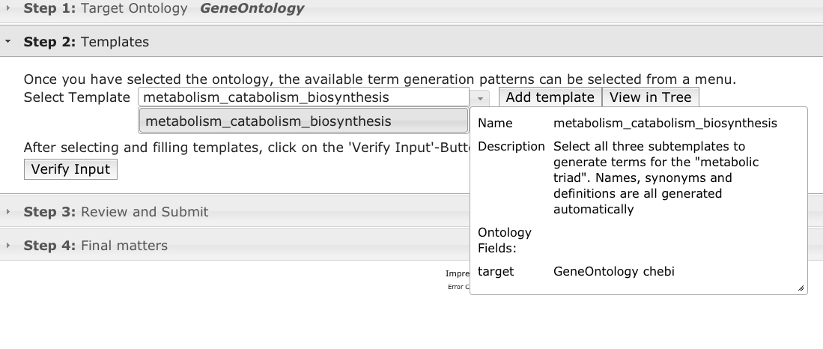
A Quick Walkthrough
Camptothecin metabolism, catabolism, and biosynthesis
Go to the website, select the template:
Notes:
Slide for short TermGenie demonstration: 1. Select template

Slide 5
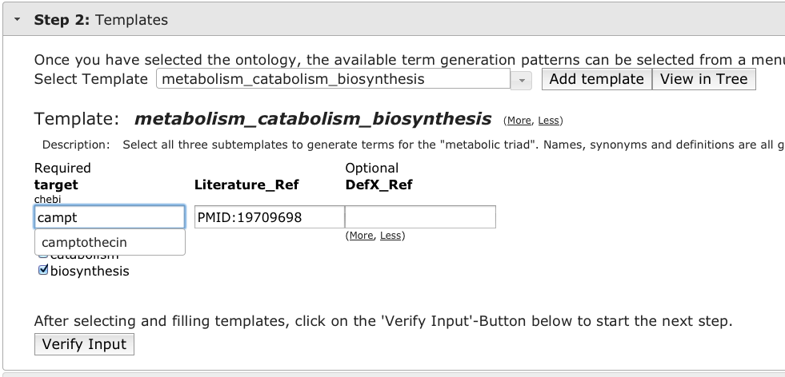
Forms & Autocomplete
Notes:
Slide for short TermGenie demonstration: 2. Fill form, auto-completion

Slide 6
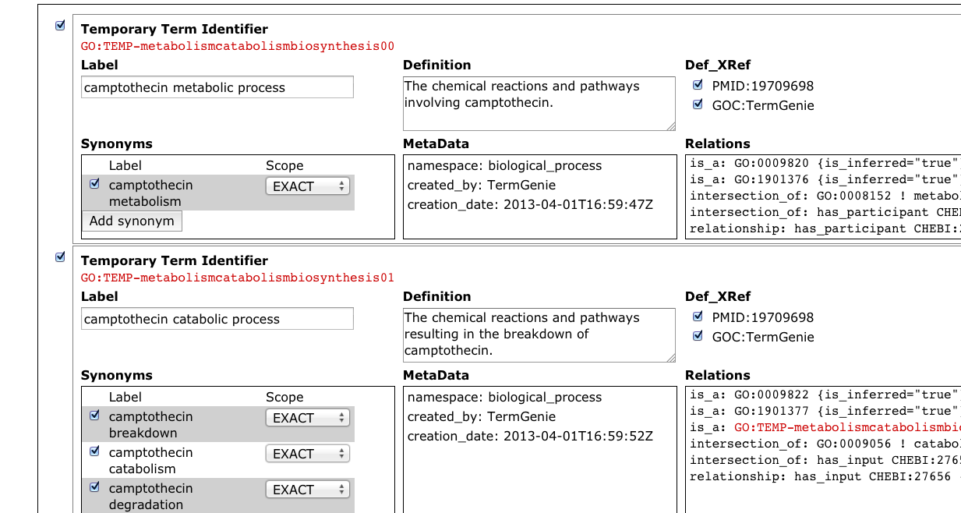
Review & Submit
Notes:
Slide for short TermGenie demonstration: 3. Review & Submit

Slide 7
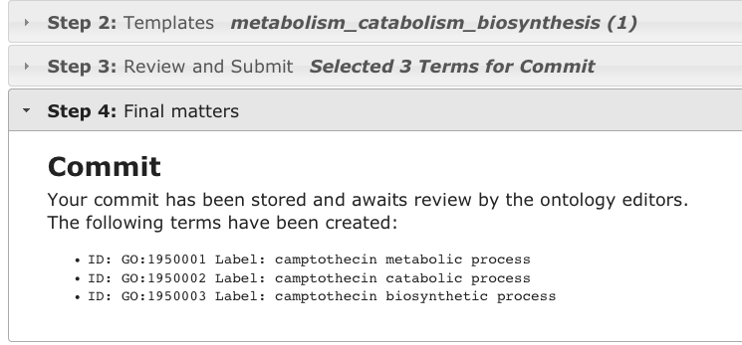
Valid Identifiers
New Identifers
Notes:
Slide for short TermGenie demonstration: 4. New Term

Slide 8
TermGenie
Template-based approach
Many term request follow known templates
genus + differentia
metabolism + camptothecin
➔Logic definition in OWL
metabolism and has_participant some camptothecin
Generate labels, definitions, metadata
Separation of roles
Ontology editors + OWL experts: Create templates in conjunction
Templates can be used many times by annotators

Slide 9
TermGenie - Reasoning
Use reasoner for:
Check for existing terms
Infer new and updated relations
Check for constraint violations (unsatisfiability)
OWL Reasoner: ELK Reasoner Kazakov et al.
metabolic process
GO:0008152
redundant
External: ChEBI
alkaloid
metabolic process
GO:0009820
has_participant
alkaloid
CHEBI:22315
GO:0008152 and has_participant
some CHEBI:22315
quinoline alkaloid
CHEBI:26509
inferred
camptothecin
metabolism
has_participant
camptothecin
CHEBI:27656
GO:0008152 and has_participant
some CHEBI:27656
Notes:
Yevgeny Kazakov, Markus Krötzsch, František Simančík. ELK Reasoner: Architecture and Evaluation. In Ian Horrocks, Mikalai Yatskevich, Ernesto Jimenez-Ruiz, eds.: Proceedings of the 1st International Workshop on OWL Reasoner Evaluation (ORE-2012). CEUR Workshop Proceedings 2012.

Slide 10
TermGenie for the GeneOntology
> 3200 new GO classes in 2 years
About 50% of term requests follow templates
At least 3 years of ontology work: Logic definitions
TermGenie server with 19 templates
10 Templates with external ontology ChEBI (Chemical Entities of Biological Interest)
Reduce turn-around time
NEW: TG free form template
Validation, Reasoning
Web form, Auto-completion
Review pipeline

Slide 11
Thank you
GeneOntology: go.termgenie.org
Open Source: termgenie.org
Gene Ontology Consortium
Chris Mungall
Suzi Lewis
Seth Carbon
Tony Sawford
Tanya Berardini
Rebecca Fougler
David Hill
Jane Lomax
Paola Roncaglia

