Slide 1

Noctua Development 2015
Noctua: Express yourself. Clearly.
Notes:
Asetofrecommendationstoaididentification,development,maintenance,andadoptionof language standards for environmental health data to enable data access, usability, and integration across diverse environmental and biomedical research programs.

Slide 2
Highlights (post-College Station)
Improved landing page
Viewing and search of models in AmiGO labs
CalTech meeting (BBOP+WormBase devs)
Defined protocol for Capella integration
Current Status:
Noctua UI: alpha
LEGO store: reaching beta
Notes:
No one can define these terms adequately – they indicate tribes as much as distinct methodologies.
“The goal of this meeting is to establish a collaborative and cross-disciplinary group to inform the development of environmental health science language standards and applications that will aid data sharing, integration and analysis, and ultimately advance discovery in environmental health research. “

Slide 3
Progress May-Oct 2014
Landing Page
Exports (gpad,gaf,owl)
Imports (owl)
Simplified model creation
Authorization and authentication
Login
Auto-tracking of edits
Federation
Reasoning
Inferred types
Logical validation
AmiGO Integration
Model Metadata
Direct Editing
Model labels
Behind the scenes
Editor refactor
Barista
Refactoring of libraries and protocol
Backend
Jenkins Integration
Refactoring
Protein fixes
AWS Storage of models

Slide 4
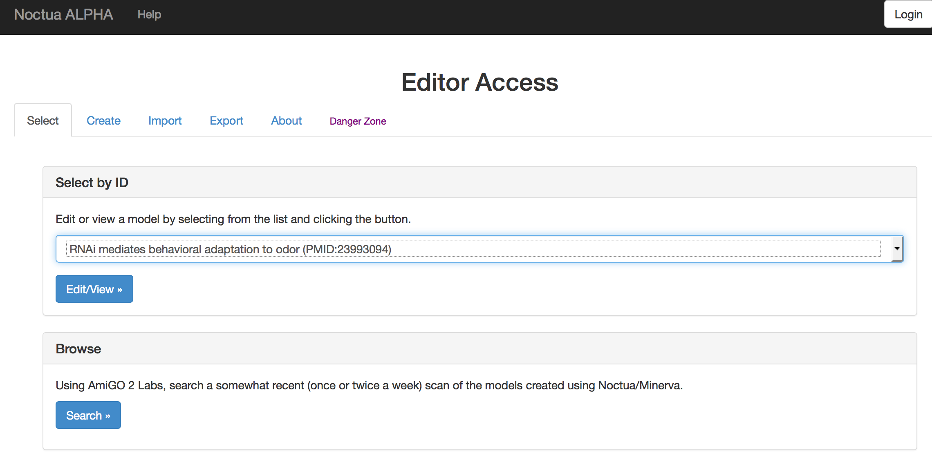
New Landing Page

Slide 5
New Landing Page

Slide 6
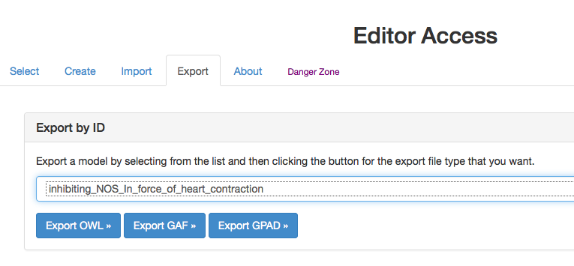
Export to GAF and GPAD

Slide 7
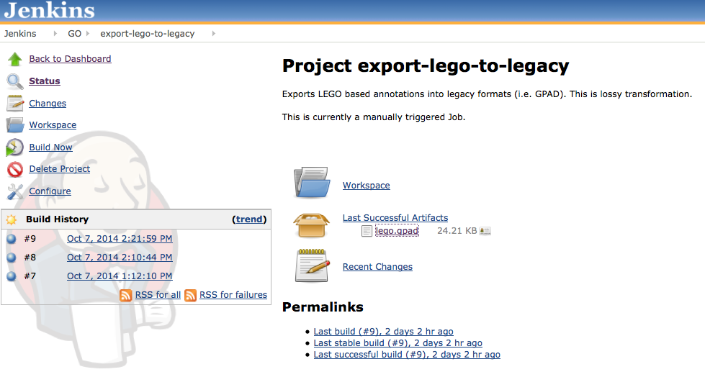
Export to GAF and GPAD
* http://build.berkeleybop.org/job/export-lego-to-legacy/

Slide 8
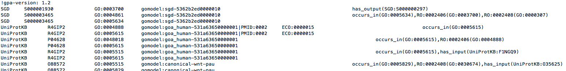
Export to GAF and GPAD
* http://build.berkeleybop.org/job/export-lego-to-legacy/

Slide 9
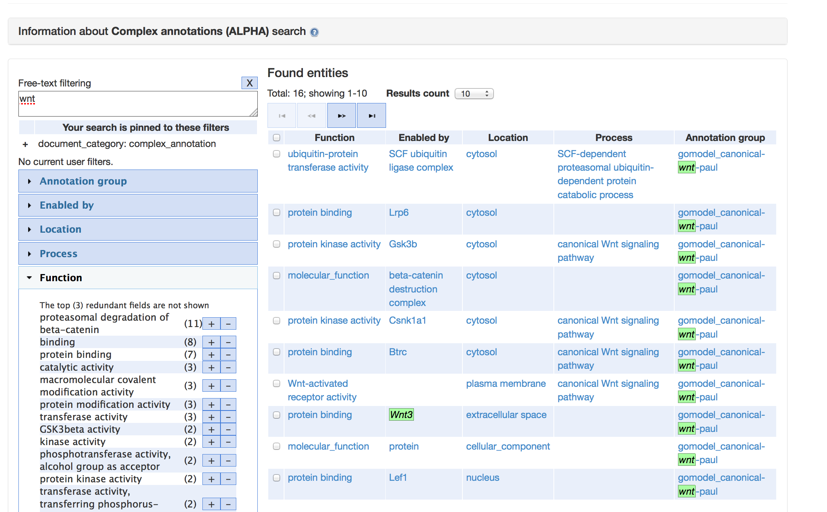

Slide 10
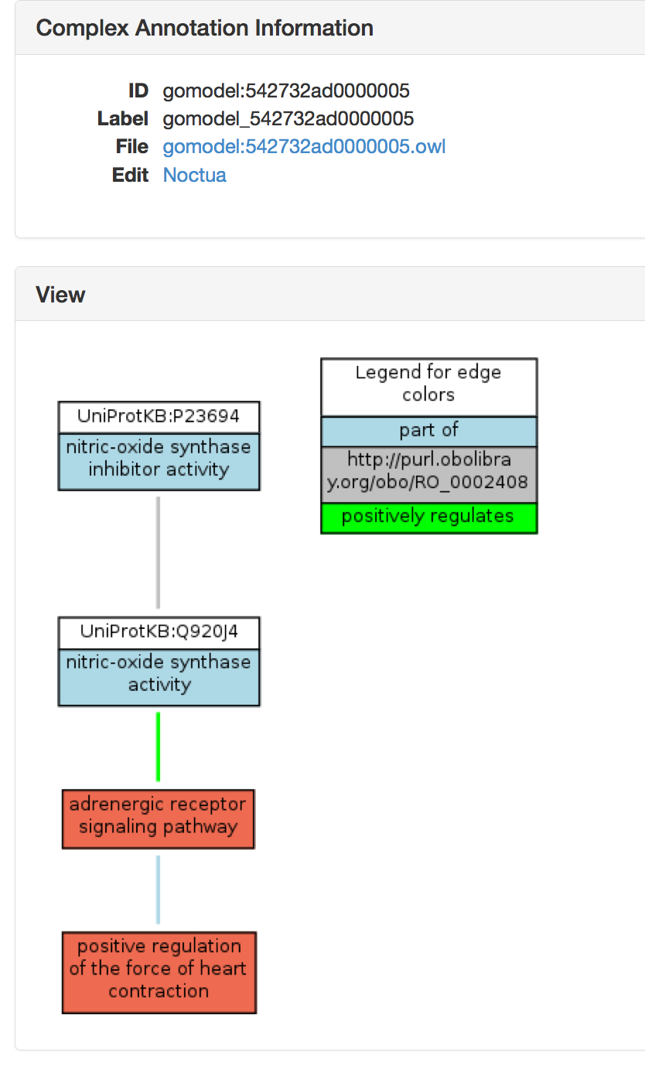

Slide 11
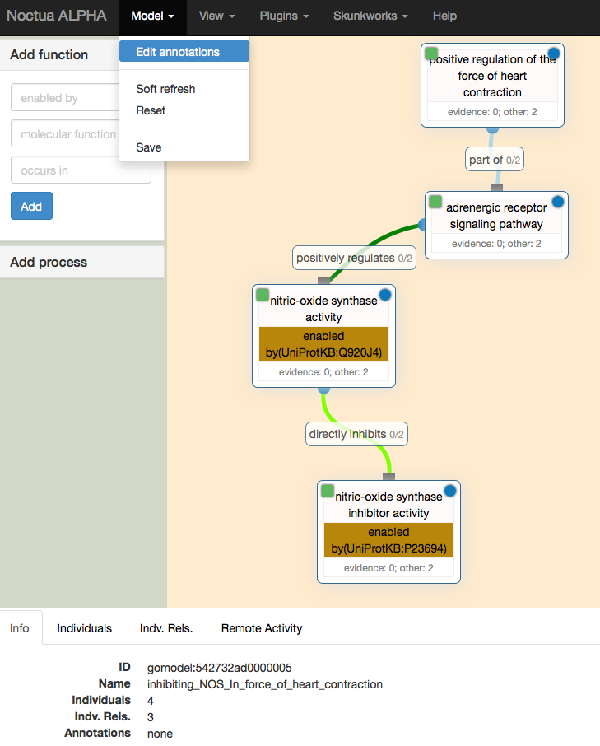

Slide 12
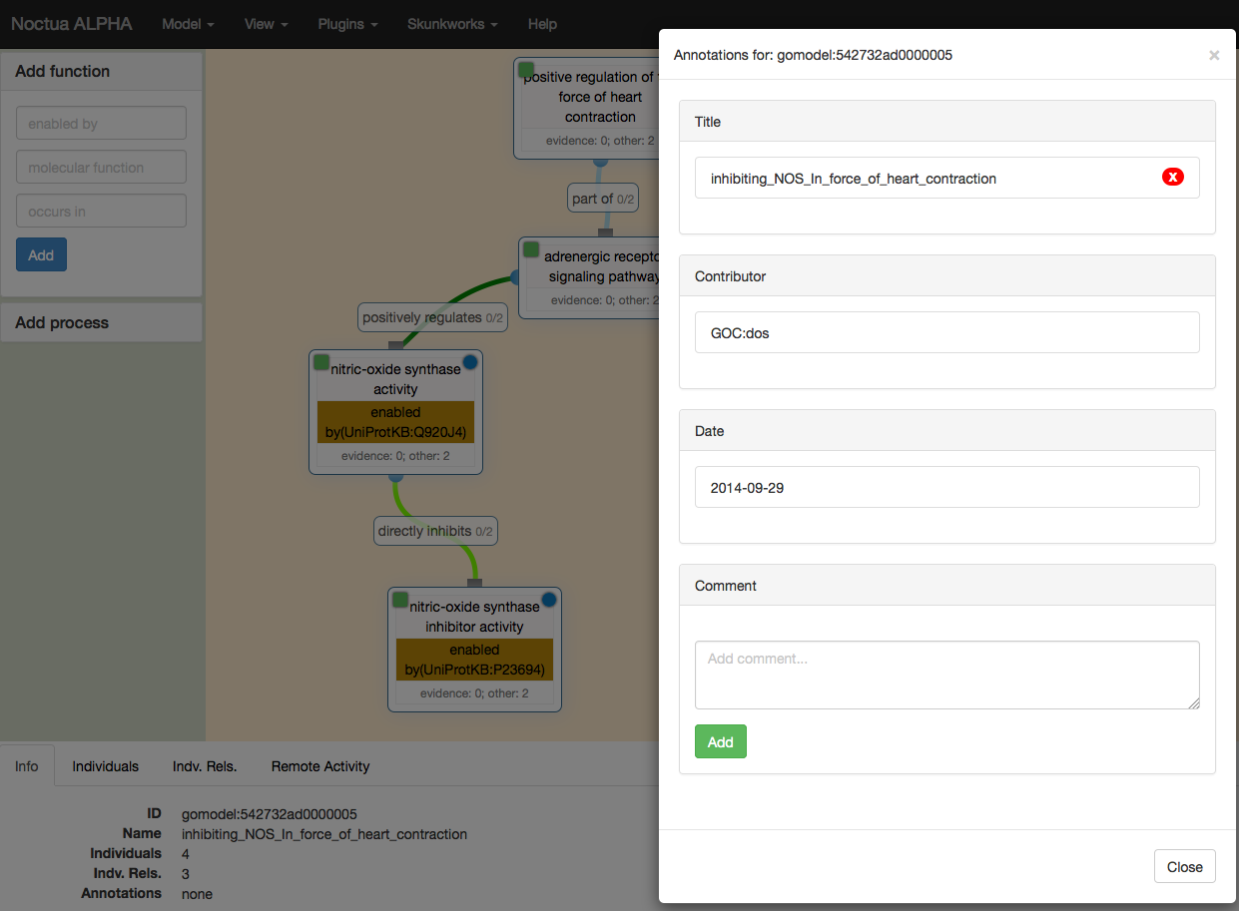

Slide 13
Plan for 2015
Goal
By end of 2015, any curator should be able to use Noctua for annotating any combination of GO and Phenotype
Anticipated Hurdles
Still in development
Noctua currently caters to the advanced user
Lacking ease-of-use features
Proposed Approach
Noctua alpha-tester-team will use Noctua for real curation throughout 2015
Results will be persisted in LEGO database
Lossy translation to GAF/GPAD for incorporating into other databases
Notes:
No one can define these terms adequately – they indicate tribes as much as distinct methodologies.
“The goal of this meeting is to establish a collaborative and cross-disciplinary group to inform the development of environmental health science language standards and applications that will aid data sharing, integration and analysis, and ultimately advance discovery in environmental health research. “

Slide 14
Proposed approach
Top-down
Integrated into ontology development workflow
Bottom-up
Integrated into curation workflow
Triage
Does the paper describe interacting gene products?
If so then curate in Noctua
‘paired programming’ approach

Slide 15
Proposed approach

Slide 16
2015 Timeline
Q1
Evidence model fully supported
Alpha team start work in earnest
Capella integration
Q2
Spreadsheet editor view
Phenotypes
Reactome import
Q3
Feature freeze: User feedback, testing, bug squashing
Q4
Beta release
2016 Q1 full release
https://github.com/kltm/go-mme/milestones
Notes:
GO:0048665 neuron fate specification FoldBasedPredictor GO:0001708 cell fate specification has_participant EMAP:1282 results_in_specification_of CL:0000101 sensory neuron IMP

