Slide 1
ClinVar: Using Centralized Databases to Interpret Sequence Variants
Donna Maglott, Ph.D.
Senior Staff Scientist
maglott@ncbi.nlm.nih.gov
www.ncbi.nlm.nih.gov./clinvar
Notes:
Presentation to demonstrate how centralizing information in ClinVar benefits the medical and research communities

Slide 2
Benefits of centralizing information
facilitates access
fewer databases to check
integration with other domains of content
stabilizes maintenance
supports standardization of content
enables time-specific snapshots
supports improvement in interpretation
Notes:
To centralize or not to centralize, that is the question.
Explicit centralization provides many benefits, especially when the result of that integration is archived to be accessible in the future.

Slide 3
ClinVar integrates four major domains of information
Variation
Phenotype
Interpretation
Evidence
Notes:
ClinVar integrates information across 4 major domains:
Variation (referencing dbSNP and dbVar)
Phenotype (referencing MedGen, OMIM, HPO, Orphanet)
Interpretation (functional consequences and clinical significance from submitters, molecular consequences calculated from NCBI’s annotation of the genome)
Evidence (supporting observations and studies; methods (including those registered in GTR), publications)

Slide 4
Domains in ClinVar related to other NCBI databases
Variation
Phenotype
Interpretation
Evidence
dbSNP
dbVar
MedGen
(HPO, OMIM)
Gene/GTR
Defines an accession from submitters
ACMG
PubMed
Sequence Ontology
GTR
Standardize, integrate with other internal and external resources
Notes:
These domains of information are integrated with other databases within NCBI. Some connections are provided via linking; some are provided by extracting data from source databases, and re-displaying, as GTR re-displays gene-specific content from NCBI’s Gene database and condition-specific data from MedGen. Also, tests registered in GTR can be cited as the method for data capture in ClinVar.

Slide 5
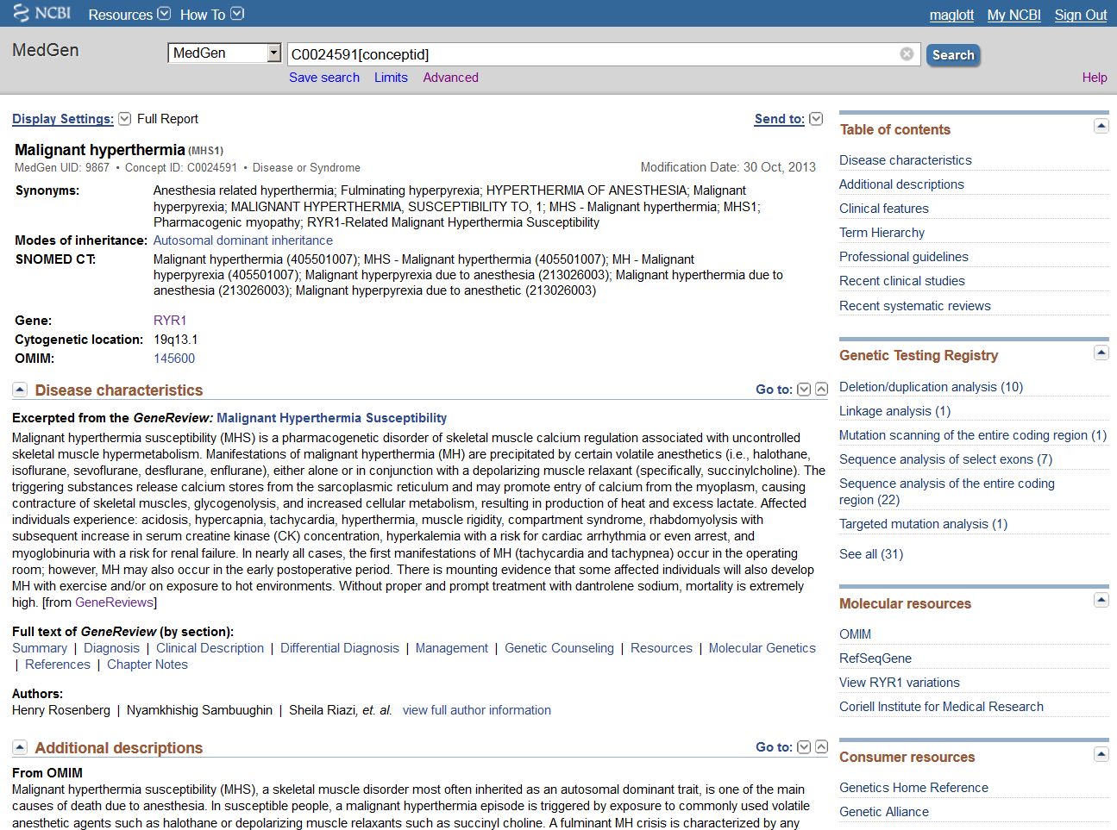
MedGen: organizes information about concepts related to medical genetics
Concepts and terms from
UMLS (Unified Medical Language System)
ClinVar
HPO: Human Phenotype Ontology
Genetic Testing Registry
GeneReviews
http://www.ncbi.nlm.nih.gov/medgen/
Notes:
Follow the link to MedGen to review data specific to a condition or a finding/clinical feature. Note from the Table of Contents that there is a section on professional guidelines.

Slide 6
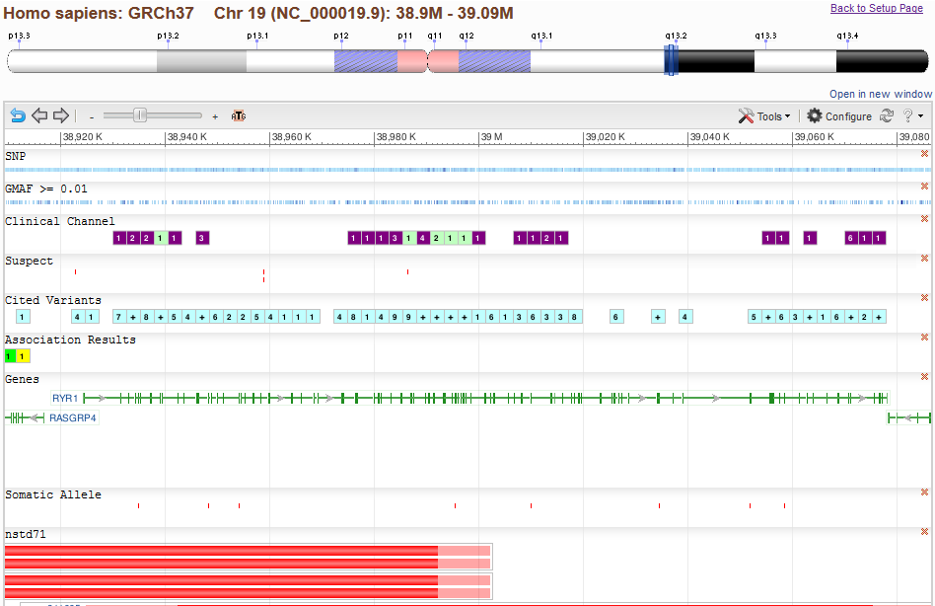
Many many types of variation-specific data: RYR1
Structural variants
Notes:
A screen shot (partial data) to show the complexities of variation data that are available, and the benefits to layering ClinVar over the calculations about Variation that NCBI already provides.
Report of the chromosome as an NCBI reference sequence and version (NC_000019.9)
Marker on the ideogram to show where on chromosome 19 according to ISCN band names
Display of structural variation by study (nsdd71)
SNP: Graph of short nucleotide variation from dbSNP
GMAF >= 0.01: The second most frequent allele at the location has a frequency > 0.01. Identifies regions where sequence variation may be tolerated, because it is relatively frequent.
Clinical channel: Subset about which some clinical information is known. Soon to be labeled ClinVar
Cited variants: Subset known to be cited specifically in PubMed
Association Results: data from GWAS studies
Somatic Allele: somatic variations reported at the indicated location

Slide 7
ClinGen: Making sense of all the data
http://www.nih.gov/news/health/sep2013/nhgri-25.htm
Notes:
What is currently understood about interpretation of variation
New NIH-funded resource focuses on use of genomic variants in medical care
http://www.nih.gov/news/health/sep2013/nhgri-25.htm

Slide 8
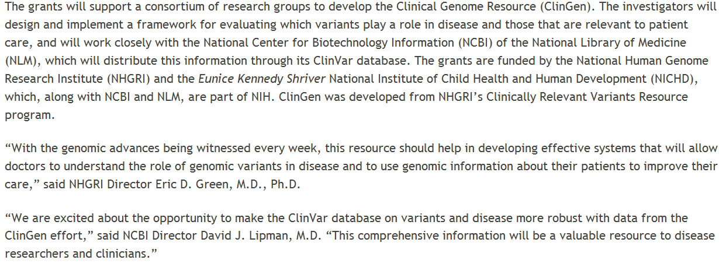
ClinGen and ClinVar
Notes:
ClinVar and assessment of medically relevant variation
NHGRI and NICHD are now supporting developing the resources to improve assessment and interpretation of variation that may be medically important.

Slide 9
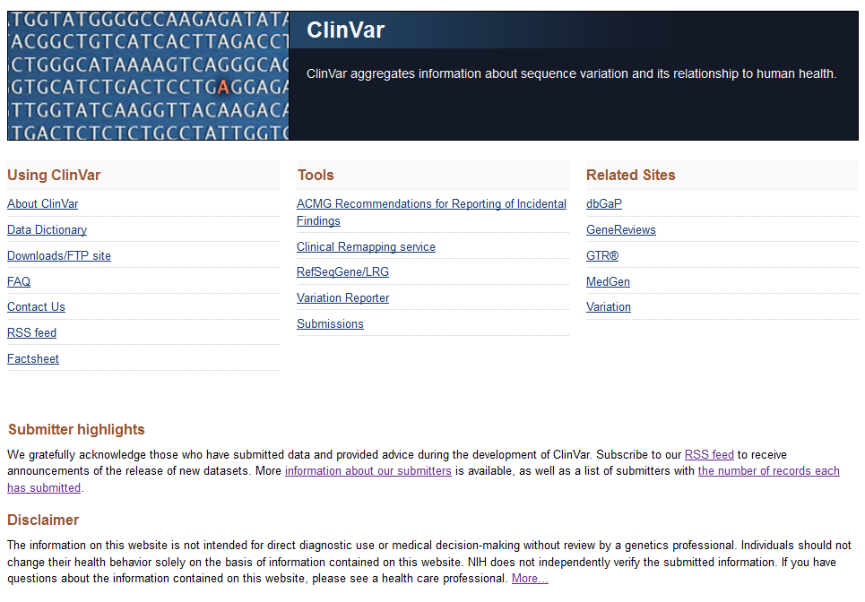
What is ClinVar?
http://www.ncbi.nlm.nih.gov/clinvar/
Notes:
ClinVar in one respect is a web site. The home page provides many useful links, including how to obtain data that are freely available for download. Tools are provided to make it easier to find the data (ACMG recommendations table) use the data, or to compare your data to what is in ClinVar (Variation reporter).

Slide 10
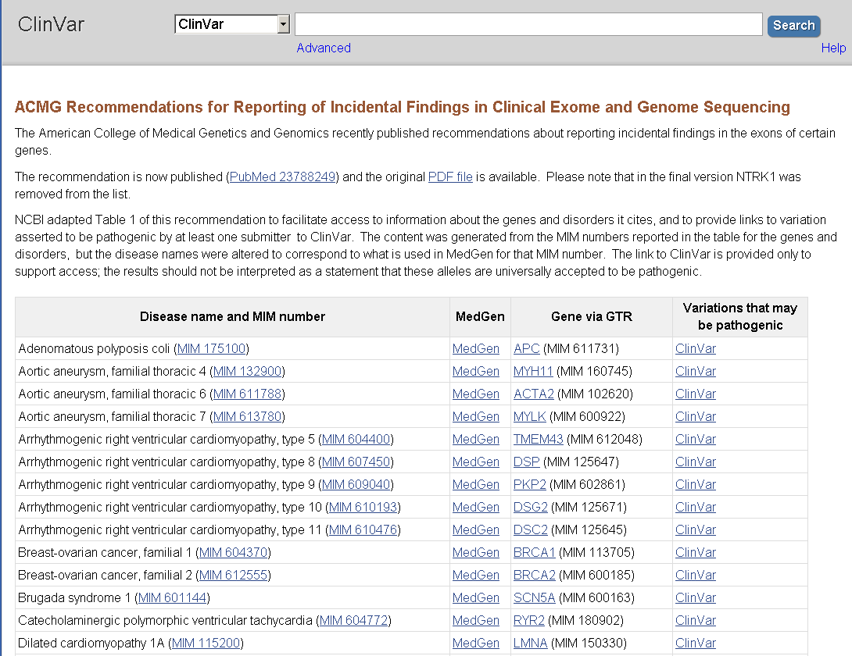
Notes:
One tool ClinVar provides is the listing of Gene in the ACMG guidelines, with links to OMIM, MedGen, Gene, and ClinVar.

Slide 11
ClinVar has multiple functions
Standardize representation of alleles, phenotypes, and interpretation
Archive submitted interpretations of variation/phenotype relationships (i.e. keep history and support re-interpretation)
Report whether interpretations are consistent or conflicting interpretations
Disseminate content via web, ftp, or API
Provide attribution to submitters
Notes:
ClinVar is designed to meet many needs.

Slide 12
Standardize data: what is the variation?
607008.0001
985A>G
985A>G (K304E)
985A>G (K329E)
A985G
ACADM, LYS304GLU
K304E
K304E (985 A->G)
K304E (K329E)
K304E only
K329E
K329E(985A>G)
LYS304GLU
Mutation c.985A>G (p.K304E)
c.985A>G
c.985A>G (p.K304E)
c.985A>G (p.Lys304Glu
c985A>G
includes: K304E (985A>G)
p.K304E
p.Lys329Glu
previously known as p.Lys329Glu
Analysis of ACADM 985A>G mutation
NC_000001.10:g.76226846A>GNG_007045.1:g.41804A>G
NM_000016.4:c.985A>G
NP_000007.1:p.Lys329Glu
ACADM:c.985A>G
rs77931234:A>G
LRG accessions reported when public
Soon to include location on GRCh38 as well as GRCh37
Notes:
Data submitted to ClinVar is standardized to support comparison and data integration.

Slide 13
ARCHIVE: accession number/content
Variant only
Allele
Variant +
Phenotype
(Reference ClinVar)
RCV
RCV
Variant+
Phenotype
(Submitted
ClinVar)
SCV
SCV
SCV
SCV
SCV
SCV
Notes:
Each submission assigned an accession starting with the letters SCV
Multiple submissions reporting the same allele and phenotype set aggregated and accessioned with an identifier starting with RCV
All data per allele are extracted for reporting

Slide 14
Novel variations submitted to ClinVar are submitted to dbSNP/dbVar
Submitters
Expert review
ClinVar provides the layer of submitted interpretation not supported by dbSNP/dbVar
ClinVar
Data in ClinVar can be extracted for review, and experts can resubmit their conclusions.
dbSNP
<~50 bp
dbVar
>~50bp
dbGaP
NCBI
Notes:
When data in ClinVar are reviewed by experts, the result of that review can be submitted to ClinVar as a ‘reviewed’ record, giving it higher status.

Slide 15
Levels of Curation: Maintaining quality and supporting multiple uses
Guideline
Practice guidelines
Expert review
Evidence-based review
ClinVar
Multi-Source submission
Inter-laboratory
Single-Source submission
Intra-laboratory
Large variant
datasets
Uncurated
dbSNP/dbVar
Notes:
Another way to consider the levels of review the interpretation of a variant relative to a disorder may have.

Slide 16
Submission, validation, feedback
Submit
XML, spreadsheet, text file
Validate format/required elements
Test load
Validate alleles and phenotype
Review results with submitter
Accession
Return identifiers to submitter - SCV123456789.1
Feedback if new related data are received
Integrate
Identify other submissions with the same assertion
Assign/update RCV123456789.1 accession
Notes:
A major benefit of submission is the standardization and feedback ClinVar provides.

Slide 17
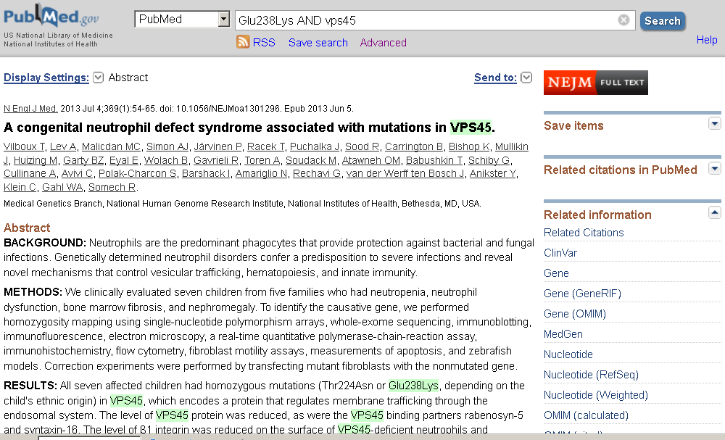
PubMed->ClinVar
Do a query, and follow the links to ClinVar to review current records
Finding records in ClinVar from PubMed
Notes:
Do your query in PubMed, follow link to ClinVar. This will find the variants in ClinVar that are connected to that record in PubMed.

Slide 18
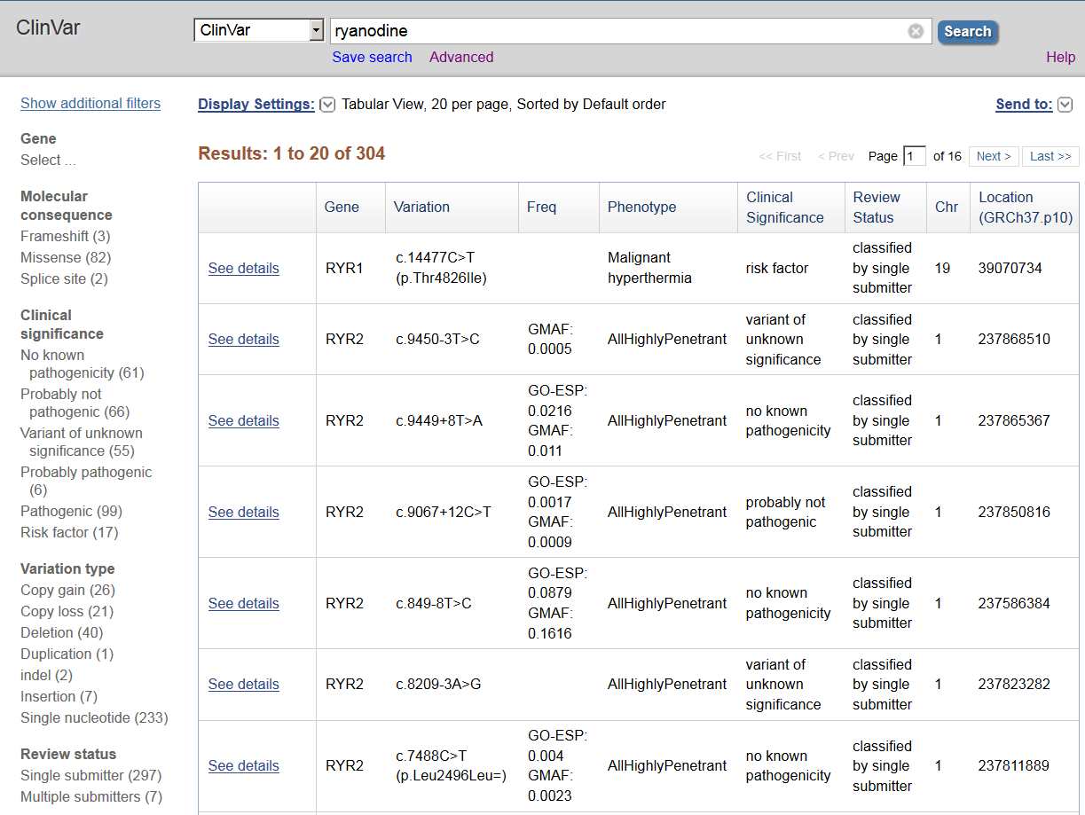
Using ClinVar: query by any word
Notes:
You can query by any text:
HGVS
Phenotype
MIM number
Gene symbol
Chromosome location
Any word
rs#
Submitter name

Slide 19
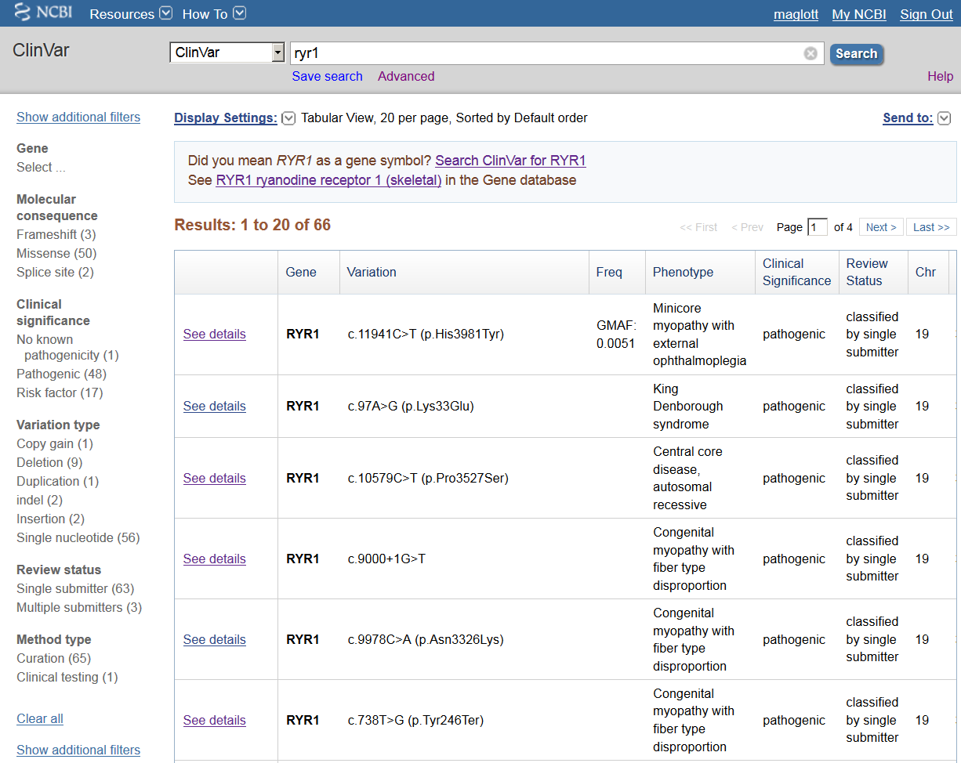
Using ClinVar: query by gene symbol
Notes:
You can query by any text:
HGVS
Phenotype
MIM number
Gene symbol
Chromosome location

Slide 20
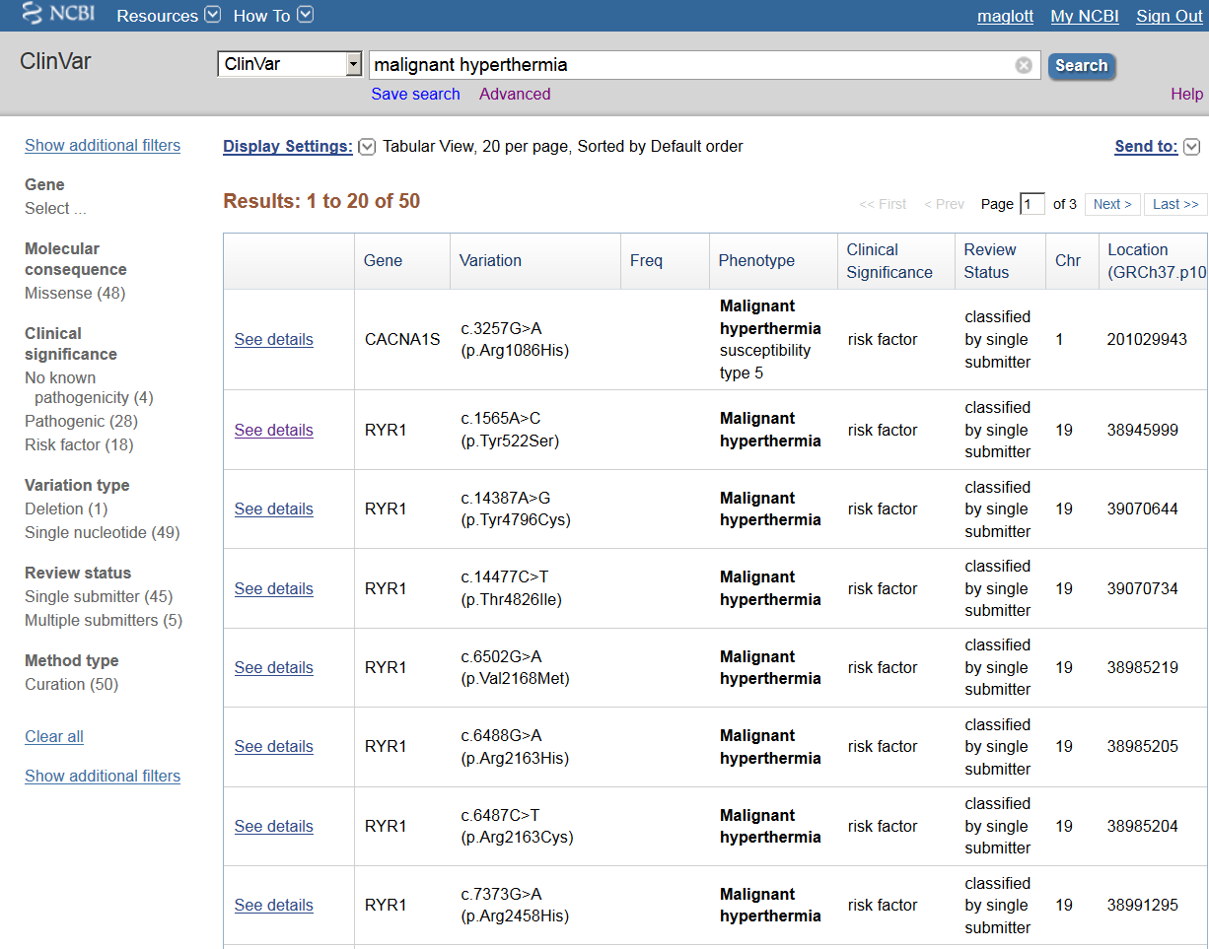
Using ClinVar: query by condition
Notes:
You can query by any text:
HGVS
Phenotype
MIM number
Gene symbol
Chromosome location

Slide 21
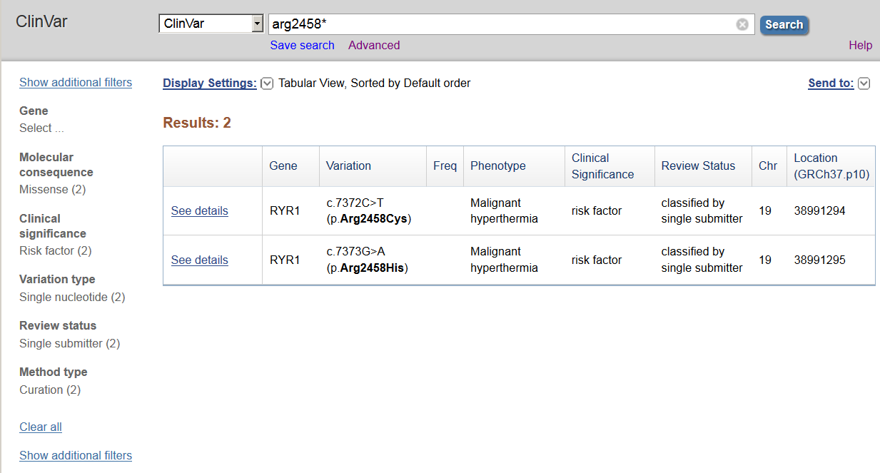
Using ClinVar: use of the wildcard *
Protein change, with wild card
Can query on both 3-letter and 1-letter abbreviations
Notes:
You can query by any text:
HGVS
Phenotype
MIM number
Gene symbol
Chromosome location

Slide 22
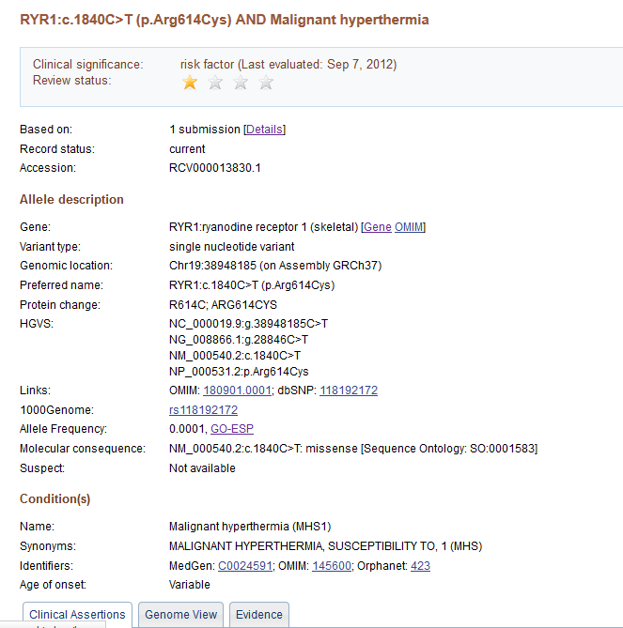
How to interpret what you see
Star rating/ Review status
0 | conflicting data from submitters
1 | classified by single submitter
2 | classified by multiple submitters
3 | reviewed by expert panel
4 | practice guideline
Interpretation
Significance (dated)
Review status *
Accession.version *
Allele summary
Gene
Variant type
Genomic location
HGVS expressions*
Molecular consequence*
Links*
Frequency*
Phenotype summary
Names
Links*
Age of onset *
Prevalence *
* May be provided by NCBI
Notes:
When you display a specific record for an RCV accession, you can see the interpretation, the definition of the allele, the conditions represented in this record. This display has been evolving since ClinVar was first launched; we appreciate the feedback from the The International Collaboration for Clinical Genomics (ICCG) (http://www.iccg.org/) and ClinGen staff.

Slide 23
ClinVar RCV record display
Notes:
The tabs in the section below indicate the sources of the data, the accessions assigned to their submissions, the method of data capture, and links to the literature.

Slide 24
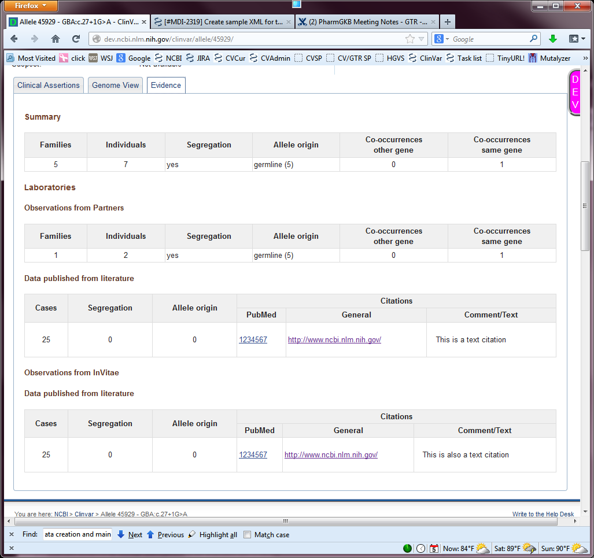
Allele report – available in 2013
Notes:
The allele report will provide an overall summary, plus subsets of data from individual submitters.

Slide 25
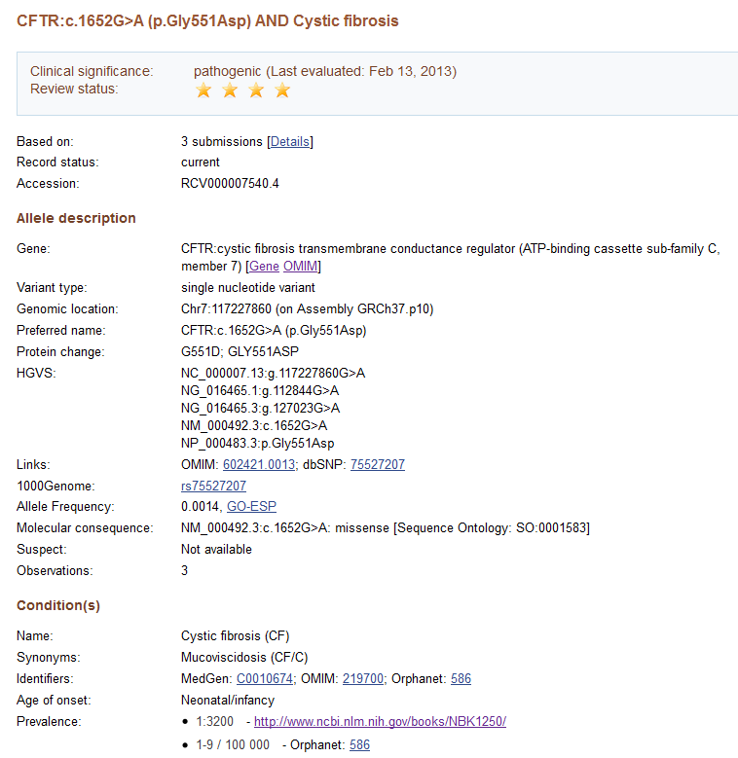
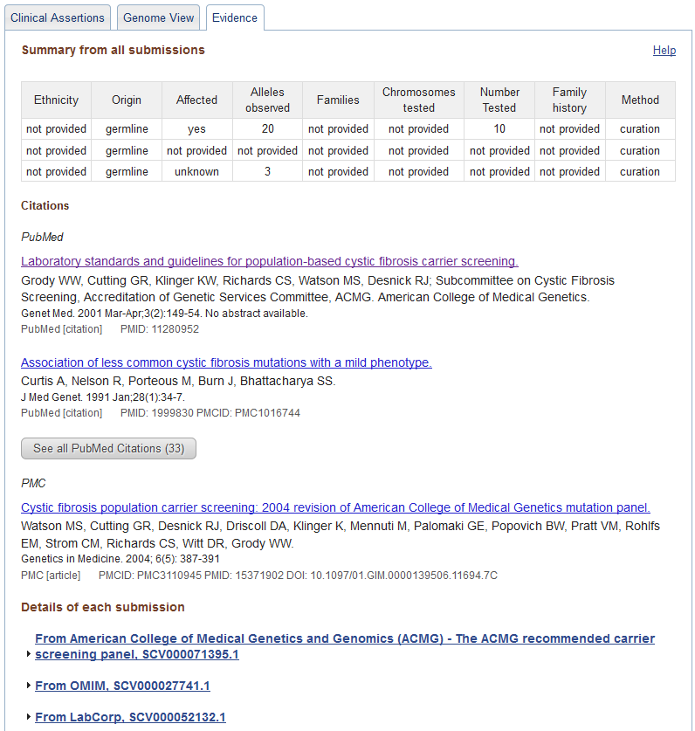
Submitting a reviewed record - CFTR
Notes:
The variations on the ACMG CFTR panel have been submitted. They represent an example of a record that has achieve the review status of a practice guideline.

Slide 26
Acknowledgements
ClinVar/Gene/GTR/ MedGen/RefSeqGene | dbSNP/dbVar/dbGaP | ICCG/ClinGen
Alex Astashyn Shanmuga Chitipiralla Viatcheslav Gorelenkov Baoshan Gu Douglas Hoffman Wonhee Jang Brandi Kattman Ken Katz Melissa Landrum Jennifer Lee Adriana Malheiro Michael Ovetsky George Riley Wendy Rubinstein Amanjeev Sethi Ray Tully Ricardo Villamarin | Deanna Church Michael Feolo Lon Phan Ming Ward John Garner Tim Hefferon Brad Holmes John Lopez Rama Maiti Jose Mena David Shao | Sherri Bale Madhuri Hegde Christa Martin Joyce Mitchell Heidi Rehm Erin Riggs …and many many others
 |  | All of NCBI
 |  | Jim Ostell Steve Sherry
 | Submitters
 | SCRP …http://www.ncbi.nlm.nih.gov/clinvar/submitters/

Slide 27
Submissions welcomed!
http://www.ncbi.nlm.nih.gov/clinvar/docs/submit/
clinvar@ncbi.nlm.nih.gov
info@ncbi.nlm.nih.gov
The accuracy and completeness of the databases depend on submissions and feedback

Slide 28
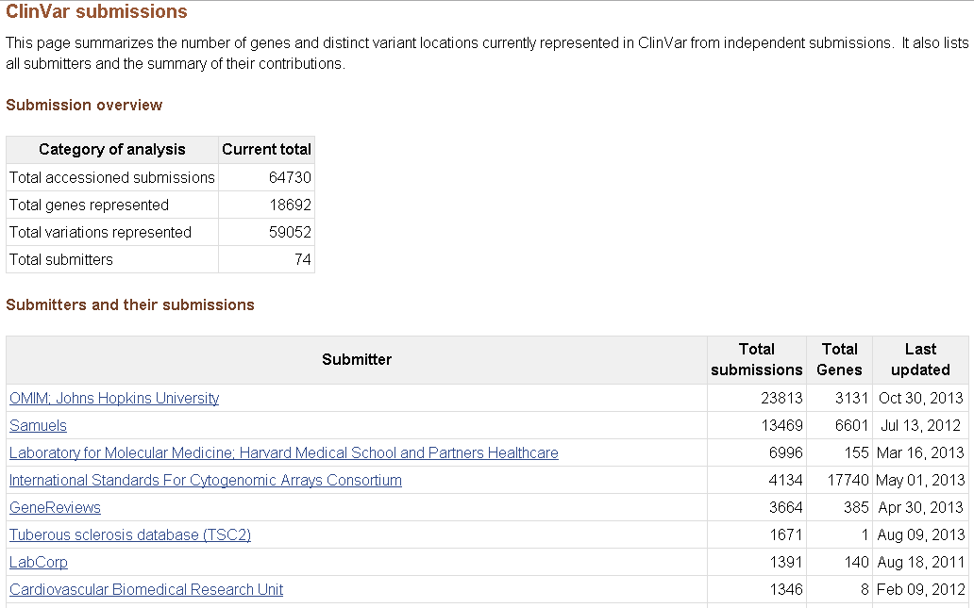
Current status
http://www.ncbi.nlm.nih.gov/clinvar/submitters/

