Slide 1
Building ontologies using Jenkins

Slide 2
Changing requirements for ontology engineering
Original ontology build pipeline
  What pipeline?
  Life on the bleeding edge: Editors version and public version were identical
Ontology editing has become ontology engineering
  We’re applying software engineering methodology
  Automated test suites
  Build process: classification using Elk, subset generation, obo/owl, derived files
  Versioned releases

Slide 3
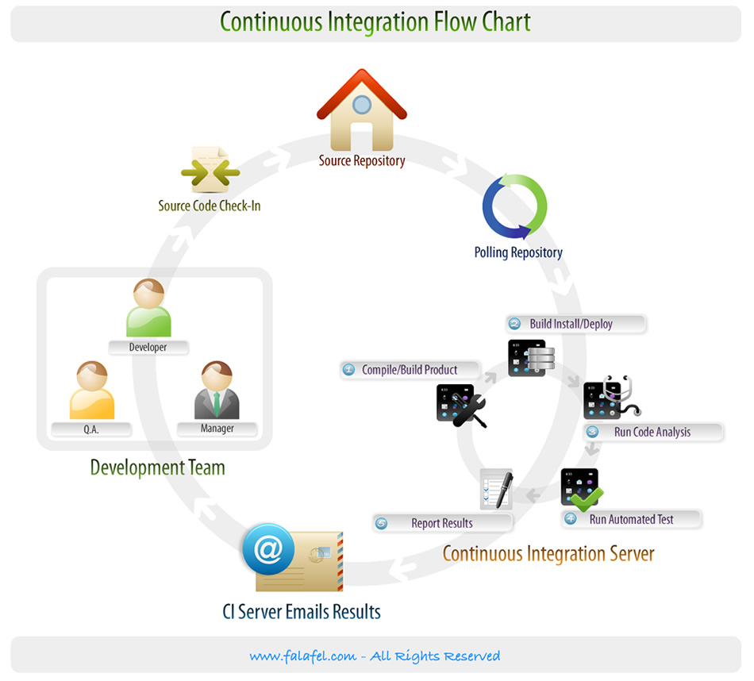
Jenkins: a Continuous Integration Server
Continuous Integration (CI):
  Builds, tests executed upfront
  Concept from agile programming
  We’re applying to ontology engineering
CI server:
  Monitors source code repository
  Integration tests triggered whenever developer commits changes
    Configurable
  Builds final product
Different solutions available
  Jenkins, Hudson

Slide 4
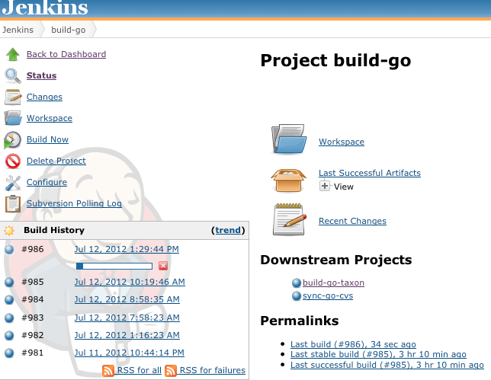
Example basic workflow
Local (e.g. EBI):
  Developer makes local modifications using OBO Edit
  Commits changes to SVN
  (optionally) checks dashboard in web browser
Notes:
Client/server

Slide 5
Example basic workflow
Local (e.g. EBI):
  Developer makes local modifications using OBO Edit
  Commits changes to SVN
  (optionally) checks dashboard in web browser
Server:
  Jenkins polls SVN
  External commit triggers Jenkins to launch the build-go job (using Oort)
build-go job:
  Load main ontology
  Import:
    disjointness axioms
    Taxon constraints
  Launch reasoner: Elk or hermit
  Write reasoner report
  Fail if unsatisfiable classes found
  Run additional perl checks, ensure external xrefs resolve, etc
Notes:
Client/server

Slide 6


Example basic workflow
FAIL
Write reasoner report
If previous build was fail, Jenkins sends ‘service resumed’ email
Downstream jobs are triggered
  (e.g. bigger integrated builds, deployment)
SUCCESS
Jenkins sends email alert to mail list
GO editor debugs using Protégé 4, fixes using oboedit then recommits

Slide 7
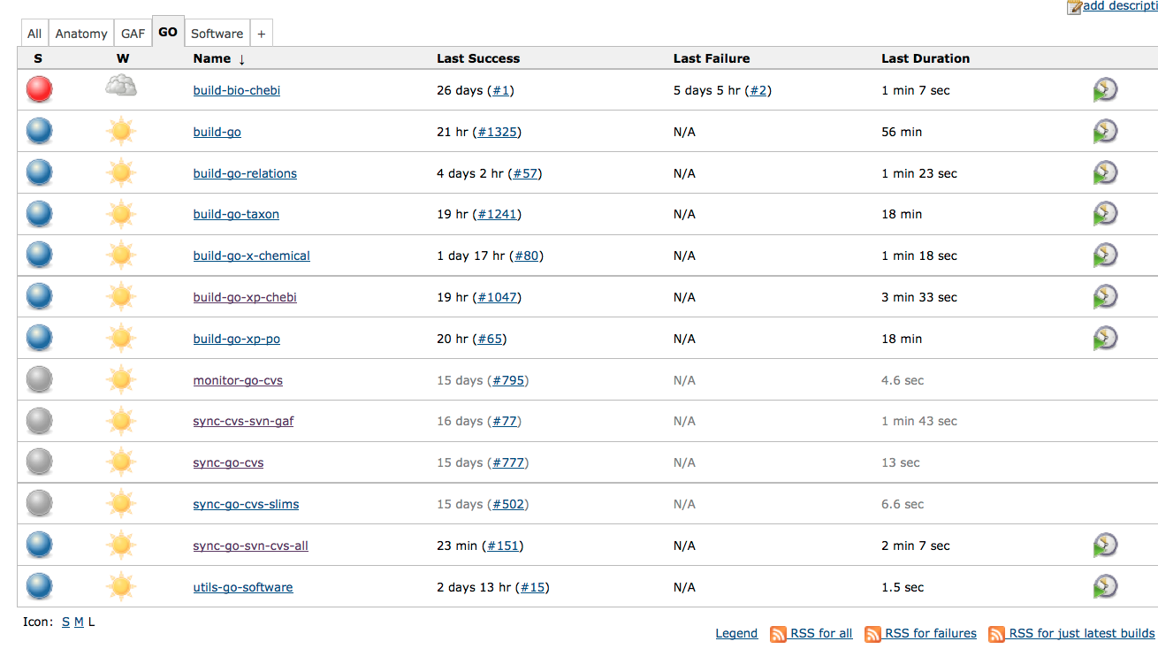

Slide 8
Current status
Jenkins is being used for validation
  Invaluable for ontology developers
  System relatively easy to set up and maintain
Release process still (mostly) run by central cron
  Only running limited subset of checks
  Missing classification step
  Need to consolidate
Extend to annotations

Slide 9
Release pipeline changes
Current:
  Go_ext is direct nightly copy of editors file
  Other files are filtered
    No inter-ontology links
Immediate changes:
  Editors file will include additional axiom tracking info
    This will be removed from all release versions
  Using obolibrary standard versioning scheme
  New obo2owl conversion
    Deprecate version that is built using MySQL pipeline
    Encourage bioinformaticians to use this
  http://wiki.geneontology.org/index.php/Ontology_Release_Files_Proposal

Slide 10
Future changes
Editors version will eventually switch to OWL
  Advantages
    owl:imports
    Direct use of reasoning
  Disadvantages
    Protégé lacks many OE features

Slide 11
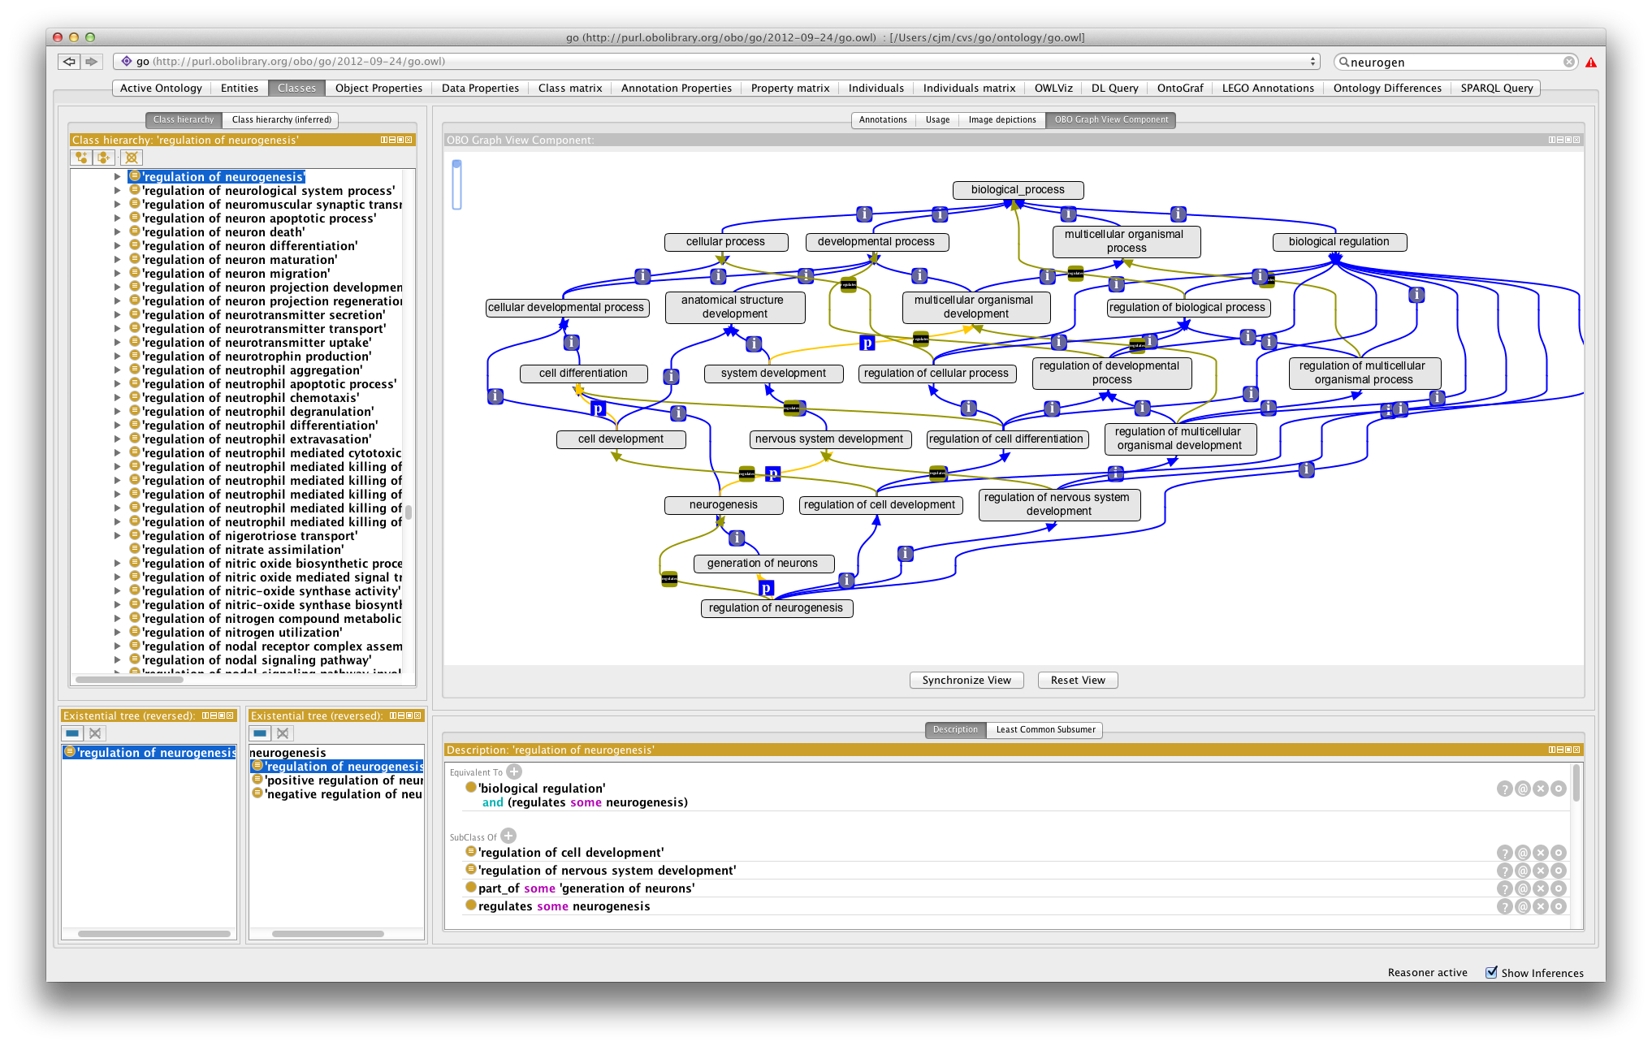
Future changes
Editors version will eventually switch to OWL
  Advantages
    Owl:imports
    Direct use of reasoning
  Disadvantages
    Protégé lacks many OE features

Slide 12
Thanks
Heiko
Seth
Sebastian Bauer (Charite.de)
Ontology editors

