Slide 1
Benefits of a GO integrated analysis environment

Slide 2
Problem 1: Selecting and effectively using tools
Enrichment analysis is a ‘killer app’ for GO
  Should be more central to what we do
  Also other tools: e.g. function prediction
Problem:
  Multiple tools with different characteristics
    Statistical method
    Environment / customizability
    Visualization
  Can we better help users:
    Select the right tool(s) for the job
    Run their analysis
    Build scalable workflows that allow replication
Notes:
Pre-processing data (e.g. IDs should be mapped beforehand)
Running the analysis (installation, parameter selection, etc.)
Interpreting and visualizing results
Comparing outputs of two or more tools
Replicate analysis

Slide 3
Problem 2: Evaluating improvements in GO
How do we know how well we’re doing?
  Progress in GO difficult to quantify
  Same enrichment analysis may give completely different results one year to the next

Slide 4
Solution: GO Tools Environment
Tools:
  Selecting the right tool
    Solution: Detailed, accurate, up-to-date metadata on each tool
  Galaxy: A standard platform for running analyses
    ‘operating system’ for bioinformatics analyses
    allows plug and play
  Combining tools
    Common community interchange standards for GO analysis tools
      Common term enrichment result format plus converters
Evaluation of GO:
  Use Term Enrichment Analyses (TEAs) and standard gene sets to evaluate GO

Slide 5
Tool metadata: background
We have ~130 GO tools registered
  ~50 TEA tools
  We don’t have all of them
  Some info out of date
We need to capture more metadata
  We want to be able to quickly answer queries like
    Find an EA tool that
      uses hypergeometric tests
      can be used for <my species>
      has not updated their annotation sets in > 6 mo
      has visualization
      I can use for my RNAseq data

Slide 6
Tool metadata: progress/tasks
Progress:
  Infrastructure migration:
    Migrated from custom tool metadata format and web infrastructure
    using curated NIF registry
      Built on semantic mediawiki
Ongoing tasks:
  Add more fields (curated and automated)
    Recommendations?
  Integrate with go-help
  Improve integration with main GO website
    seamlessness
    allow intuitive filtering of tools
    See Seth’s presentation

Slide 7
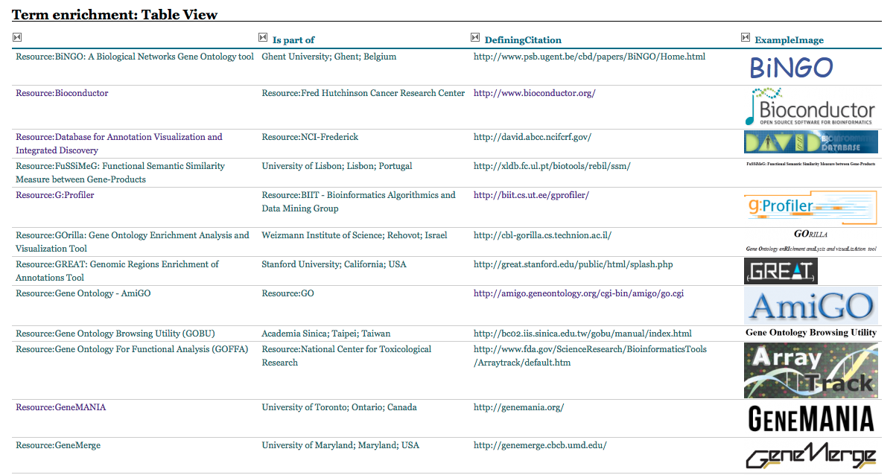
New Tools Registry

Slide 8
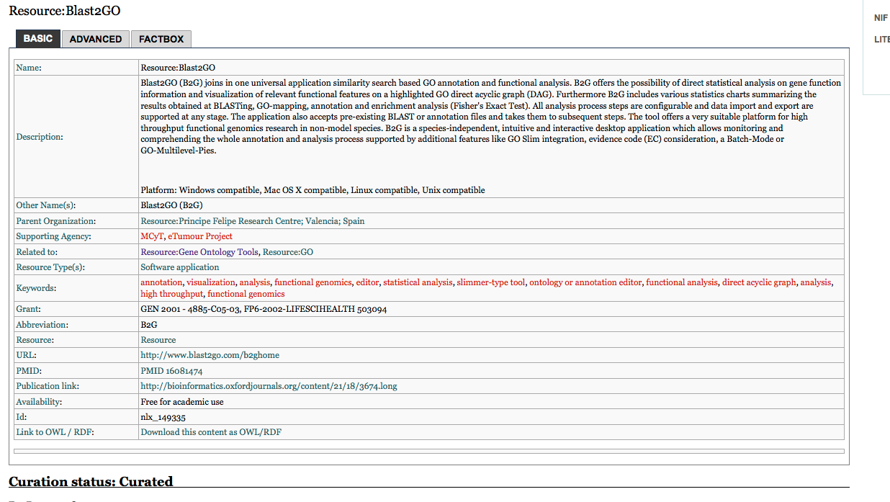
Example

Slide 9
Standard Term Enrichment Analysis Platform: background
Tools run in their own environment
  Difficult to
    Compare
    Integrate into larger workflows
    Provide uniform interface
Solution:
  Standard workflow environment
    Variety of workflow systems
      Kepler
      Galaxy
      Taverna
    Galaxy has a number of advantages
      Simple to set up and extend
      heavily used for next-gen analyses
      Tools for intermine etc

Slide 10
Standard Term Enrichment Analysis Platform: progress/tasks
Progress
  proof of concept prototype of GO environment
    http://galaxy.berkeleybop.org
Ongoing tasks
  Stabilize environment
  Add more enrichment tools
  Seamless integration with GO website
  Outreach
    User documentation
    Bio-curators 2013 presentation
ONTO-ToolKit: enabling bio-ontology engineering via Galaxy
E Antezana, A Venkatesan, C Mungall, V Mironov, M Kuiper
BMC bioinformatics 11 (Suppl 12), S8 2010

Slide 11
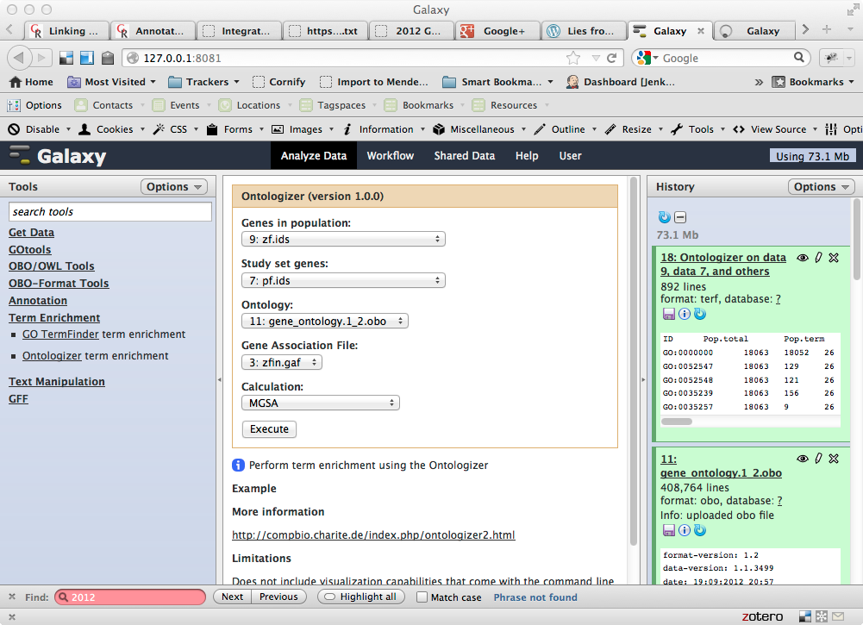
Screenshot

Slide 12
Interchange Standards: Outline
We need a Term Enrichment Result Format (TERF)
  Standard output format for TE tools
    Compliant tools will export TERF
    We will write wrappers for non-compliant tools
    Allows capture of detailed metadata about each result set
Example of use:
  User runs gene set through tool X
  User takes output of tool X and feeds it into visualizer Y

Slide 13
Interchange Standards: progress/tools
Progress
  google code project created
    http://code.google.com/p/terf/
  preliminary format specified
    TSV form and RDF/turtle form
  some converters written
    ermine/J, ontologizer
Ongoing tasks:
  complete specification
    public working draft for comments
    incorporate comments
    final specification
  Outreach
    work with tool developers
  write additional converters
    target command-line tools that provide diverse capabilities

Slide 14
GO evaluation: background
How do changes in the GO affect user’s queries and analyses?
  We would hope that concerted ontology and annotation improvements would yield more complete and informative results
  But we don’t know!
Notes:
If we had a repository of gene sets we could systematically re-analyze these with different variables
version of GO, version of annotations
different tools
If these gene sets were annotated with ‘expected’ results we could systematically determine if GO was delivering expected answers
danger of overfitting, but still useful

Slide 15
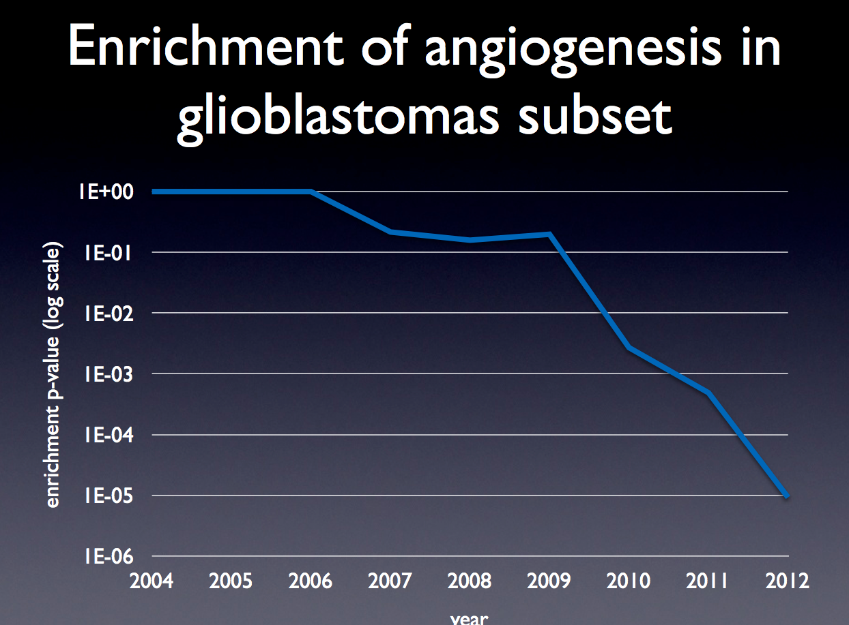
GO evaluation: background
How do changes in the GO affect queries and analyses?
  We don’t know!
  We would hope that concerted ontology and annotation improvements would yield more informative results
  TE results are frequently reported in papers but rarely replicated
If we had a repository of gene sets we could systematically re-analyze these with different variables
  version of GO, version of annotations
  different tools
If these gene sets were annotated with ‘expected’ results we could systematically determine if GO was delivering expected answers
  danger of overfitting, but still useful
ESlvaluation
Slide + analysis by:
Erik Clarke (Su Group)

Slide 16
GO evaluation: plan
Collect gene sets
  Others can help us here
Select subset of tools
Analyze gene sets with this tool set and previous versions of GO + annotations
  Cache results in TERF
Every month/quarter re-analyze gene sets
  Can be done in Jenkins or Galaxy
Investigate anomalies
Explore as metric for GO

Slide 17
Conclusions
An integrated analysis environment can help
  Users
  The GOC
More work to be done
  Need to dedicate resources

Slide 19
Example user scenario
User (optionally) specifies their problem. E.g.
  species
  specific hypothesis; e.g. immune system
  identifier type (e.g. ensembl IDs)
User is given a list of appropriate tools
  Either:
    link to external web interface
    link to download, install and run tool
    ability to run tool(s) in GO analysis environment
User chooses to run ontologizer in GO environment
  ensembl IDs are mapped using external ID mapper
  GO immune subset is created on-the-fly
  annotations filtered
  subset, filtered annotations, mapped IDs fed to ontologizer
  ontologizer results translated to common format
  results can be plugged into choice of visualization tool

