Slide 1

Increased Expressivity of Gene Ontology Annotations
Huntley RP, Harris MA, Alam-Faruque Y, Carbon SJ, Dietze H, Dimmer E, Foulger R, Hill DP, Khodiyar V, Lock A, Lomax J, Lovering RC, Mungall CJ, Mutowo-Muellenet P, Sawford T, Van Auken K, Wood V
Notes:
10 mins. GAF2.0

Slide 2
The Gene Ontology
A vocabulary of 37,500* distinct, connected descriptions that can be applied to gene products
That’s a lot…
How big is the space of possible descriptions?
^{*April 2013}

Slide 3
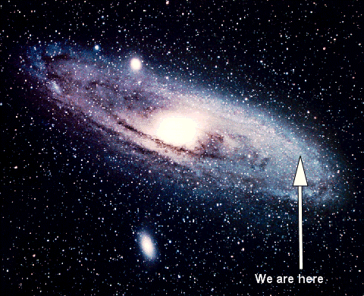
Notes:
Sweet spot in a large galaxy

Slide 4
Current descriptions miss details
Author:
LMTK1 (Aatk) can negatively control axonal outgrowth in cortical neurons by regulating Rab11A activity in a Cdk5-dependent manner
http://www.ncbi.nlm.nih.gov/pubmed/22573681
GO:
Aatk: GO:0030517 negative regulation of axon extension
GO terms will always be a subset of total set of possible descriptions
We shouldn’t attempt to make a term for everything

Slide 5
T63 Toxic effect of contact with venomous animals and plants
Term from ICD-10, a hierarchical medical billing code system use to ‘annotate’ patient records

Slide 6
T63 Toxic effect of contact with venomous animals and plants
T63.611 Toxic effect of contact with Portugese Man-o-war, accidental (unintentional)

Slide 7
T63 Toxic effect of contact with venomous animals and plants
T63.611 Toxic effect of contact with Portugese Man-o-war, accidental (unintentional)
T63.612 Toxic effect of contact with Portugese Man-o-war, intentional self-harm

Slide 8
T63 Toxic effect of contact with venomous animals and plants
T63.611 Toxic effect of contact with Portugese Man-o-war, accidental (unintentional)
T63.612 Toxic effect of contact with Portugese Man-o-war, intentional self-harm
T63.613 Toxic effect of contact with Portugese Man-o-war, assault

Slide 9
T63 Toxic effect of contact with venomous animals and plants
T63.611 Toxic effect of contact with Portugese Man-o-war, accidental (unintentional)
T63.612 Toxic effect of contact with Portugese Man-o-war, intentional self-harm
T63.613 Toxic effect of contact with Portugese Man-o-war, assault
T63.613A Toxic effect of contact with Portugese Man-o-war, assault, initial encounter
T63.613D Toxic effect of contact with Portugese Man-o-war, assault, subsequent encounter
T63.613S Toxic effect of contact with Portugese Man-o-war, assault, sequela

Slide 10
Post-composition
Curators need to be able to compose their complex descriptions from simpler descriptions (terms) at the time of annotation
➔ GO annotation extensions
Introduced with Gene Association Format (GAF) v2
Also supported in GPAD
Has underlying OWL description-logic model
http://www.geneontology.org/GO.format.gaf-2_0.shtml

Slide 11
“Classic” annotation model
Gene Association Format (GAF) v1
Simple pairwise model
Each gene product is associated with an (ordered) set of descriptions
Where each description == a GO term
http://www.geneontology.org/GO.format.gaf-1_0.shtml

Slide 12
GO annotation extensions
Gene Association Format (GAF) v1
Simple pairwise model
Each gene product is associated with an (ordered) set of descriptions
Where each description == a GO term
Gene Association Format (GAF) v2 (and GPAD)
Each gene product is (still) associated with an (ordered) set of descriptions
Each description is a GO term plus zero or more relationships to other entities
Entities from GO, other ontologies, databases
Description is an OWL anonymous class expression (aka description)
http://www.geneontology.org/GO.format.gaf-2_0.shtml
Notes:
Not ad-hoc – OWL description

Slide 13
“Classic” GO annotations are unconnected
protein localization to nucleus[GO:0034504]
positive regulation of transcription from pol II promoter in response to oxidative stress[GO:0036091]
pap1
sty1
cellular response to oxidative stress
[GO:0034599]
DB | Object | Term | Ev | Ref |  | ..
PomBase | sty1 SPAC24B11.06c | GO:0034504 | IMP | PMID:9585505 | .. | .. | ..
PomBase | sty1 SPAC24B11.06c | GO:0034599 | IMP | PMID:9585505 | .. | ..
PomBase | pap1 SPAC1783.07c | GO:0036091 | IMP | PMID:9585505 |  | ..

Slide 14
Now with annotation extensions
protein localization to nucleus[GO:0034504]
cellular response to oxidative stress
[GO:0034599]
positive regulation of transcription from pol II promoter in response to oxidative stress[GO:0036091]
happens
during
sty1
pap1
has
input
<anonymous
description>
<anonymous
description>
has regulation
target
DB | Object | Term | Ev | Ref |  | Extension
PomBase | sty1 SPAC24B11.06c | GO:0034504 protein localization to nucleus | IMP | PMID:9585505 | .. | happens_during(GO:0034599), has_input(SPAC1783.07c) | ..
PomBase | pap1 SPAC1783.07c | GO:0036091 | IMP | PMID:9585505 |  | has_reulation_target(…)
Notes:
Key point: logically equivalent to an annotation to a term in the <anon desc> box, with the same links out.

Slide 15
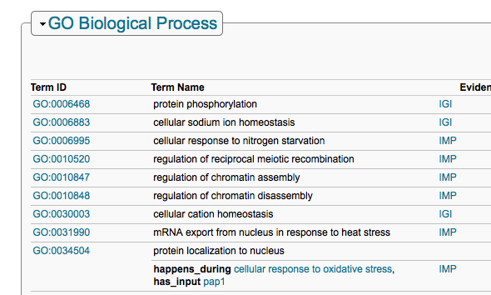
PomBase web interface – sty1
http://www.pombase.org/spombe/result/SPAC24B11.06c

Slide 16
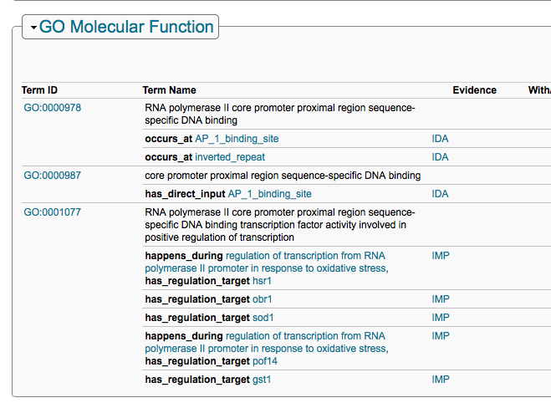
pap1
http://www.pombase.org/spombe/result/SPAC1783.07c

Slide 17
Where do I get them?
Download
http://geneontology.org/GO.downloads.annotations.shtml
MGI (22,000)
GOA Human (4,200)
PomBase (1,588)
Search and Browsing
Cross-species
AmiGO 2 – http://amigo2.berkeleybop.org - poster#57
QuickGO (later this year) - http://www.ebi.ac.uk/QuickGO/
MOD interfaces
PomBase – http://bombase.org

Slide 18
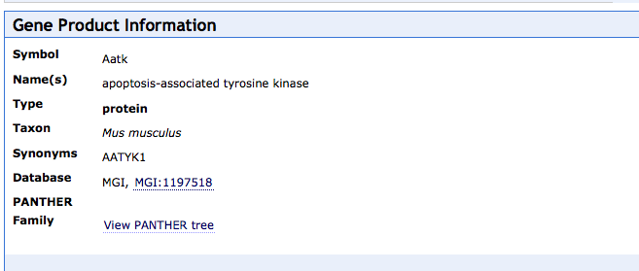
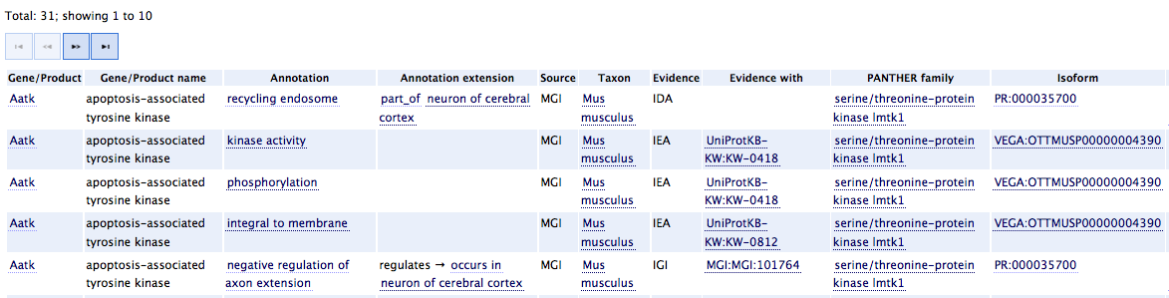
Query tool support: AmiGO 2
Annotation extensions make use
of other ontologies
CHEBI
CL – cell types
Uberon – metazoan anatomy
MA – mouse anatomy
EMAP – mouse anatomy
….
CL
– http://amigo2.berkeleybop.org

Slide 19

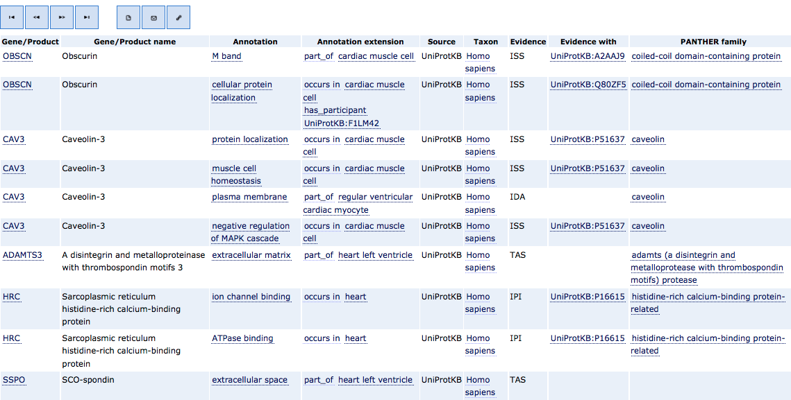
CL, Uberon
– http://amigo2.berkeleybop.org

Slide 20

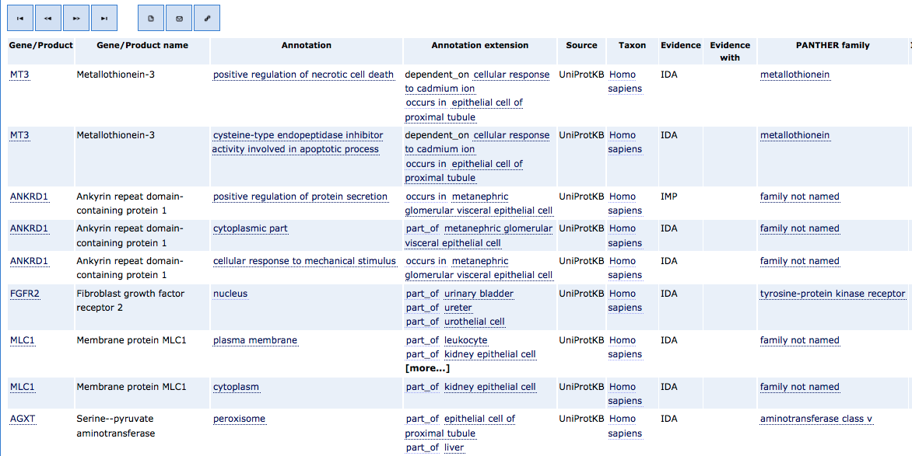
CL, Uberon
– http://amigo2.berkeleybop.org

Slide 21
Curation tool support
Supported in
Protein2GO (GOA, WormBase) [poster#97]
CANTO (PomBase) [poster#110]
MGI curation tool

Slide 22
Analysis tool support
Currently: Enrichment tools do not yet support annotation extensions
Annotation extensions can be folded into an analysis ontology - http://galaxy.berkeleybop.org
Future: Analysis tools can use extended annotations to their benefit
E.g. account for other modes of regulation in their model
Tool developers: contact us!

Slide 23
Challenge: pre vs post composition
Curator question: do I…
Request a pre-composed term via TermGenie[*]?
Post-compose using annotation extensions?
See Heiko’s TermGenie talk tomorrow & poster #33

Slide 24
Challenge: pre vs post composition
Curator question: do I…
Request a pre-composed term via TermGenie?
Post-compose using annotation extensions?
From a computational perspective:
It doesn’t matter, we’re using OWL
40% of GO terms have OWL equivalence axioms
protein localization to nucleus[GO:0034504]
≡
end_location
protein localization [GO:0008104]
⊓
Nucleus [GO:0005634]
http://code.google.com/p/owltools/wiki/AnnotationExtensionFolding

Slide 25
Curation Challenges
Manual Curation
Fewer terms, but more degrees of freedom
Curator consistency
OWL constraints can help
Automated annotation
Phylogenetic propagation
Text processing and NLP

Slide 26
Similar approaches and future directions
Post-composition has been used extensively for phenotype annotation
ZFIN [poster#95]
Phenoscape [next talk]
Future:
A more expressive model that bridges GO with pathway representations

Slide 27
Conclusions
Description space is huge
Context is important
Not appropriate to make a term for everything
OWL allows us to mix and match pre and post composition
Number of extension annotations is growing
Annotation extensions represent untapped opportunity for tool developers

Slide 28
Acknowledgments
GO Consortium, model organism and UniProtKB curators
GO Directors
PomBase developers:
Mark McDowell, Kim Rutherford
Funding
GO Consortium NIH 5P41HG002273-09
UniProtKB GOA NHGRI U41HG006104-03
British Heart Foundation grant SP/07/007/23671
Kidney Research UK RP26/2008
PomBase - Wellcome Trust WT090548MA
MGD NHGRI HG000330

