Slide 1
Generating a minimal model
Basic idea:
  What we think of as “relationships” are “existential axioms”
    They say what exists
  E.g.
    Nucleus SubClassOf part_of some cell
      If n1 is an instance of a nucleus, then there must exist some cell c1 such that n1 part_of c1
    Chain together
    Historically GO axioms go ‘up’ but there is power in going ‘down’

Slide 2
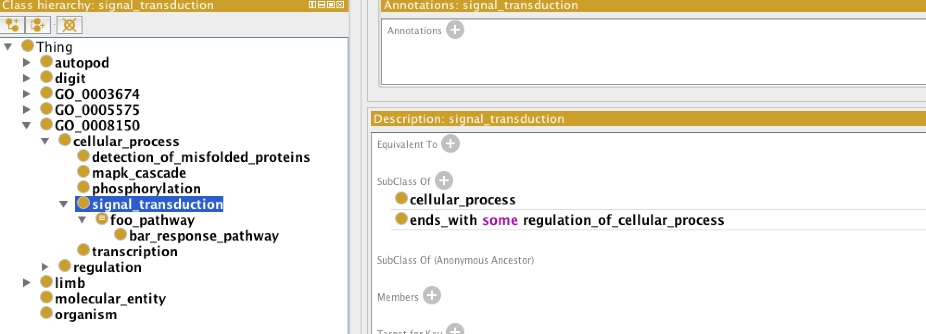
Sample ontology

Slide 3
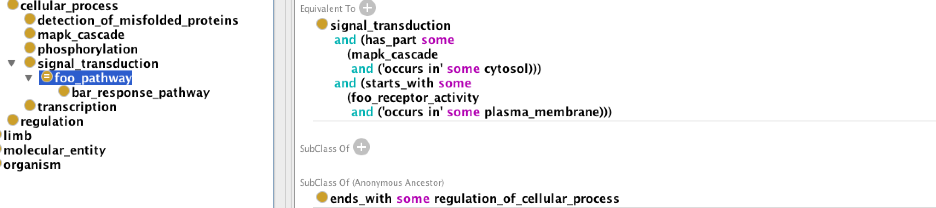
Fake pathway

Slide 4
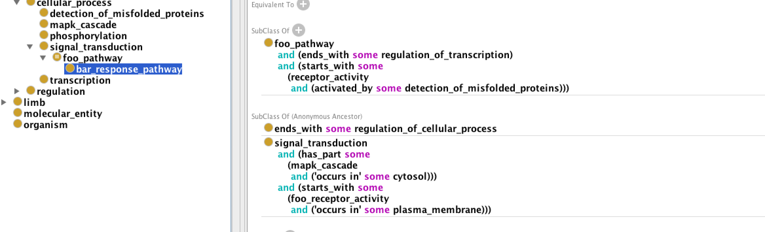
Axioms are inherited

Slide 5
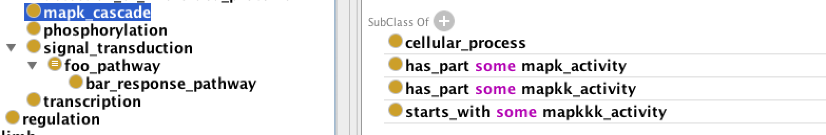

Slide 6
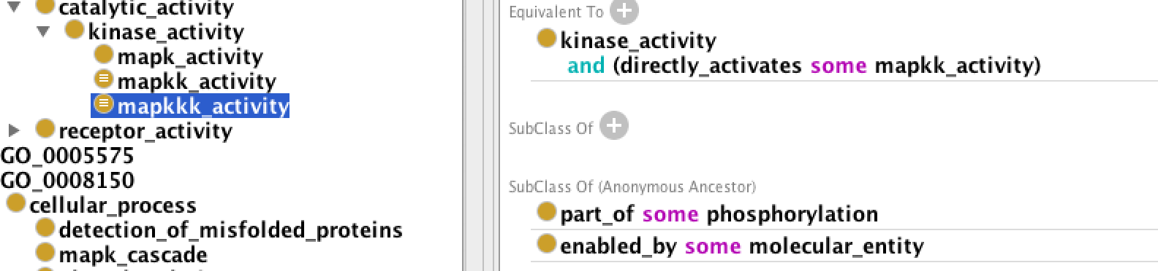

Slide 7
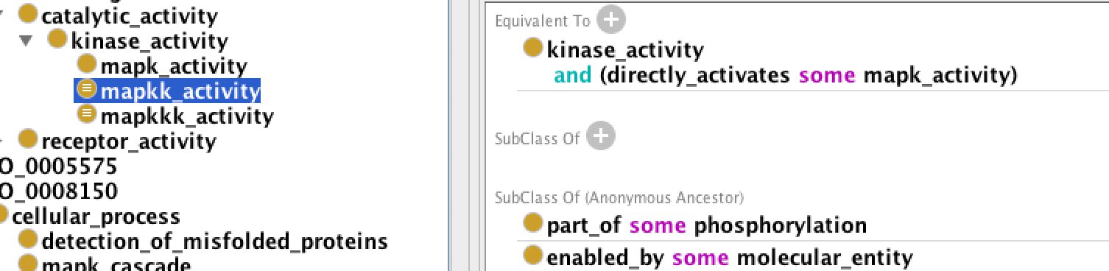

Slide 8
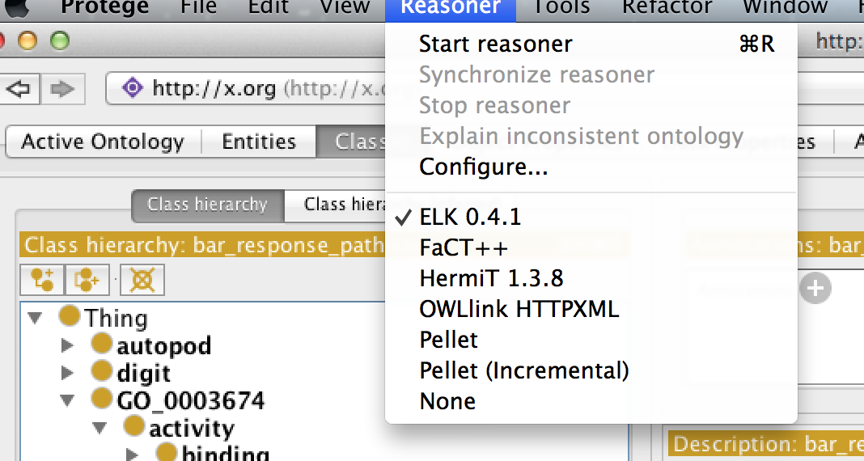
Make sure your reasoner is on

Slide 9
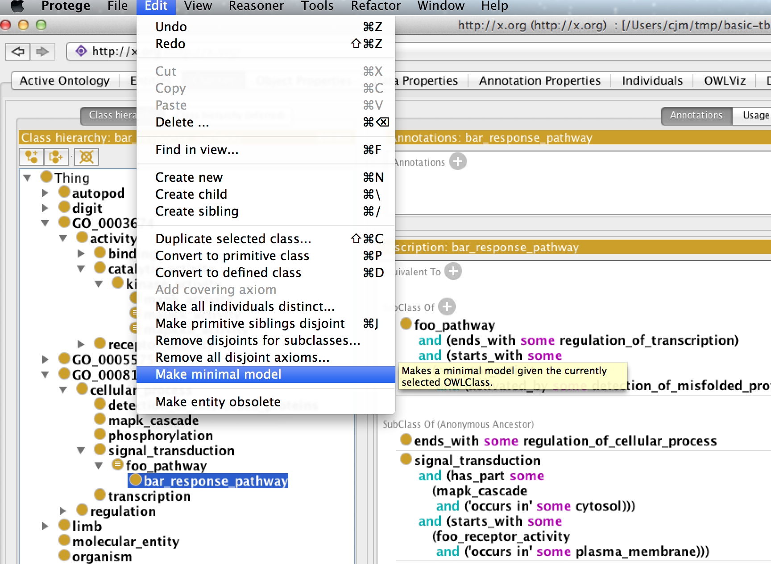

Slide 10
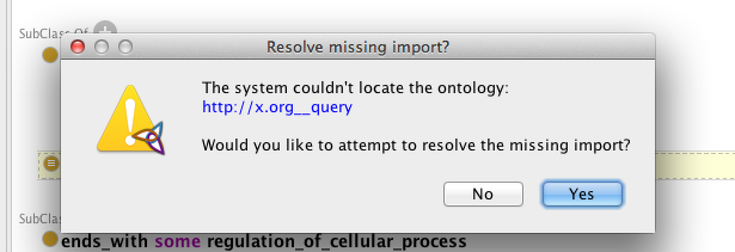
JUST SAY NO!!!

Slide 11
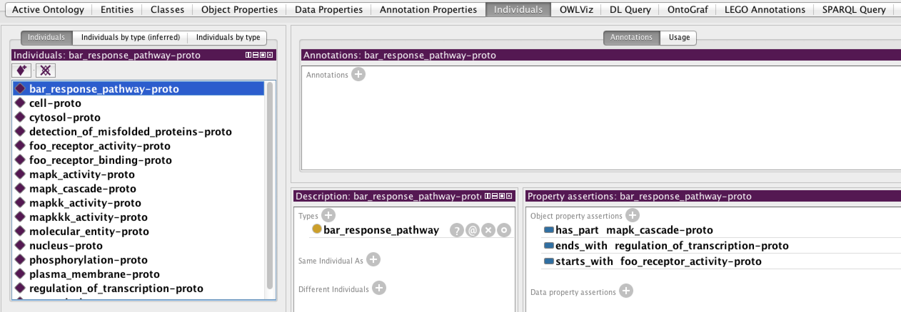
Generated individuals
If some instance of bar_pathway exists, then all of these individuals must
also necessarily exist – this is what the OWL class axioms tell us

Slide 12
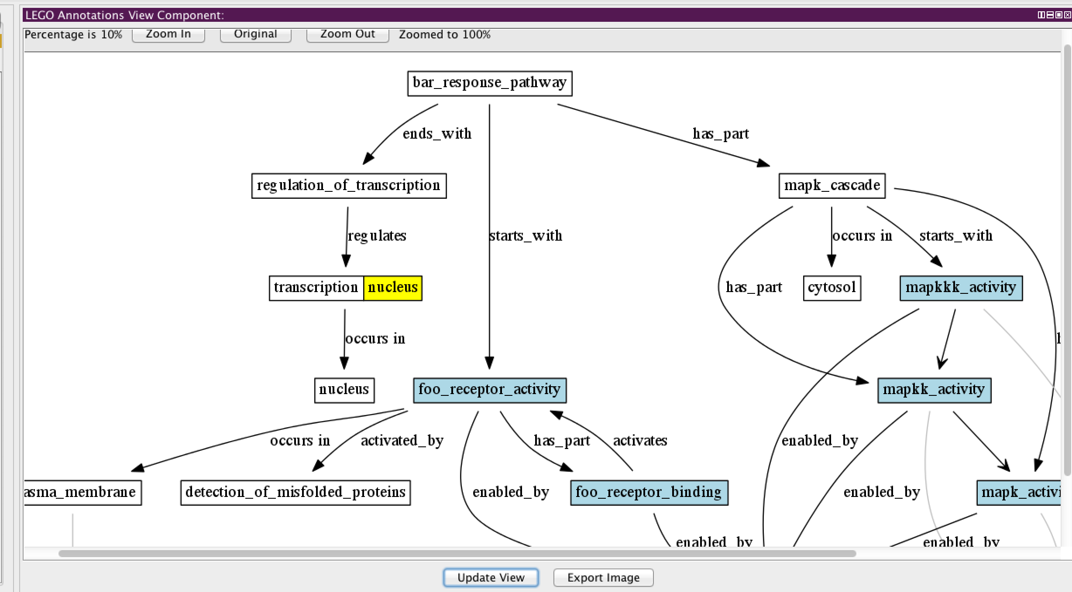

Slide 13
How does it work on GO?
x-signaling.owl

Slide 14
