Slide 1
Building ontologies using Jenkins

Slide 2
Changing requirements for ontology engineering
Original ontology build pipeline
What pipeline?
Life on the bleeding edge: Editors version and public version were identical
Ontology editing has become ontology engineering
We’re applying software engineering methodology
Automated test suites
Build process: classification using Elk, subset generation, obo/owl, derived files
Versioned releases

Slide 3
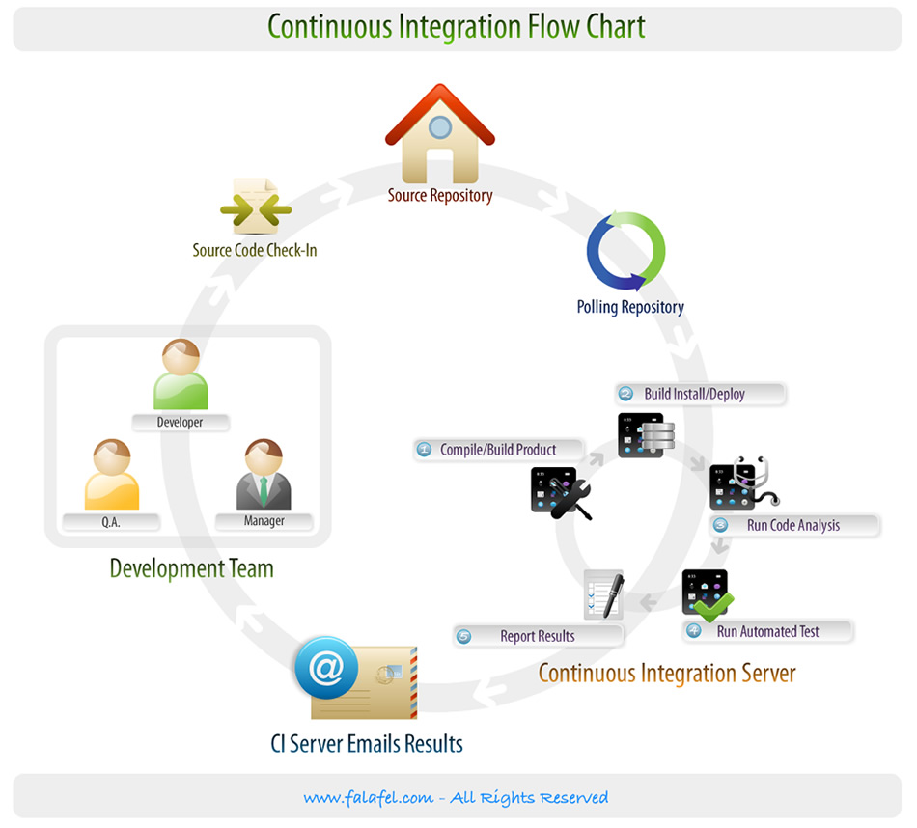
Jenkins: a Continuous Integration Server
Continuous Integration (CI):
Builds, tests executed upfront
Concept from agile programming
We’re applying to ontology engineering
CI server:
Monitors source code repository
Integration tests triggered whenever developer commits changes
Configurable
Builds final product
Different solutions available
Jenkins, Hudson

Slide 4
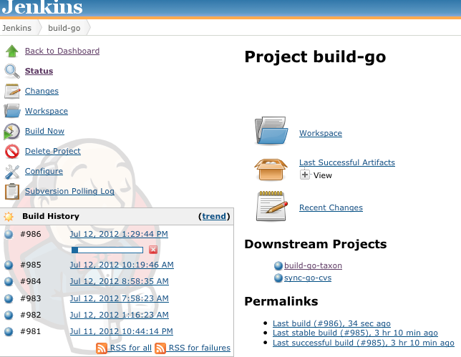
Example basic workflow
Local (e.g. EBI):
Developer makes local modifications using OBO Edit
Commits changes to SVN
(optionally) checks dashboard in web browser
Notes:
Client/server

Slide 5
Example basic workflow
Local (e.g. EBI):
Developer makes local modifications using OBO Edit
Commits changes to SVN
(optionally) checks dashboard in web browser
Server:
Jenkins polls SVN
External commit triggers Jenkins to launch the build-go job (using Oort)
build-go job:
Load main ontology
Import:
disjointness axioms
Taxon constraints
Launch reasoner: Elk or hermit
Write reasoner report
Fail if unsatisfiable classes found
Run additional perl checks, ensure external xrefs resolve, etc
Notes:
Client/server

Slide 6
Example basic workflow
FAIL
Write reasoner report
If previous build was fail, Jenkins sends ‘service resumed’ email
Downstream jobs are triggered
(e.g. bigger integrated builds, deployment)
SUCCESS
Jenkins sends email alert to mail list
GO editor debugs using Protégé 4, fixes using oboedit then recommits

Slide 7
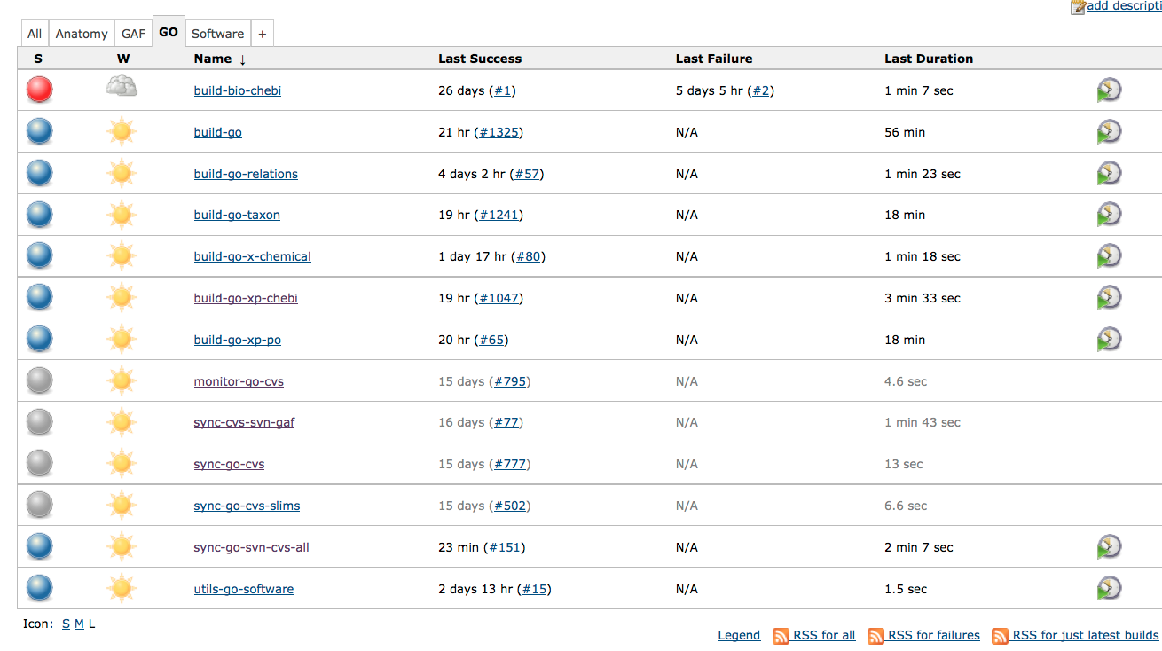

Slide 8
Current status
Jenkins is being used for validation
Invaluable for ontology developers
System relatively easy to set up and maintain
Release process still (mostly) run by central cron
Only running limited subset of checks
Missing classification step
Need to consolidate
Extend to annotations

Slide 9
Release pipeline changes
Current:
Go_ext is direct nightly copy of editors file
Other files are filtered
No inter-ontology links
Immediate changes:
Editors file will include additional axiom tracking info
This will be removed from all release versions
Using obolibrary standard versioning scheme
New obo2owl conversion
Deprecate version that is built using MySQL pipeline
Encourage bioinformaticians to use this
http://wiki.geneontology.org/index.php/Ontology_Release_Files_Proposal

Slide 10
Future changes
Editors version will eventually switch to OWL
Advantages
owl:imports
Direct use of reasoning
Disadvantages
Protégé lacks many OE features

Slide 11
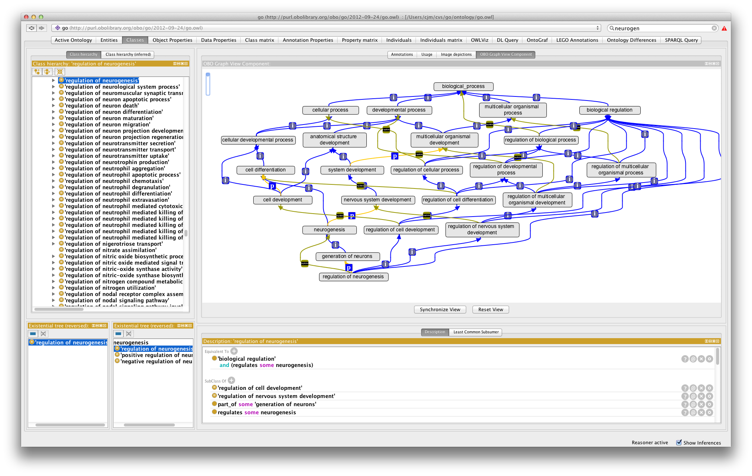
Future changes
Editors version will eventually switch to OWL
Advantages
Owl:imports
Direct use of reasoning
Disadvantages
Protégé lacks many OE features

Slide 12
Thanks
Heiko
Seth
Sebastian Bauer (Charite.de)
Ontology editors

