Slide 1
Towards a Common Annotation Framework for Knowledge Acquisition
College Station, Texas, 2014

Slide 2
Goals
Capture the biology
Do this efficiently
Maximise impact
Do this in a future-proofy way

Slide 3
1. Capture the biology

Slide 4
1. Capture the biology

Slide 5
2. Maximise efficiency
Software engineering
  We are resource-limited for developers
  Reuse components, share APIs, eliminate overlap
Knowledge Acquisition
  Resource-limited for curators/editors
  Automate where appropriate
    Data-driven (see SAB report)
  Coordinate teams
    Eliminate redundancy
SAB report::
- Data driven curation
- Making use of hi-throughput data
- GBA, proteomics, clustering (Nexo)

Slide 6
3. Maximise impact
Not just about number of annotations
Can we incorporate impact into annotation process?
SAB report::
- annotations
- enabling users to make discoveries
- ease of access to extended annotations

Slide 7
4. Future proofing
Don’t over-fit requirements to what we do today
Conservative predictions
  Integration of curation into publications and even experiment portion of data lifecycle
  Less resources for retrospective curation
  Increased pressure to interoperate across informatics systems
  More high-throughput data
  Individual gene → network view

Slide 8
How close are we?

Slide 9
Annotation Tool Landscape
Previously
  Multiple tools with highly redundant functionality
Now
  Converging towards smaller number of tools each with their own specific niche
    Specifically: migration from MOD-centric →protein2go
      (see Kimberley’s presentation)
    Remaining challenges:
        Still redundancy
        Indirect interoperation
        Stovepipes

Slide 10
Toolscape*
*with apologies
to gonuts

Slide 11
Toolscape

Slide 13
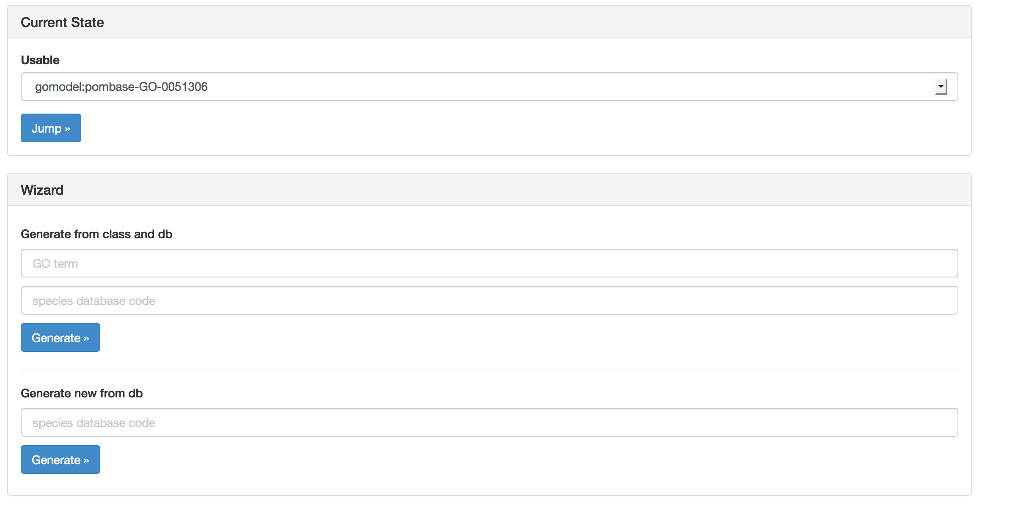

Slide 14
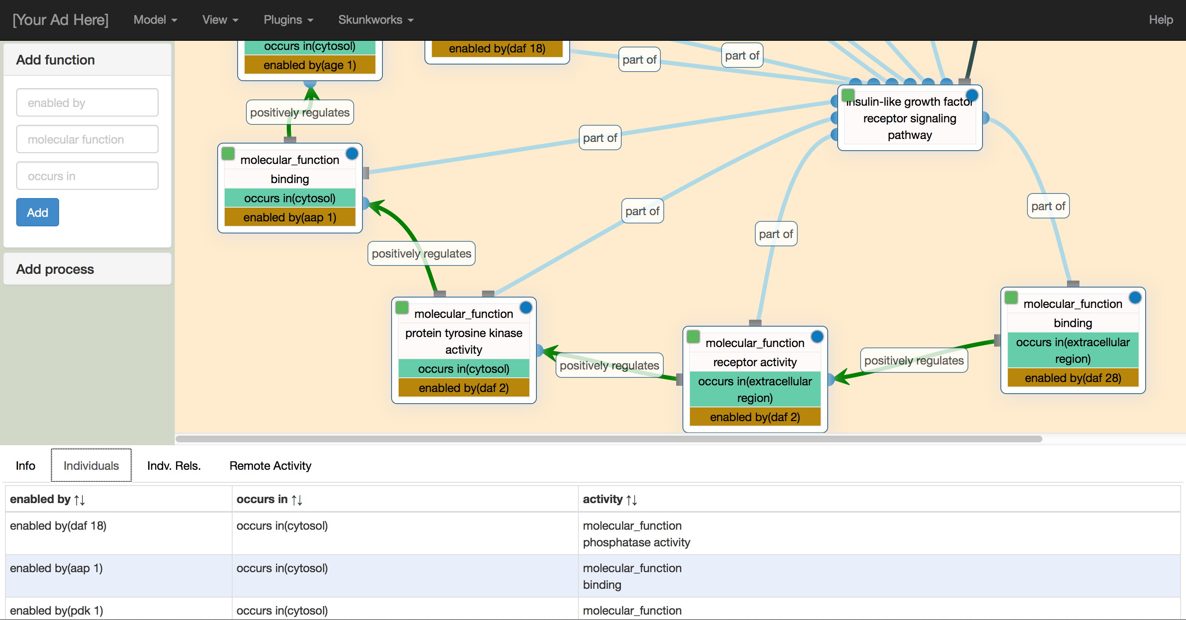

Slide 15
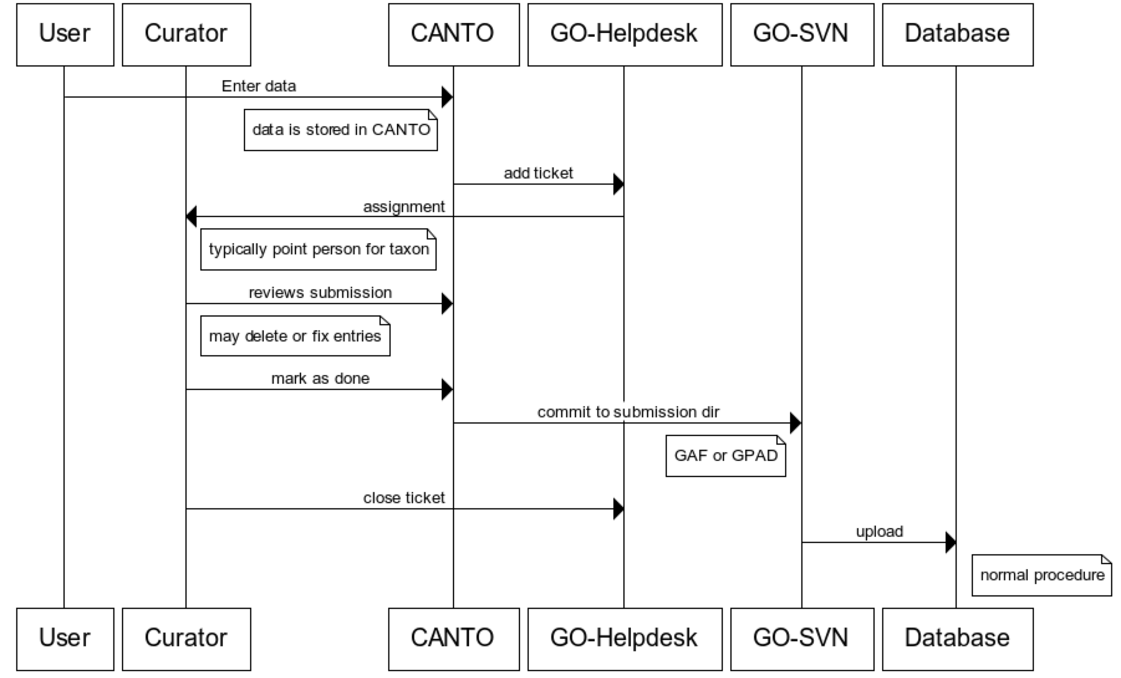

Slide 16
How do these tools interoperate?
File-level export-transport-import
Peer to peer
Common service layer

Slide 18
Current data architecture is suboptimal

Slide 19
The Vision

Slide 20
Orion March 2014

Slide 21
Progress with respect to grant
GO Proposal 2012-2017
  Timeline yr2 “prototype 2nd generation annotation tool”

Slide 22
Idealized plan
Split CCC into a UI widget and textpresso services
Integrate protein2go and Orion into common framework
Merge in other curation efforts
  Phenotype
  Expression
Work with bioinformatics community on data-driven acquisition services

Slide 23
Will we be successful?
Strengths
  Many pieces are in place
  Leverage work done in annotations and ontology
Weaknesses
  Lack of resources (see next slide)
  Disjointed distributed teams, different goals
Opportunities
  Technology Synergy (EBI-RDF, Monarch)
  Data-driven methods, exploit community
Threats
  Other aspects of GO are neglected
  Aiming too high
  (conversely) overfitting to today’s requirements
  As yet unknown leap-frogger

Slide 24
Addressing the weaknesses
Resource-limitation
  The time is right to get the funding
    US: BD2K (May-July deadlines)
    Europe: ?
Integrating teams
  Rallying around common goal

Slide 25
The fallback position

