Slide 1
Plan
Areas of coverage:
  high-level neurological system process, inc. sensory perception, sensory processing, cognition
  transmission of nerve impulse, inc synaptic transmission (needs fleshing out, made more generic)
  functions: neurotransmitter binding/receptor
    c.f. problems with binding to roles
  behaviour (export to NBO?)
annotation efforts
no action potential
cellular component terms
taxon constraints [do we have any for neurobiology?]
lego?

Slide 2
Mental Functioning and the Gene Ontology
Jane Lomax
EMBL-EBI

Slide 3
What is the Gene Ontology?
Well established ontology for ‘normal’ processes, functions and subcellular components
Notes:
Project has been active for about 12 years

Slide 4
What is the Gene Ontology?
Genes and proteins annotated with GO terms by trained curators at genome databases
Also created automatically
Notes:
These GO phrases, or TERMS are linked to genes by expert curators at genome databses.
will talk about in more detail later

Slide 5
GO annotations
GO database
gene -> GO term
associated genes
genome and protein databases
Notes:
The individual genome and protein databases submit their genes and proteins annotated to GO terms to a central GO database.

Slide 6
What is the Gene Ontology?
Allows biologists to make queries across large numbers of genes and across species

Slide 7
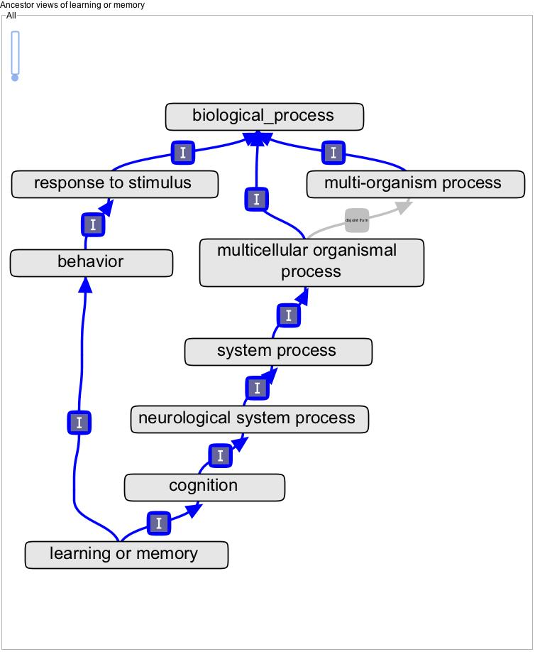
GO structure
terms are related within a hierarchy
Notes:
Two arrangements for DNA replication

Slide 8
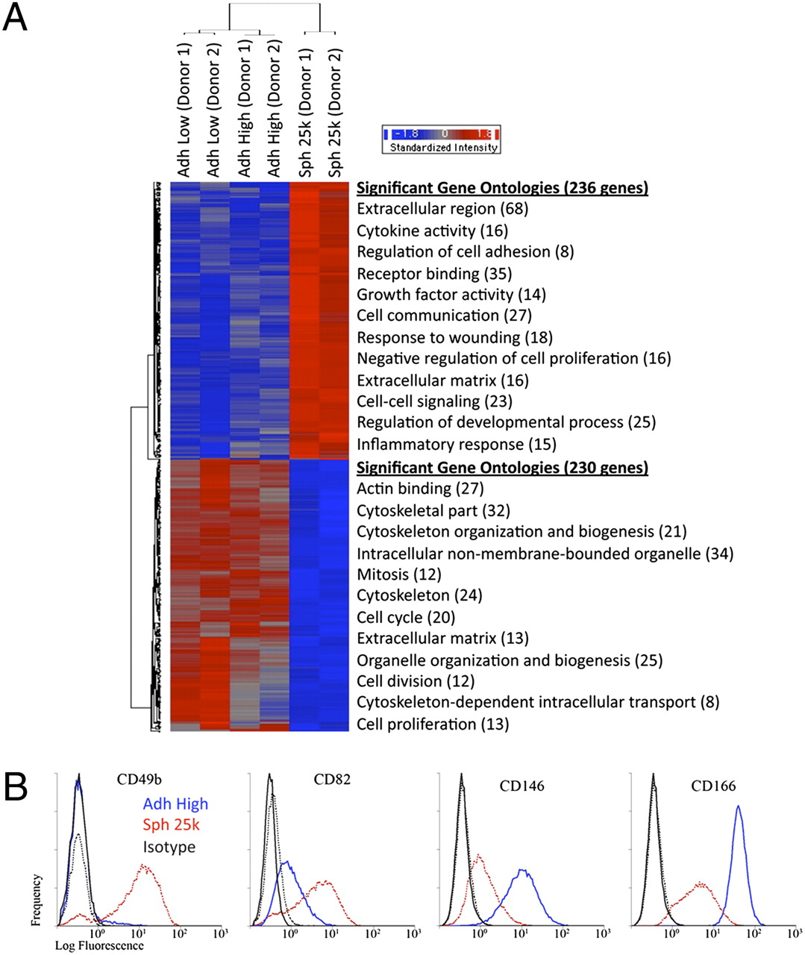
Microarray assays of hMSCs from two donors.
Bartosh T J et al. PNAS 2010;107:13724-13729
©2010 by National Academy of Sciences
Notes:
Microarray assays of hMSCs from two donors. (A) Hierarchical clustering of differentially expressed genes. Genes that were either up- (236 genes) or down-regulated (230 genes) in spheroids (Sph 25k) at least twofold compared with their adherent culture counterparts (Adh Low and Adh High), were used in hierarchical clustering. The most significant Gene Ontology terms for up-regulated genes (red) and down-regulated genes (blue) are shown next to the heat map. (B) Flow cytometry of differentially expressed surface epitopes on hMSCs. Abbreviations: as in Fig. 1.

Slide 9
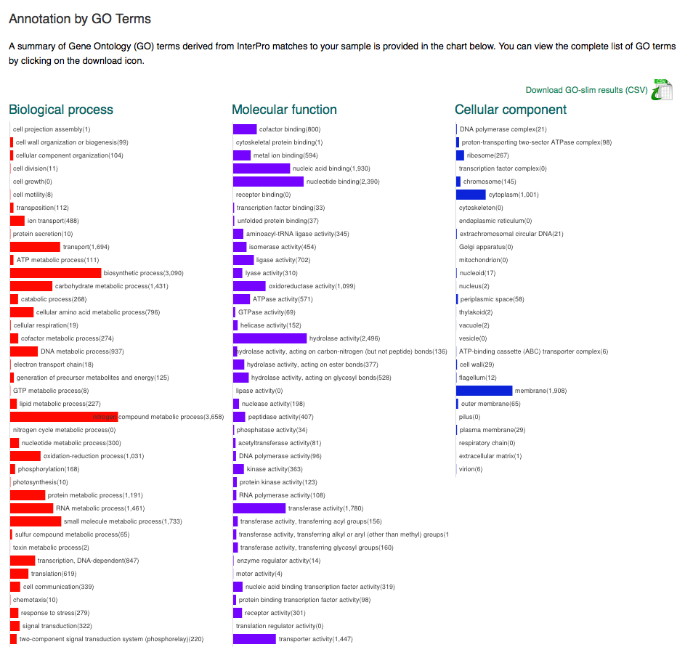
GO slims
Classification at user-defined levels (slims)

Slide 10
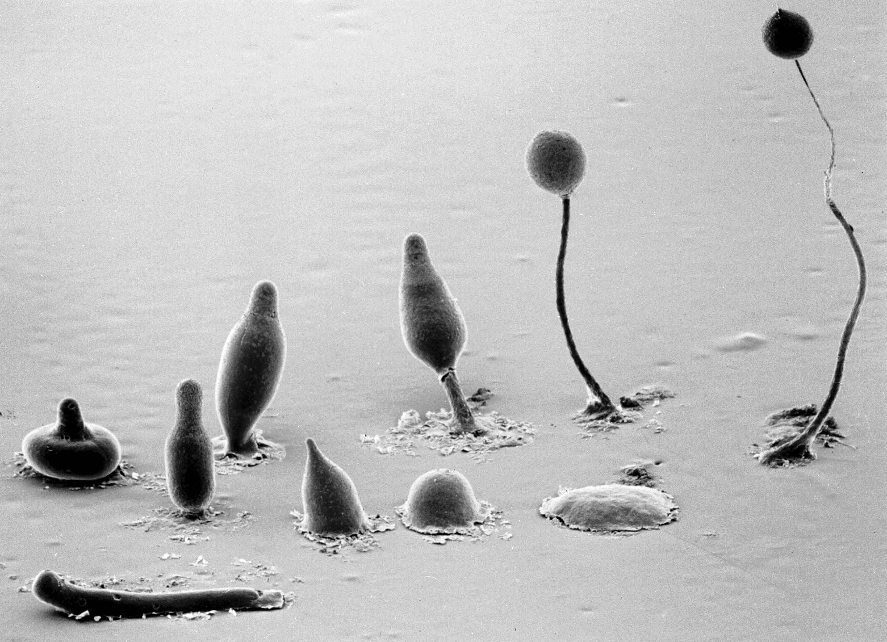
Notes:
some terms, especially lower-level, detailed terms may be specific to a certain group
e.g. photosynthesis
But when collapsed up to the higher levels, terms are not dependent on species

Slide 11
History
GO was developed as a system for annotating genes and proteins

Slide 12
Notes:
No defined semantics between gene and GO term in this model – we are in the process of moving to something more sophisticated
Evidence – which might be an assay – is separate to the

Slide 13
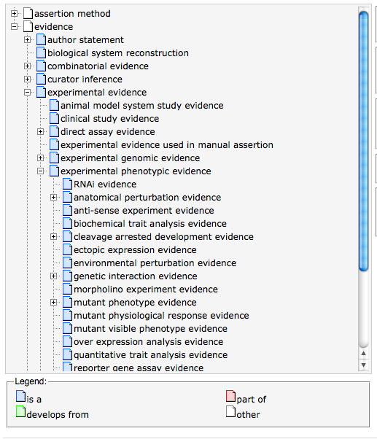
Evidence
The evidence for an annotation is separate from the ontology of real processes and components

Slide 14
Evolution of GO
From an initial core ‘ontology’ terms were added as they were needed

Slide 15
Evolution of GO
Terms are added in a reflexive manner – in response to requests
  by an ontology developer
  automatically via a ‘template’
small numbers of terms involved for each request

Slide 16
Evolution of GO
Or as part of a larger focused ontology/annotation development effort
  transcription
  cardiac conduction
  apoptosis

Slide 17
Evolution of GO
Leads to an uneven distribution of new terms
Branch depths variable
Bias results from
  annotation focus
  experimental trends
  species producing annotation

Slide 18

Evolution of GO
Terms also reflect the types of experiment being annotated
Annotation is for the underlying biological process, not the assay
Often you are limited in the statements you can make from the assay

Slide 19
For example:
  e.g. knock out gene A to create a mutant, observe effect

Slide 20
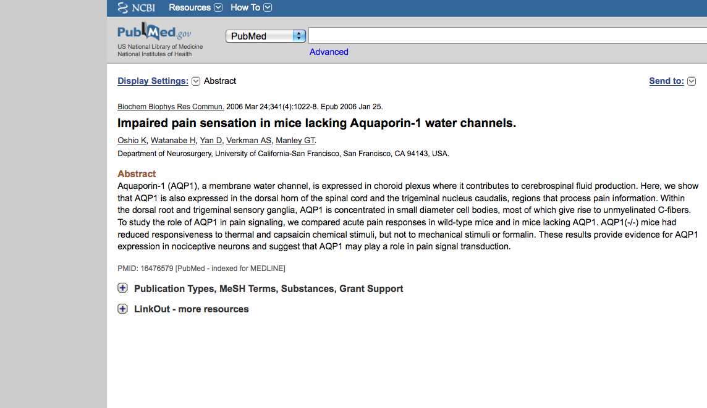

Slide 22
This is all that you can deduce from this experiment – that when this gene is not present, perception of pain is impaired
We can say nothing about the underlying process
This seems to be quite characteristic of neurobiology in GO

Slide 23
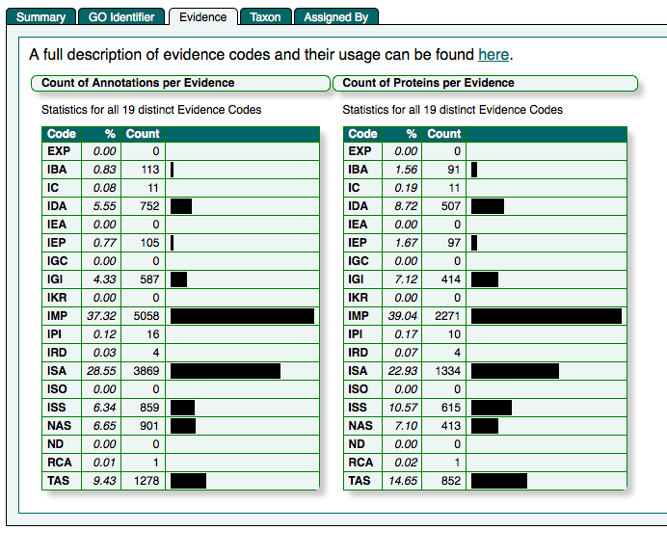

Slide 24
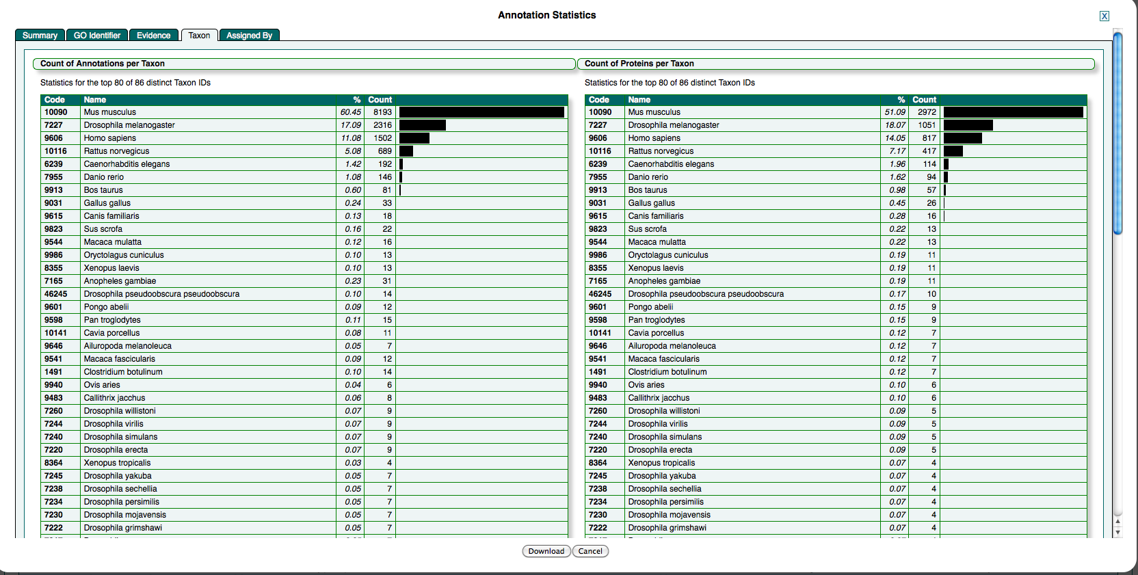

Slide 25
GO has several areas that reference neurobiology:
  high-level neurological system process, including behaviour, cognition, sensory perception, sensory processing
  cell-level processes: transmission of nerve impulse, synaptic transmission
  functions: neurotransmitter binding/receptor
Notes:
Show OE

Slide 26
Some higher level terms e.g. behaviour/cognition are borderline out-of-scope for GO
  behaviour already described in Neurobehaviour Ontology (NBO)
  Others?
  possibly MIREOT into GO although some technical issues with id spaces
Notes:
Thinking in terms of annotating individual genes

Slide 27
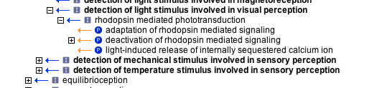
The sensory processing steps are unknown, whereas the detection process is often well-characterized e.g.

Slide 28
Moves into more granular, molecular processes:
  transmission of nerve impulse
  synaptic transmission
These core processes are not fully modeled or annotated right now.

Slide 29
More granular still – the realization of functions within these processes, e.g.
  binding of neurotransmitter to receptor
  neurotransmitter transporters

Slide 30
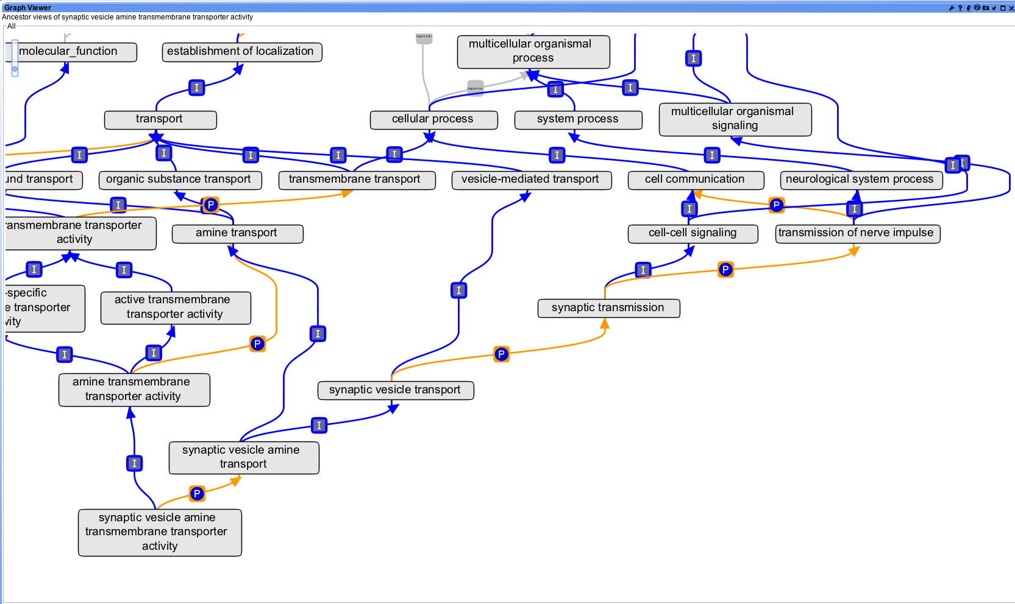

Slide 31
One potential problem here is the use of roles (neurotransmitter) in classification
by classifying e.g. acetylcholine binding as neurotransmitter binding
acetylcholine only acts as a neurotransmitter in certain contexts
In the gut it can act as vasodilator
So for an instance of acetylcholine binding in the gut, the inference acetylcholine binding is_a neurotransmitter binding is incorrect

Slide 32
The solution is to make context-specific subtypes e.g.
  acetylcholine binding involved in synaptic transmission

Slide 33
cellular components
Parts of neurons in scope for GO
Working with NIF to add missing components
Need relationships to specific cell types in CL

Slide 34
Conclusions
High-level neural processes and behaviours better covered by ontologies outside GO
Core neuron processes in GO need better ontology modeling and annotation
Most annotation is from model organisms, from mutant phenotypes

Slide 35
Thanks to David Hill

