Slide 1
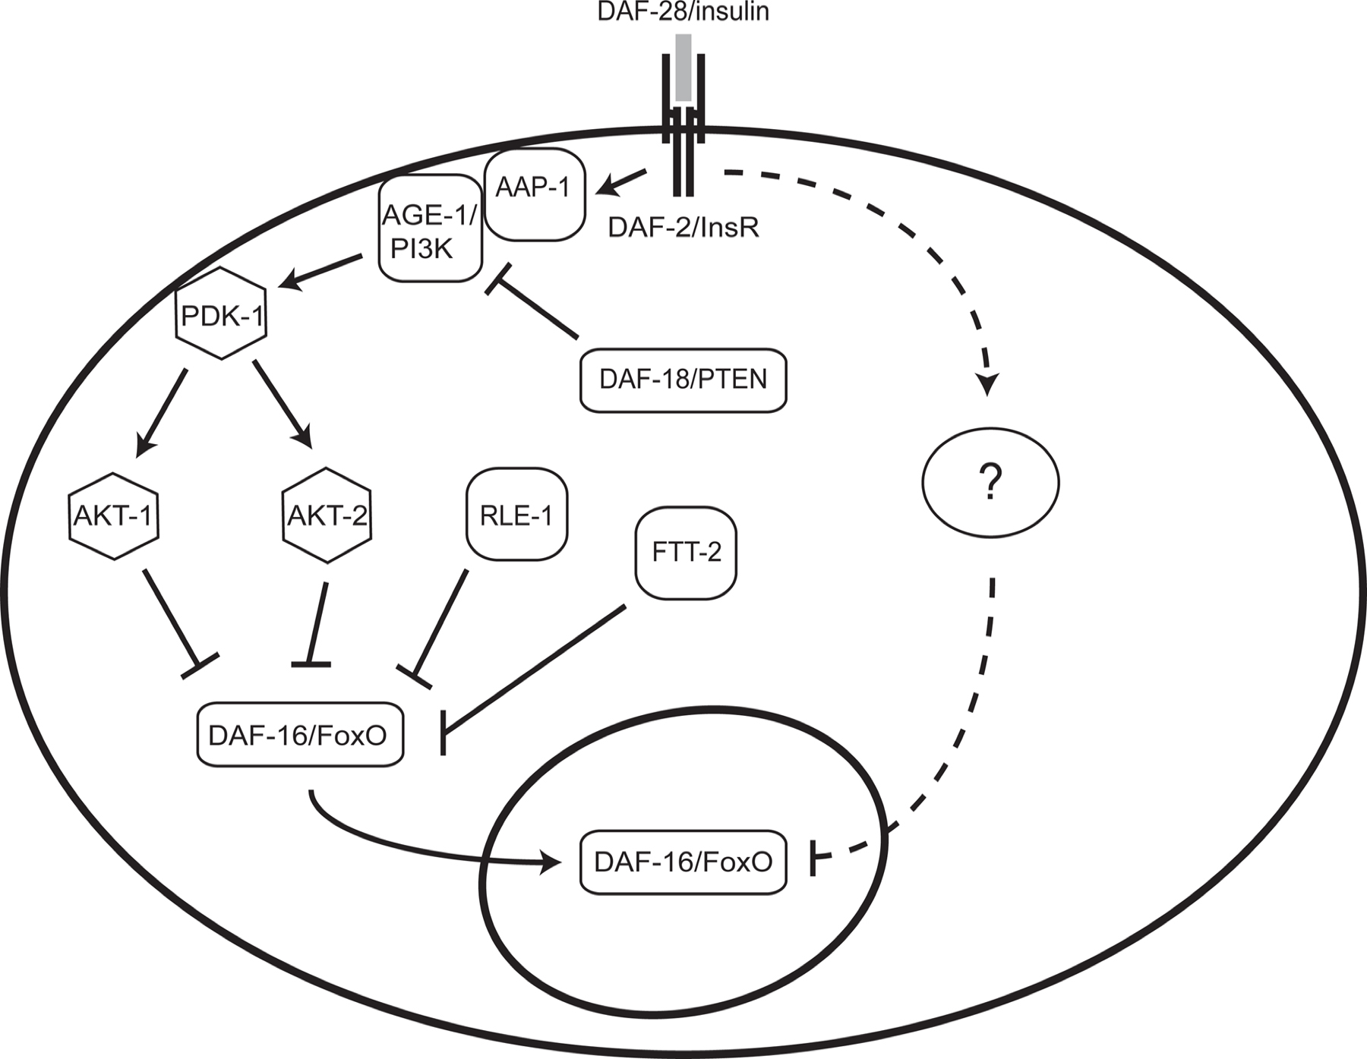
Increased expressivity in GO annotations

Slide 2
LEGO model expressed as UML

Slide 3
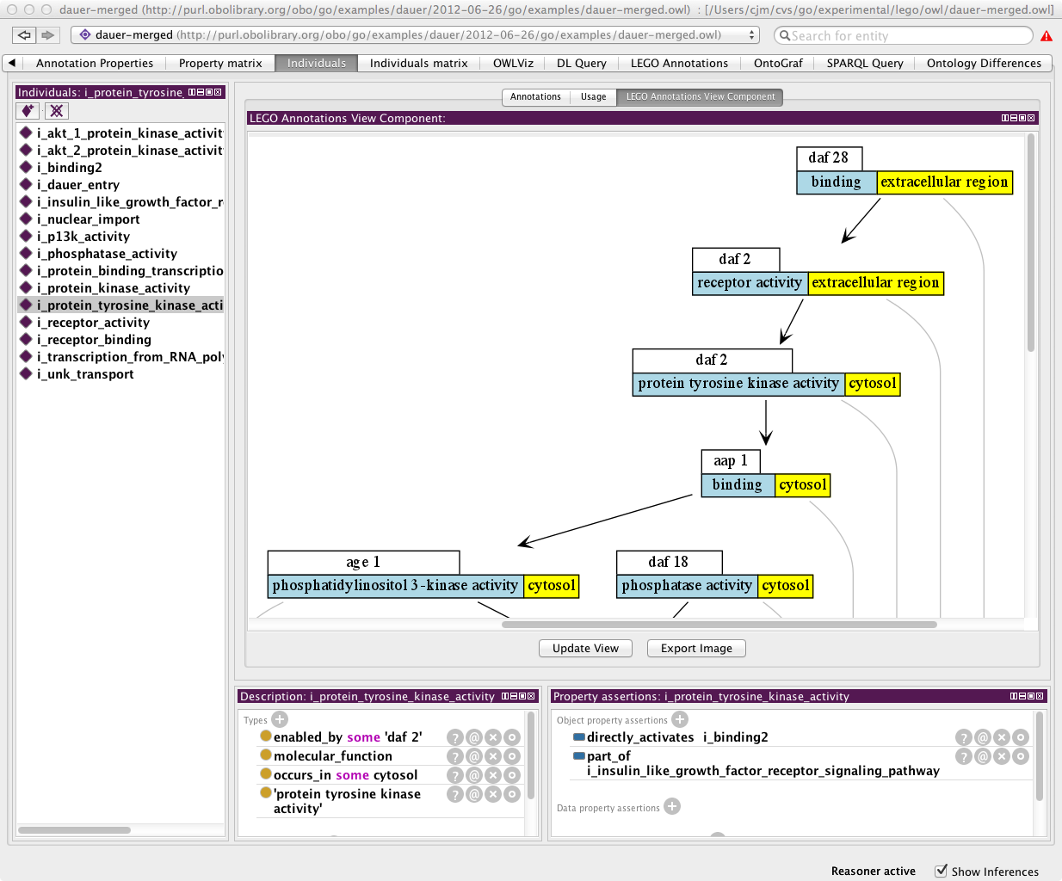
LEGO is a subset of RDF/OWL
Naturally extends GO model
Uses same relations as extended GO
occurs_in
part_of
Can use the same toolchain, reasoners
Easily extended for
Phenotype
Interaction

Slide 4
Current status: Prototyping stage
We’re building sample annotation sets using Protégé
LEGO plugin (Heiko)
Eventual goal is to build de novo / extend existing web application
Goals:
Test model
Refactor ontology as needed
Gather requirements
Generate test data set for next generation of tools

Slide 5
Relationship to c16
C16 semantics are formally OWL class expressions
See bio-ontologies 2012 presentation
Reasoner can determine equivalence/subsumption to existing pre-coordinated logically defined GO classes
Limited to depth of 1
Necessitates some awkward relations that do the work of nesting
LEGO extends this
No depth limit – full pathways are possible
Uses subset of relations
Composite relations expanded and individual elements filled in
Everything in c16 expressible in OWL

Slide 7
BFO2

Slide 8
GO and BFO2
Upper level ontologies contain abstract classes and relations that can be inherited or used in domain ontologies
E.g.
GO-CC, cell ontology, anatomy ontologies and CHEBI all represent physical entities; contrast with biological process
Useful for error checking
Upper ontologies come with baggage
Difficult to understand and apply
Competing standards
BFO (multiple versions)
SIO
GFO
DOLCE
…

Slide 9
The part_of relation
In GO we use the same parthood relations for all ontologies
Defined in 2005 Genome Biology paper
This was shared with other ontologies
BFO:0000050 “is part of” (2010 onwards – proposed BFO 2)
Not overloading: same axioms applied
Transitive, reflexive, anti-symmetric
Temporal interpretation: True at all times
Works well for GO

Slide 10
BFO 2, Graz release
BFO 2 development centered in Buffalo
BFO 2 has no generic part_of / has_part relation
Instead:
part of continuant at all times
part of continuant at all times that whole exists
part of continuant at some times
has continuant part at some times
has continuant part of at all times that part exists
has continuant part at all times
part of occurrent
has occurrent part
Note:
None of these work for the relationship between a nucleus and a cell
It’s to do with transfer between containers; see bfo mail list for gory details..
BFO2 takes a position on time and identity that makes other things difficult for us
Our position:
We are not ready to commit to BFO 2 at this time
We will provide converters for people who want to use GO+BFO2

