Slide 1
GO Galaxy

Slide 2
Enrichment
Enrichment analysis is a ‘killer app’ for GO
  Should be more central to what we do
  Also other tools: e.g. function prediction
Problem:
  Multiple tools with different characteristics
    Statistical method
    Environment / customizability
    Visualization
  Can we better help users:
    Select the right tool(s) for the job
    Run their analysis
    Build scalable workflows that allow replication
Notes:
Pre-processing data (e.g. IDs should be mapped beforehand)
Running the analysis (installation, parameter selection, etc.)
Interpreting and visualizing results
Comparing outputs of two or more tools
Replicate analysis

Slide 3
Solution: GO Tools Environment
Tools:
  Selecting the right tool
    Solution: Detailed, accurate, up-to-date metadata on each tool
  Galaxy: A standard platform for running analyses
    ‘operating system’ for bioinformatics analyses
    allows plug and play
  Combining tools
    Common community interchange standards for GO analysis tools
      Common term enrichment result format plus converters

Slide 4
Tool metadata: background
We have ~130 GO tools registered
  ~50 TEA tools
  We don’t have all of them
  Some info out of date
We need to capture more metadata
  We want to be able to quickly answer queries like
    Find an EA tool that
      uses hypergeometric tests
      can be used for <my species>
      has not updated their annotation sets in > 6 mo
      has visualization
      I can use for my RNAseq data

Slide 5
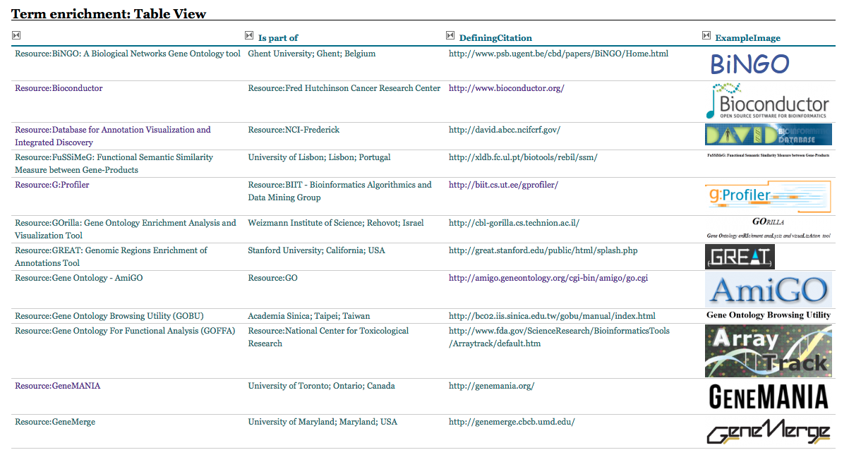
New Tools Registry

Slide 6
Standard Term Enrichment Analysis Platform: background
Tools run in their own environment
  Difficult to
    Compare
    Integrate into larger workflows
    Provide uniform interface
Solution:
  Standard workflow environment
    Variety of workflow systems
      Kepler
      Galaxy
      Taverna
    Galaxy has a number of advantages
      Simple to set up and extend
      heavily used for next-gen analyses
      Tools for intermine etc

Slide 7
GO Galaxy Environment
    http://galaxy.berkeleybop.org

Slide 8
Interchange Standards: progress/tools
Progress
  google code project created
    http://code.google.com/p/terf/
  preliminary format specified
    TSV form and RDF/turtle form
  some converters written
    ermine/J, ontologizer
Ongoing tasks:
  complete specification
    public working draft for comments
    incorporate comments
    final specification
  Outreach
    work with tool developers
  write additional converters
    target command-line tools that provide diverse capabilities

Slide 10
Summary

Slide 11
Biological Modeling

Slide 12
The Gene Ontology
A vocabulary of 37,500* distinct, connected descriptions that can be applied to gene products
That’s a lot…
  How big is the space of possible descriptions?
^{*April 2013}
Notes:
1

Slide 13
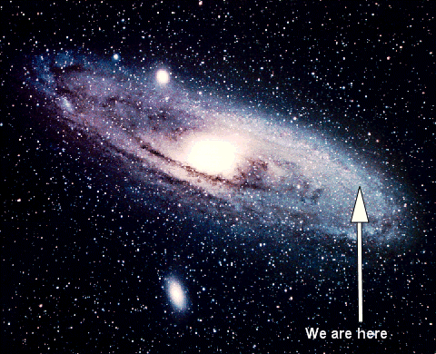
Notes:
Sweet spot in a large galaxy

Slide 14
Current descriptions miss details
Author:
  LMTK1 (Aatk) can negatively control axonal outgrowth in cortical neurons by regulating Rab11A activity in a Cdk5-dependent manner
      http://www.ncbi.nlm.nih.gov/pubmed/22573681
GO:
  Aatk: GO:0030517 negative regulation of axon extension
The set of classes in GO will always be a subset of total set of possible descriptions

Slide 15
OWL underpins GO
OWL is a Description Logic
  Allows building block approach
Under the hood everywhere in GO
  TermGenie
  AmiGO 2
  But not OBO-Edit
Key to expressivity extensions in GO
  Annotation extensions
  LEGO

Slide 16
Transition to OWL in ontology engineering
Two workshops
  Hinxton 2012
  Berkeley 2013
Currently hybrid tool solution
  OBO-Edit
  Protégé 4
  Jenkins
  TermGenie

Slide 17
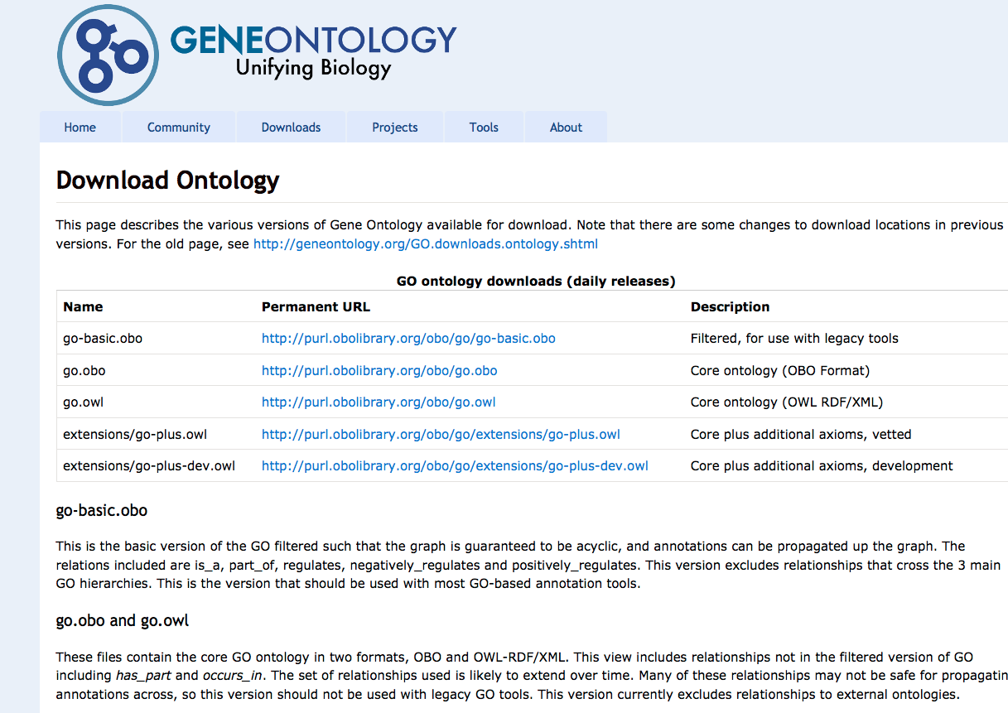

Slide 18
Composing descriptions
Curators need to be able to compose their complex descriptions from simpler descriptions
  TermGenie:
    With a Term ID, name, definition, etc – Pre-composition
  Annotation extensions
    Post-composition
  Same OWL model under the hood
http://www.geneontology.org/GO.format.gaf-2_0.shtml

Slide 19
“Classic” annotation model
Gene Association Format (GAF) v1
  Simple pairwise model
  Each gene product is associated with an (ordered) set of descriptions
    Where each description == a GO term
http://www.geneontology.org/GO.format.gaf-1_0.shtml

Slide 20
GO annotation extensions
Gene Association Format (GAF) v1
  Simple pairwise model
  Each gene product is associated with an (ordered) set of descriptions
    Where each description == a GO term
Gene Association Format (GAF) v2 (and GPAD)
  Each gene product is (still) associated with an (ordered) set of descriptions
  Each description is a GO term plus zero or more relationships to other entities
    Description is an OWL anonymous class expression (aka description)
http://www.geneontology.org/GO.format.gaf-2_0.shtml
Notes:
Not ad-hoc – OWL description

Slide 21
“Classic” GO annotations are unconnected
protein localization to nucleus[GO:0034504]
positive regulation of transcription from pol II promoter in response to oxidative stress[GO:0036091]
pap1
sty1
cellular response to oxidative stress
[GO:0034599]
DB | Object | Term | Ev | Ref |  | ..
PomBase | sty1 SPAC24B11.06c | GO:0034504 | IMP | PMID:9585505 | .. | .. | ..
PomBase | sty1 SPAC24B11.06c | GO:0034599 | IMP | PMID:9585505 | .. | ..
PomBase | pap1 SPAC1783.07c | GO:0036091 | IMP | PMID:9585505 |  | ..

Slide 22
Now with annotation extensions
protein localization to nucleus[GO:0034504]
cellular response to oxidative stress
[GO:0034599]
positive regulation of transcription from pol II promoter in response to oxidative stress[GO:0036091]
happens
during
sty1
pap1
has
input
<anonymous
description>
<anonymous
description>
has regulation
target
DB | Object | Term | Ev | Ref |  | Extension
PomBase | sty1 SPAC24B11.06c | GO:0034504 protein localization to nucleus | IMP | PMID:9585505 | .. | happens_during(GO:0034599), has_input(SPAC1783.07c) | ..
PomBase | pap1 SPAC1783.07c | GO:0036091 | IMP | PMID:9585505 |  | has_reulation_target(…)
Notes:
Key point: logically equivalent to an annotation to a term in the <anon desc> box, with the same links out.

Slide 23
Where do I get them?
Download
  http://geneontology.org/GO.downloads.annotations.shtml
    MGI (22,000)
    GOA Human (4,200)
    PomBase (1,588)
Search and Browsing
  Cross-species
    AmiGO 2 – http://amigo2.berkeleybop.org
    QuickGO (later this year) - http://www.ebi.ac.uk/QuickGO/
  MOD interfaces
    PomBase – http://bombase.org

Slide 24
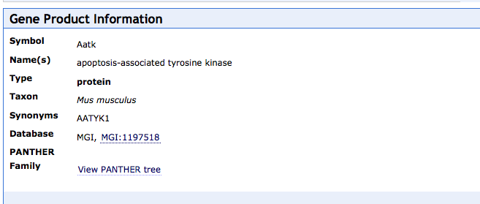
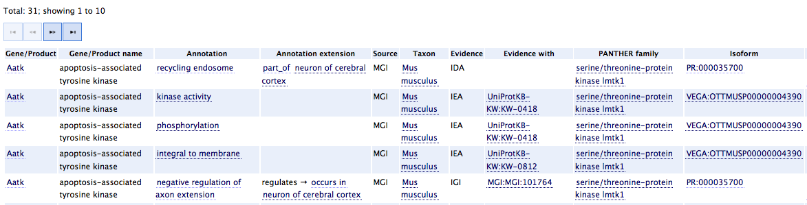
Query tool support: AmiGO 2
Annotation extensions make use
of other ontologies
CHEBI
CL – cell types
Uberon – metazoan anatomy
MA – mouse anatomy
EMAP – mouse anatomy
….
CL
– http://amigo2.berkeleybop.org

Slide 25

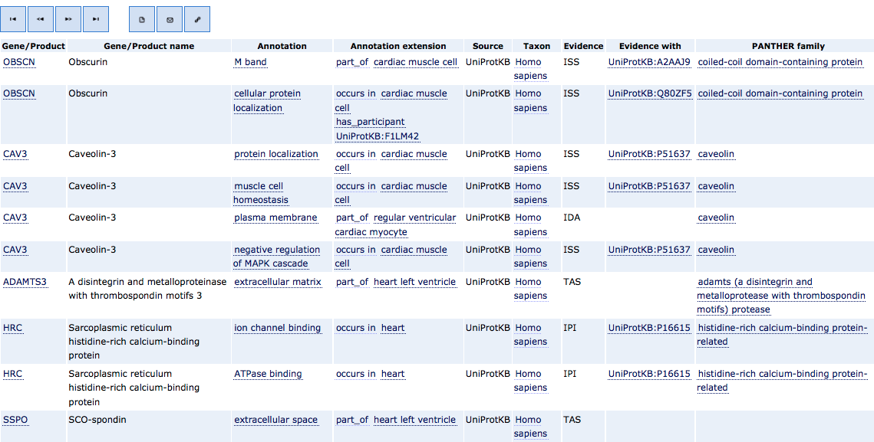
CL, Uberon
– http://amigo2.berkeleybop.org

Slide 26

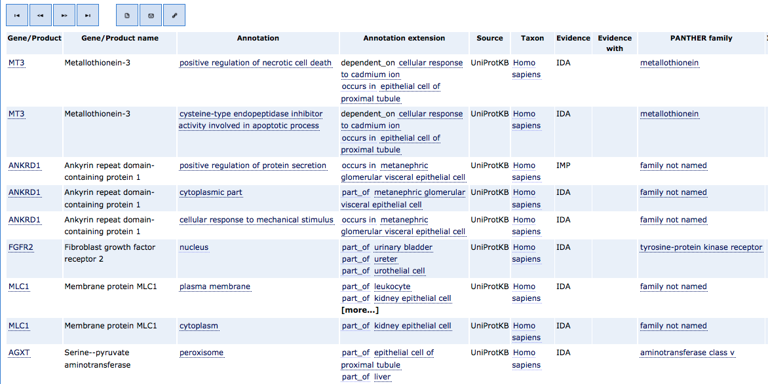
CL, Uberon
– http://amigo2.berkeleybop.org

Slide 27
Curation tool support
Supported in
  Protein2GO (GOA, WormBase)
  CANTO (PomBase)
  MGI curation tool

Slide 28
Analysis tool support
Currently: Enrichment tools do not yet support annotation extensions
  Annotation extensions can be folded into an analysis ontology - http://galaxy.berkeleybop.org
Future: Analysis tools can use extended annotations to their benefit
  E.g. account for other modes of regulation in their model

Slide 29
Challenge: pre vs post composition
Curator question: do I…
  Request a pre-composed term via TermGenie[*]?
  Post-compose using annotation extensions?
See Heiko’s TermGenie talk tomorrow & poster #33

Slide 30
Challenge: pre vs post composition
Curator question: do I…
  Request a pre-composed term via TermGenie?
  Post-compose using annotation extensions?
From a computational perspective:
  It doesn’t matter, we’re using OWL
  40% of GO terms have OWL equivalence axioms
protein localization to nucleus[GO:0034504]
≡
end_location
protein localization [GO:0008104]
⊓
Nucleus [GO:0005634]
http://code.google.com/p/owltools/wiki/AnnotationExtensionFolding

Slide 31
Curation Challenges
Manual Curation
  Fewer terms, but more degrees of freedom
  Curator consistency
    OWL constraints can help
Automated annotation
  Phylogenetic propagation
  Text processing and NLP

Slide 32
Conclusions
Description space is huge
  Context is important
  Not appropriate to make a term for everything
  OWL allows us to mix and match pre and post composition
Number of extension annotations is growing
Annotation extensions represent untapped opportunity for tool developers

Slide 33
T63 Toxic effect of contact with venomous animals and plants
Term from ICD-10, a hierarchical medical billing code system use to ‘annotate’ patient records

Slide 34
T63 Toxic effect of contact with venomous animals and plants
  T63.611 Toxic effect of contact with Portugese Man-o-war, accidental (unintentional)

Slide 35
T63 Toxic effect of contact with venomous animals and plants
  T63.611 Toxic effect of contact with Portugese Man-o-war, accidental (unintentional)
  T63.612 Toxic effect of contact with Portugese Man-o-war, intentional self-harm

Slide 36
T63 Toxic effect of contact with venomous animals and plants
  T63.611 Toxic effect of contact with Portugese Man-o-war, accidental (unintentional)
  T63.612 Toxic effect of contact with Portugese Man-o-war, intentional self-harm
  T63.613 Toxic effect of contact with Portugese Man-o-war, assault

Slide 37
T63 Toxic effect of contact with venomous animals and plants
  T63.611 Toxic effect of contact with Portugese Man-o-war, accidental (unintentional)
  T63.612 Toxic effect of contact with Portugese Man-o-war, intentional self-harm
  T63.613 Toxic effect of contact with Portugese Man-o-war, assault
    T63.613A Toxic effect of contact with Portugese Man-o-war, assault, initial encounter
    T63.613D Toxic effect of contact with Portugese Man-o-war, assault, subsequent encounter
    T63.613S Toxic effect of contact with Portugese Man-o-war, assault, sequela

Slide 38
Goals: Transition
Where we were: Classic GO
  Large tangle of manually maintained strings largely opaque to computation
  Ontology editing
Where we want to be: Computable model of biology
  Composition of descriptions from building blocks
  Flexibility as to where in product lifecycle the composition takes place
  Ontology engineering
Where we are:
  Somewhere in between

Slide 39
Steps
Computable language: OWL

Slide 40
Modeling enhancements: overview
Enhancements:
  Increased expressivity in ontology
  Increased expressivity in traditional gene associations
  Future: A new model for GO annotation
Underpinning this all:
  Transition to OWL as a common model

Slide 41
What is OWL?
Web Ontology Language
More than just a format
Allows for reasoning

Slide 42
Increased expressivity in ontology
Problem
  Traditional ontology development leads to large difficult to maintain ontologies
    Errors of omission and comission
Solution
  Refactor ontology to include additional logical axioms (e.g. logical definitions)
  Use OWL reasoners to automatically build hierarchy and detect errors
  Use TermGenie for de-novo terms

Slide 43
Challenges: Tools
Challenges
  OBO-Edit very efficient for editors to use, but limited support for reasoning and leveraging external ontologies
  Protégé has good OWL and reasoning support, but clunky and inefficient for editors
Approach
  Hybrid environment
  Obo2owl converters
  Debugging and high level design in Protégé
  Refactoring and day to day editing in OBO-Edit
  New terms in TermGenie
  Continuous Integration server

Slide 44
Nothing to see here, move along…

Slide 45
Example (basic GO annotation)
Negative regulation of axon extension [GO:0030517]
Aatk
 |  | ..
Aatk | GO:0030517 | .. | PMID:22573681 | ..
LMTK1 (Aatk) can negatively control axonal outgrowth in cortical neurons

Slide 46
Now with annotation extensions
negative regulation of axon extension [GO:0030517]
cortical neuron
[CL:0002609]
occurs
in
Aatk
Rab11a
DB | Obj | Term | .. | Ref |  |  | Ext
MGI | Aatk | GO:0030517 | .. | PMID:22573681 | .. | .. | occurs_in(CL:0002609) | ..
LMTK1 (Aatk) can negatively control axonal outgrowth in cortical neurons

Slide 47
Pre-composition: creating terms prior to annotation
Sensible pre-composition
  Build terms as OWL descriptions from simpler terms
  See TermGenie talk tomorrow
There are limits to what should be pre-composed….

Slide 48
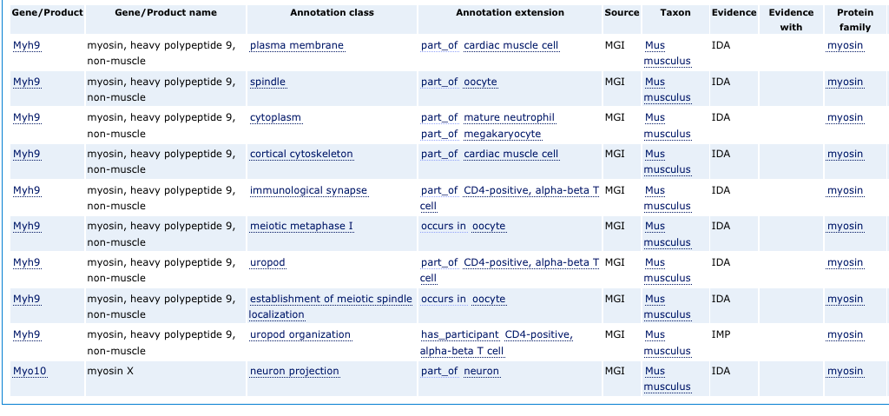

Slide 50
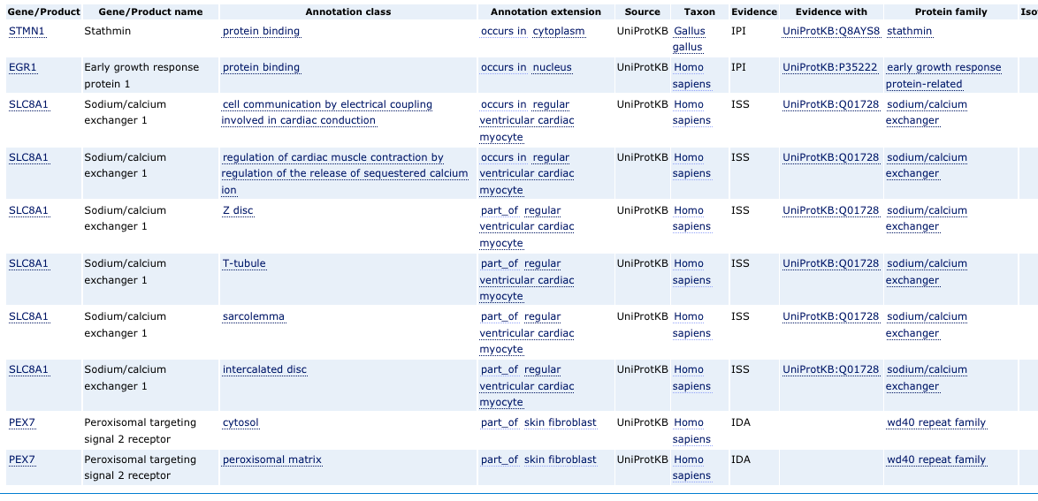
http://amigo2.berkeleybop.org

Slide 51
Results/Status
Current:
  Mouse
    MGI: 22k
    GOA: 696
  Human
    GOA: 3110
  Other species
    GOA
  Fission yeast
    PomBase 1588
More coming
  Transition to Protein2GO
Notes:
gzip -dc submission/gene_association.goa_mouse.gz | perl -ne '@x=split(/\t/);print if $x[15] && $x[14] ne "MGI"'

Slide 52
Example simple annotation
protein localization to nucleus[GO:0034504]
sty1
DB | Object | Term | Ev | Ref |  | .. | Extension
PomBase | sty1 SPAC24B11.06c | GO:0034504 protein localization to nucleus | IMP | PMID:9585505 | .. | .. | -

Slide 53
Unfolding and folding
protein localization [GO:0008104]
Nucleus [GO:0005634]
OWL:
Class: ‘protein localization to nucleus’
EquivalentTo: ‘protein localization’
and has_target_end_location
some nucleus
end
location
sty1
DB | Object | Term | Ev | Ref |  | .. | Extension
PomBase | sty1 SPAC24B11.06c | GO:0008104 protein localization | IMP | PMID:9585505 | .. | .. | has_target_end_location(GO:0005634)

Slide 54
Example PomBase annotations
protein localization to nucleus[GO:0034504]
cellular response to oxidative stress
[GO:0034599]
positive regulation of transcription from pol II promoter in response to oxidative stress[GO:0036091]
happens
during
sty1
pap1
has regulation
target
has
input
DB | Object | Term | Ev | Ref |  | Extension
PomBase | sty1 SPAC24B11.06c | GO:0034504 | IMP | PMID:9585505 | .. | happens_during(GO:0034599), has_input(SPAC1783.07c) | ..
PomBase | pap1 SPAC1783.07c | GO:0036091 | IMP | PMID:9585505 |  | has_reulation_target(…)| has_regulation_target(…)|…

Slide 55
LEGO / MF-based model
protein localization to nucleus[GO:0034504]
positive regulation of transcription from pol II promoter in response to oxidative stress[GO:0036091]
cellular response to oxidative stress
[GO:0034599]
happens
during
sty1
kinase activity
pap1
has regulation
target
enabled
by
has
input
DB | Object | Term | Ev | Ref |  | Extension
PomBase | sty1 SPAC24B11.06c | GO:0034504 | IMP | PMID:9585505 | .. | happens_during(GO:0034599), has_input(SPAC1783.07c) | ..
PomBase | pap1 SPAC1783.07c | GO:0036091 | IMP | PMID:9585505 |  | has_reulation_target(…)| has_regulation_target(…)|…

Slide 58
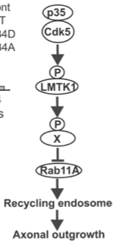

Slide 59
Basic GO annotation model
GO Annotations are essentially pairs <G,T>
  (Setting aside evidence, provenance, and a few abstruse details for the moment)
  Tab delimited Gene Association Format (GAF)
Strength in simplicity
  Over 120 registered tools that use the GO, e.g. term enrichment tools
  Annotations contributed from multiple databases
Drawback:
  No way to compose more complex descriptions from constituent terms
    A gene can be annotated with multiple terms but this is strictly weaker than composing a new class description

Slide 60
Annotation scenario
I need a term ‘xanthine biosynthesis’ to annotate my gene
  (let’s pretend) there is no such term in GO
  GO has ‘biosynthesis’
  CHEBI has ‘xanthine’
Previous solution:
  Annotator makes new term request to ontology editors using tracker
  Ontology editors manually add the new term and send back ID
  Problem: inefficient, bottleneck

Slide 61
Current solution: assisted pre-composition
Annotator uses TermGenie web template form to create new term
  Selects ‘xanthine’ from CHEBI
  New term and axiom:
    ‘xanthine biosynthesis’ EquivalentTo
    biosynthesis and has_output some xanthine
  added to ontology
  Reasoner (Elk) computes graph placement
  Annotator can use new term immediately
    No ontology editor bottleneck
Annotator has some level of increased expressivity
  Terms can be combined within a certain restricted space
Problem solved?
  Possible concerns over ‘ontology inflation’
  Will this work for all scenarios?
http://go.termgenie.org
http://wiki.geneontology.org/index.php/Ontology_extensions

Slide 62
Scenario #2
Annotator needs to describe a gene product that phosphorylates another gene product, PPP1CC
We could use TermGenie to autogenerate new pre-composed term ‘phosphorylation of PPP1CC’…
  Excess pre-composition

Slide 63
Solution: Post-composition using Annotation Extensions
Each <G,T> pair is adorned list of extension pairs
  Stored in column 16 in the GAF2.0 format
Syntax:
  Each pair is of the form R(Y)
  Y can be GO class or external ontology or class representation of a gene product or complex
  R is a relation symbol e.g. has_input
Semantics:
  Each of these pairs is an OWL SomeValuesFrom restriction
    R some Y
  This has the effect of making the annotation to a new anonymous class expression
    Intersection of T and all the specified restrictions

Slide 64
Example
db | id |  | GO term |  |  | evidence |  |  |  |  |  |  |  |  | extension
MGI | 135948 |  | GO:0005886 |  |  | IDA |  |  |  |  |  |  |  |  | part_of(CL:0000084)
Annotation:
  Gene product = Slp1
  GO term = GO:0005886 (plasma membrane)
  Extension = part_of(CL:0000084)
    (this is the cell ontology ID for ‘T cell’)
Semantics:
  Equivalent to an annotation to a new term that has an equivalence axiom to:
    ‘plasma membrane’ and part_of some ‘T cell’

Slide 65
Where do I get these?
GO annotation downloads
  http://www.geneontology.org/GO.downloads.annotations.shtml
  GAF 2.0
Number of annotations with extensions
  UniProtKB – 3000
  PomBase – 425
  MGI – 12274
Small proportion of corpus have extensions, but growing fast
  More groups moving to EBI protein2go annotation system

Slide 66

What about tool support?
Almost all tools (e.g. term enrichment) assume pre-coordination model
  Band-aid: Use reasoning to find most specific named class for each anonymous class expression
  Other options: back-door pre-coordination
    Generate pre-coordinated analysis ontology
    Materialize all anonymous class expressions
    Optionally materialize least common subsumer class expressions
  Neither of these take full advantage of the additional semantics
Our preferred solution:
  Tools adapt - use the OWLAPI + reasoners
  Opportunity: We need YOU to write the Killer app

Slide 67
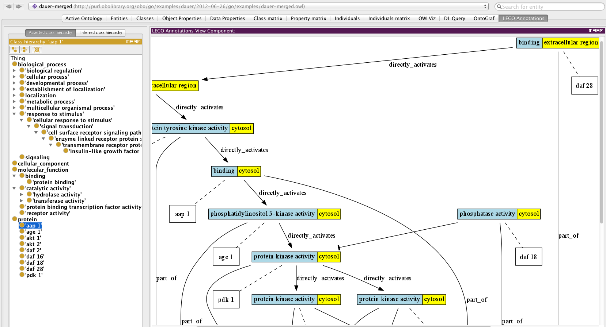
The next phase: Annotation graphs
GAF2.0 gives a lot more expressive power to curators
Still not enough to do justice to the biology
We are currently prototyping a less restricted subset of OWL
Capable of describing pathways in a way consistent with the GO model
org.geneontology.lego Protégé plugin: http://code.google.com/p/owltools/downloads/list

Slide 68
Acknowledgments
Amelia Ireland
Heiko Dietze
Valerie Wood
Midori Harris
David Hill
Emily Dimmer
Tony Sawford
Paul Sternberg
Suzanna Lewis
Paul Thomas

Slide 69
GO as a community resource

Slide 70
AmiGO 2 and Solr

Slide 71
AmiGO 2: Background
Background:
  MySQL database has been at core of GO since 2000
  Drives PAINT, AmiGO
Problem
  MySQL/RDBMS no longer a good fit for many GO requirements (fast website, faceted browsing)
Plan
  Migrate to Solrbackend (Golr)
  Rewrite AmiGO to use Golr
  Provide fast faceted search
  Keep pace with increased expressivity in GO
  Share components with QuickGO and other software

Slide 72
AmiGO 2: Results
Status: beta release
Loader code ported to use java and OWL API for pre-computing ontology operations
Frontend code rewritten to be lightweight and make increased use of javascript
Graphics from QuickGO
Faceted browsing
Generic – being adapted by other groups
Leverages full expressivity of GO
  Full evidence ontology
  Annotation extensions
  External ontologies

Slide 73
AmiGO 2 screenshot

Slide 74
AmiGO 2 plans
Reuse Golr backend in QuickGO
Open community development model
  Generic model, easily customized
  Being adopted by other groups

Slide 75
GO WebSite

