Slide 1
The Gene Ontology Project
What can it do for you?
Jane Lomax

Slide 2

Notes:
About to release a new Drupal-based website, this is the new logo

Slide 3
capturing and describing biological function…
Notes:
The Gene Ontology is a major project which has the aim of capturing and describing biological function of biological entities such as proteins and RNAs on a large scale and in a systematic, standardized way, and making that data accessible such that meaningful biological questions can be made of it.

Slide 4
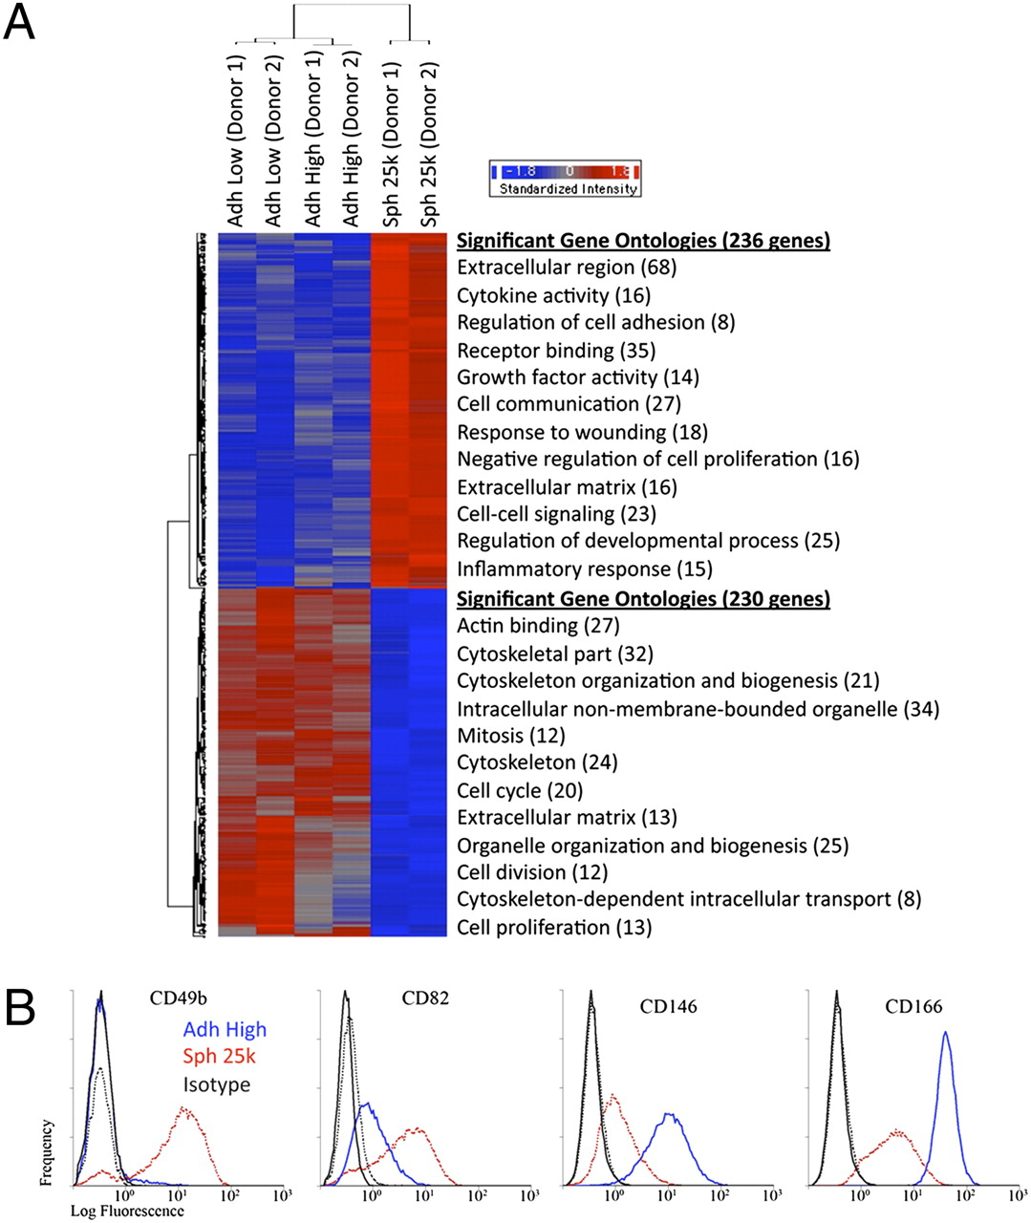
Microarray assays of hMSCs from two donors.
Bartosh T J et al. PNAS 2010;107:13724-13729
©2010 by National Academy of Sciences
Notes:
Microarray assays of hMSCs from two donors. (A) Hierarchical clustering of differentially expressed genes. Genes that were either up- (236 genes) or down-regulated (230 genes) in spheroids (Sph 25k) at least twofold compared with their adherent culture counterparts (Adh Low and Adh High), were used in hierarchical clustering. The most significant Gene Ontology terms for up-regulated genes (red) and down-regulated genes (blue) are shown next to the heat map. (B) Flow cytometry of differentially expressed surface epitopes on hMSCs. Abbreviations: as in Fig. 1.

Slide 5
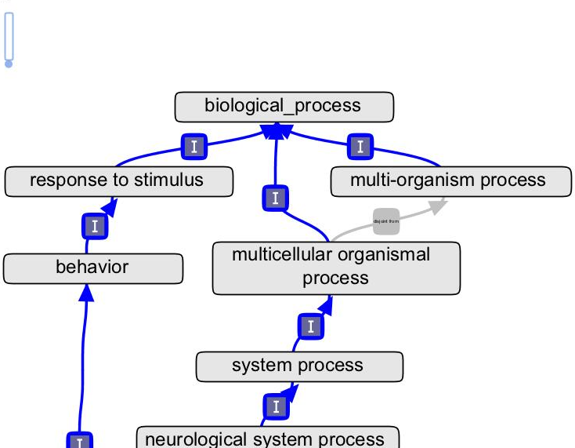
3
ontologies
Notes:
Biological entities are associated with terms from a set of 3 ontologies

Slide 6
normal processes, subcellular components and functions

Slide 7
Notes:
No defined semantics between gene and GO term in this model – we are in the process of moving to something more sophisticated
Evidence – which might be an assay – is separate to the

Slide 8
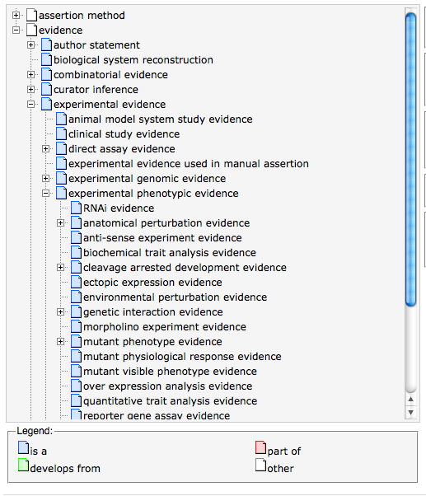
evidence
Notes:
The evidence for an annotation is separate from the ontology of real processes and components
ECO

Slide 9
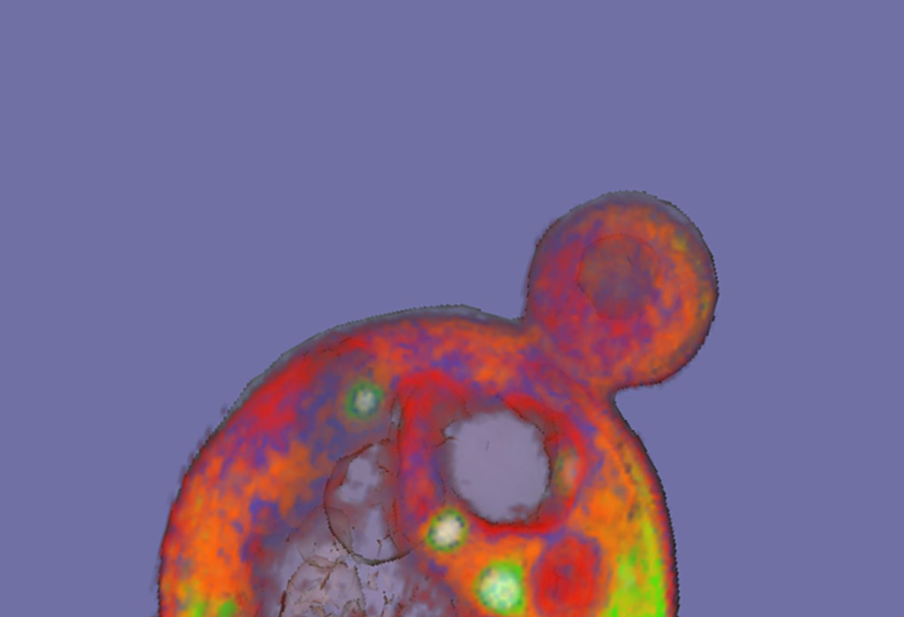
Databases
Notes:
GO annotations are made by independent dbs who comprise the GOC
Collaborate to make sure annotation practice is consistent across species
GO is applicable across all species including prokaryotes and viruses

Slide 10
GO database
gene -> GO term
associated genes
genome and protein databases
Notes:
The individual genome and protein databases submit their genes and proteins annotated to GO terms to a central GO database.
In turn consumed by many downstream tools
Contributing dbs submit annotations in GAF, this will be switching imminently to a new denormalized format, GPAD

Slide 11
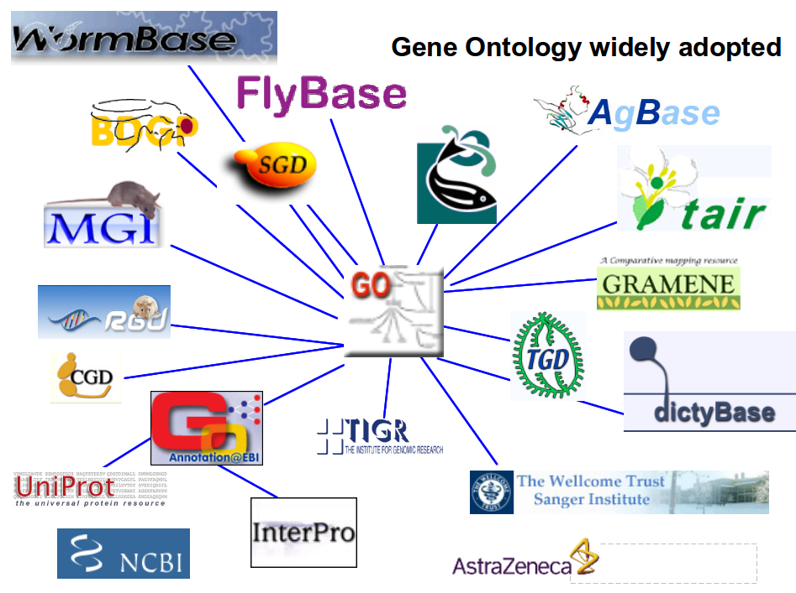
Notes:
All the submitting groups
Covers most taxonomic groups, although prokaryotes not well represented

Slide 12
Annotation status - all
http://build.berkeleybop.org/view/Statistics/job/GOlr%20stats/lastBuild/console

Slide 13
AmiGO 2
http://amigo2.berkeleybop.org/cgi-bin/amigo2/amigo

Slide 14
annotation models
Notes:
Going to talk about some of the systems for annotating used by the GOC

Slide 15

manual
annotation
Notes:
Carried out by a human curator

Slide 16

Notes:
Traditionally by curators directly from experimental literature
This is the gold standard method
Not scalable for all species

Slide 17
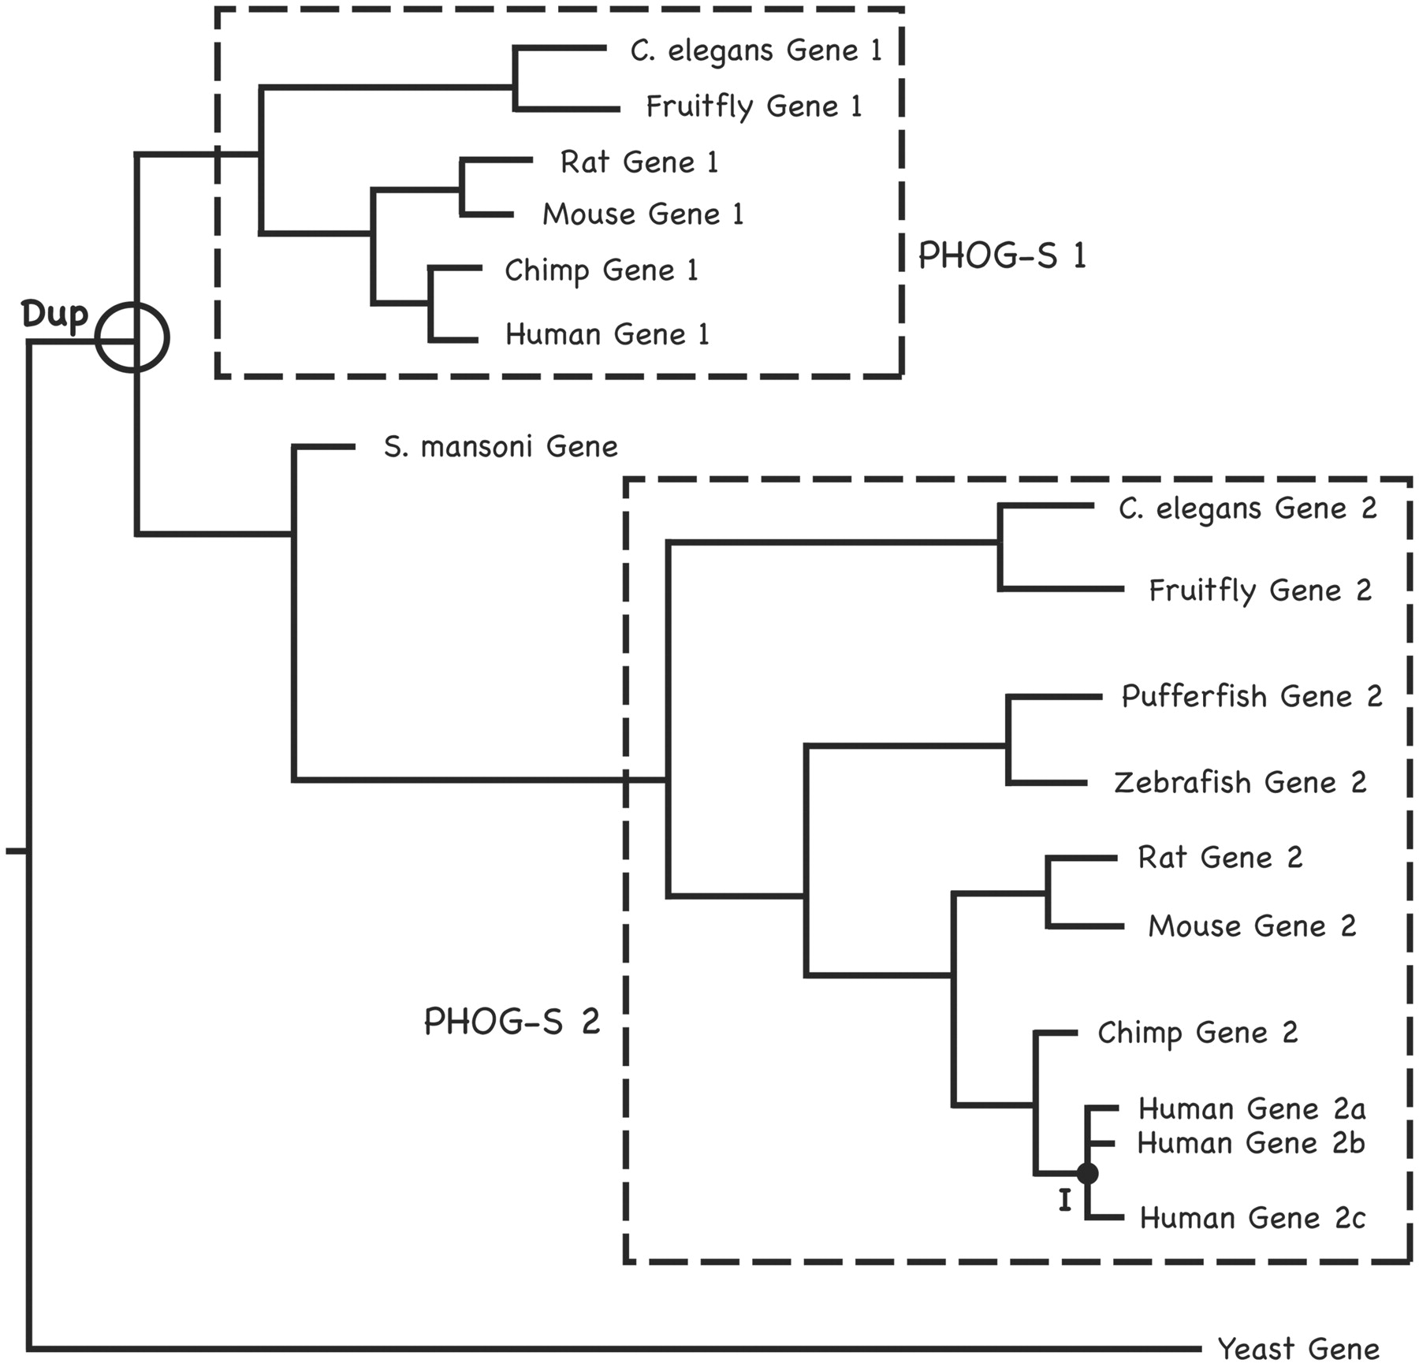
orthology
Notes:
This sort of manual annotation is expensive, so it makes sense to propagate these where orthology amongst species can be established.

Slide 18
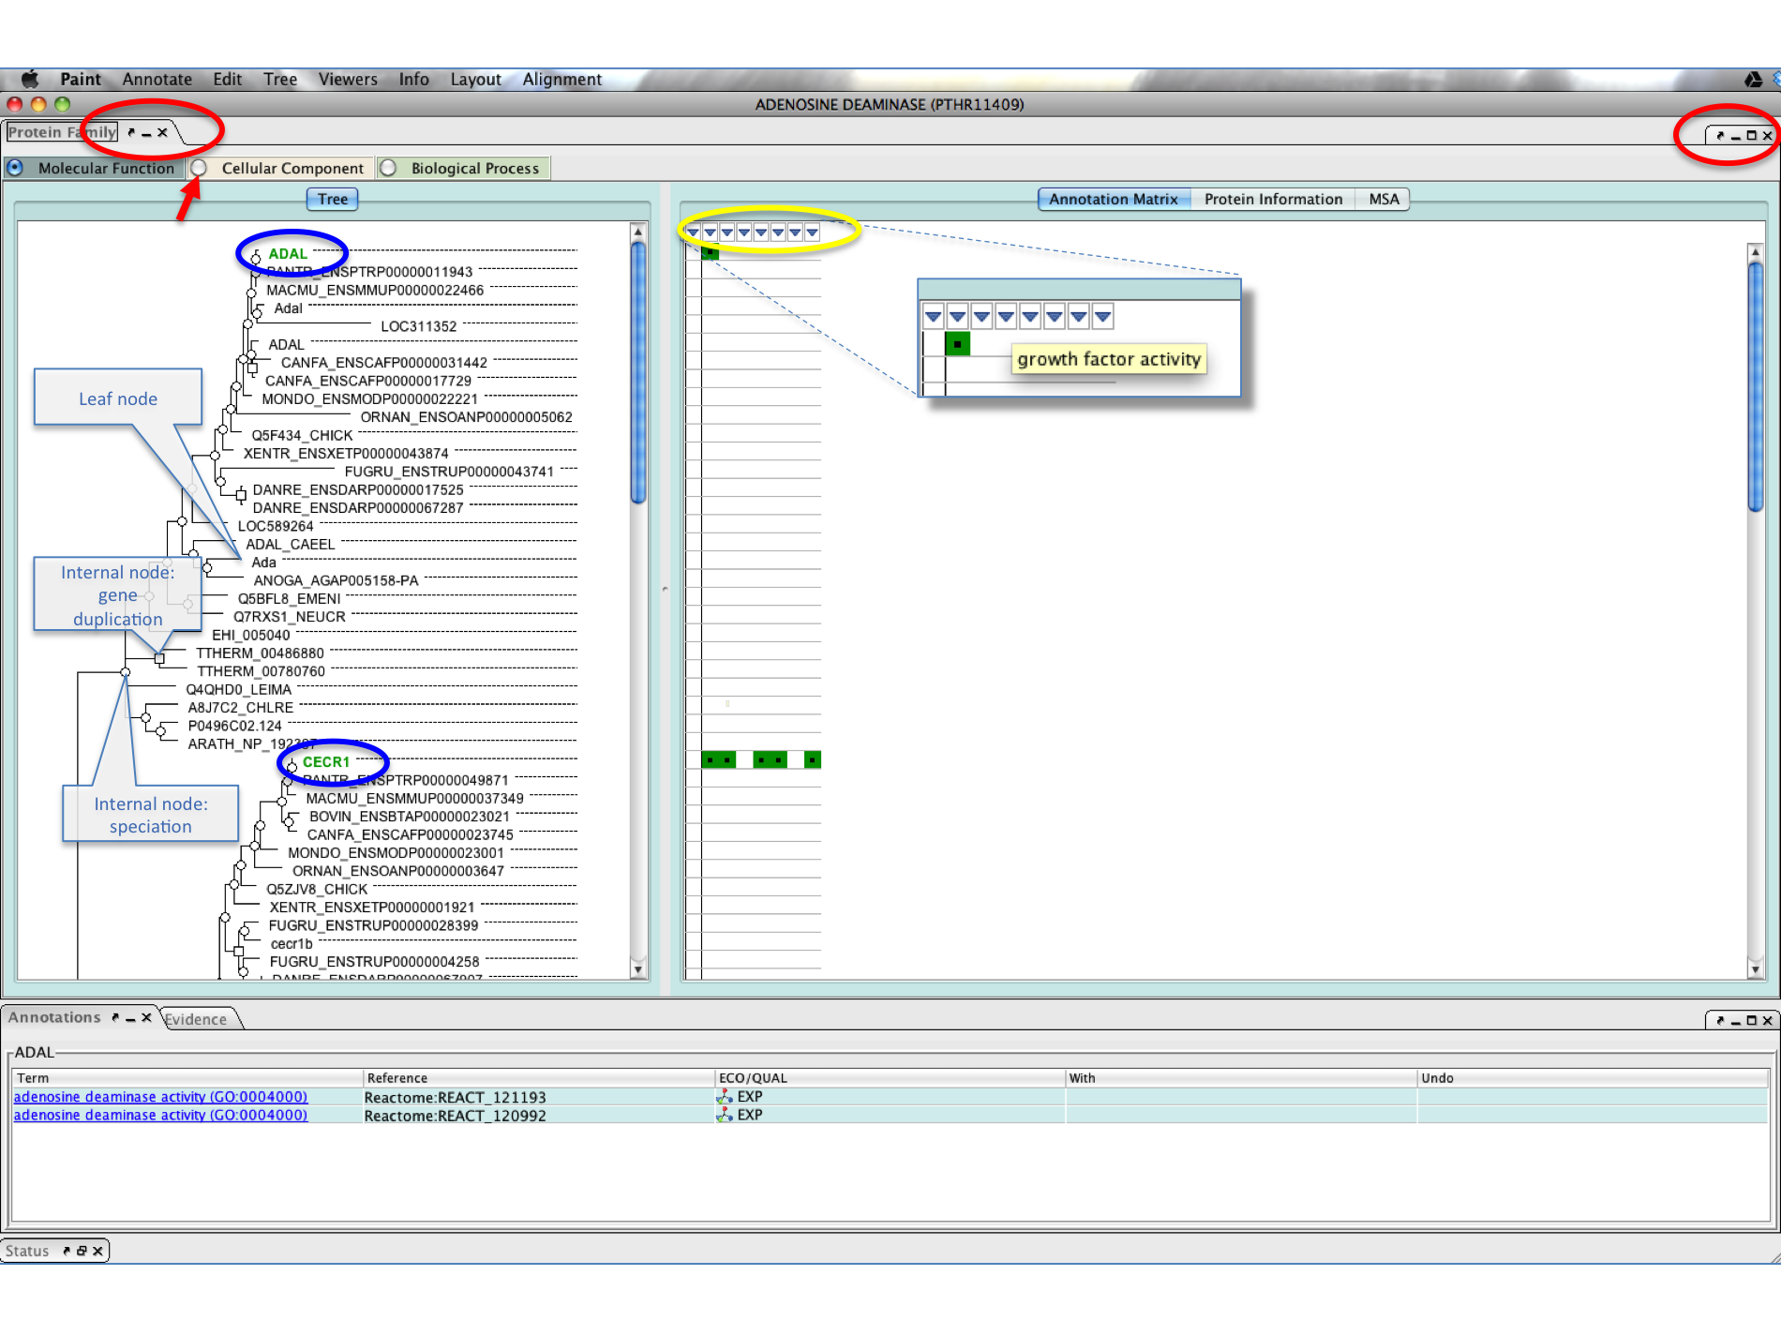
PAINT
https://sourceforge.net/projects/pantherdb/files/PAINT/
Notes:
GO project has developed software for propagating annotations by orthology.
Also helps for identifying errors in existing annotation
These annotations are being included in the DB.

Slide 19
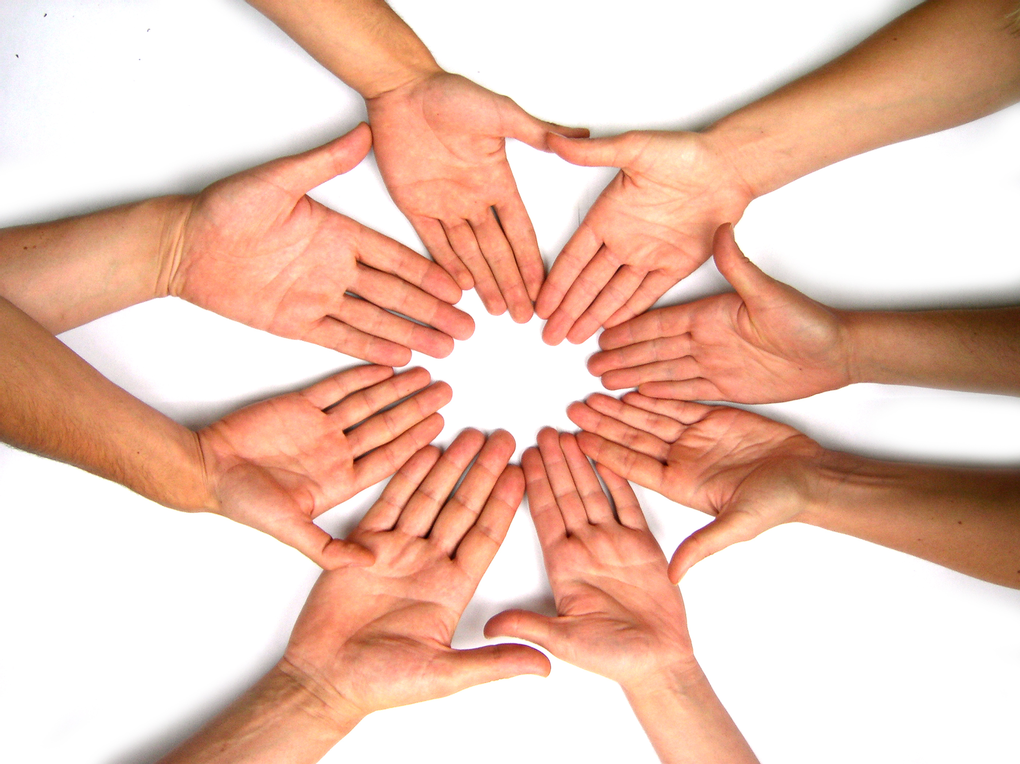
community annotation
Notes:
Another way of getting additional high-quality annotation is by using the biological community to create annotations.

Slide 20
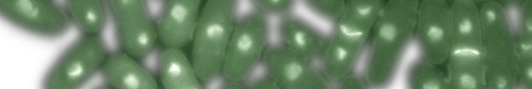

http://www.pombase.org/community/fission-yeast-community-curation-pilot-project
Notes:
Val Wood ran a pilot project in 2009 where she sent a simple Word doc to various Pombe bench researchers and asked them to fill it in.
She got a great response and on the basis of this they developed a tool for community curation

Slide 21
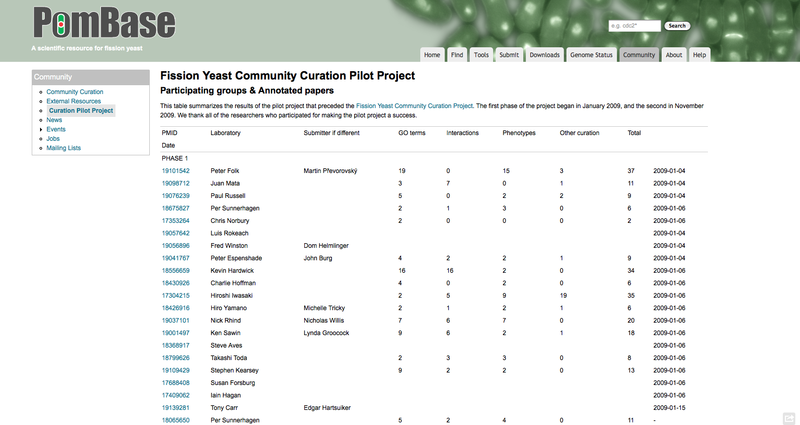

Slide 22
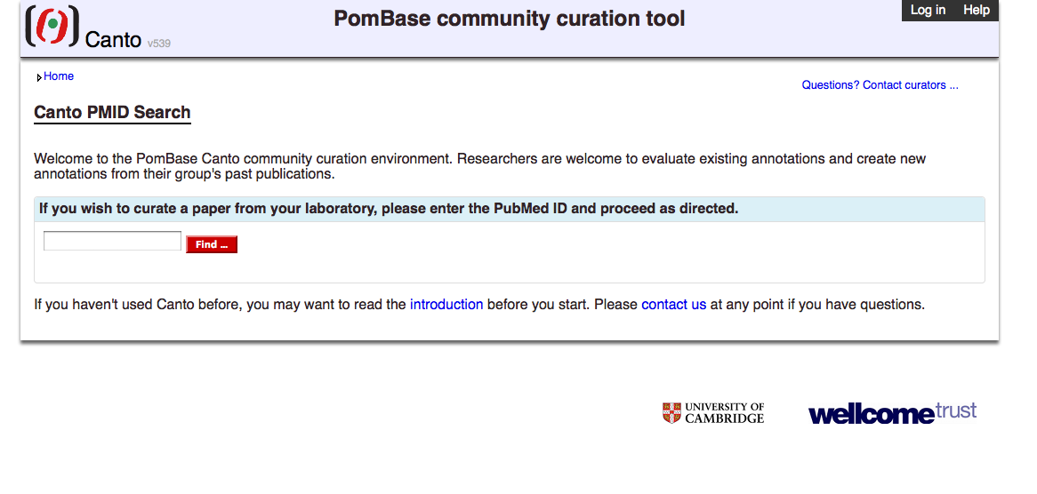
Canto
http://curation.pombase.org/
developed by Kim Rutherford
and Val Wood
Notes:
Step by step interface, allows people with no cura3on background to curate their own papers
• Curators can create a cura3on session and send it out to authors
• OR Authors can supply PMID for their publica3on to create their own cura3on session
• Demo session: hMp://cura3on.pombase.org/demo/test_curs/ (you can create your own demo session and make annota3ons using this link)
Transferrable, can be used for other species and datatypes (other implementations exist).

Slide 23
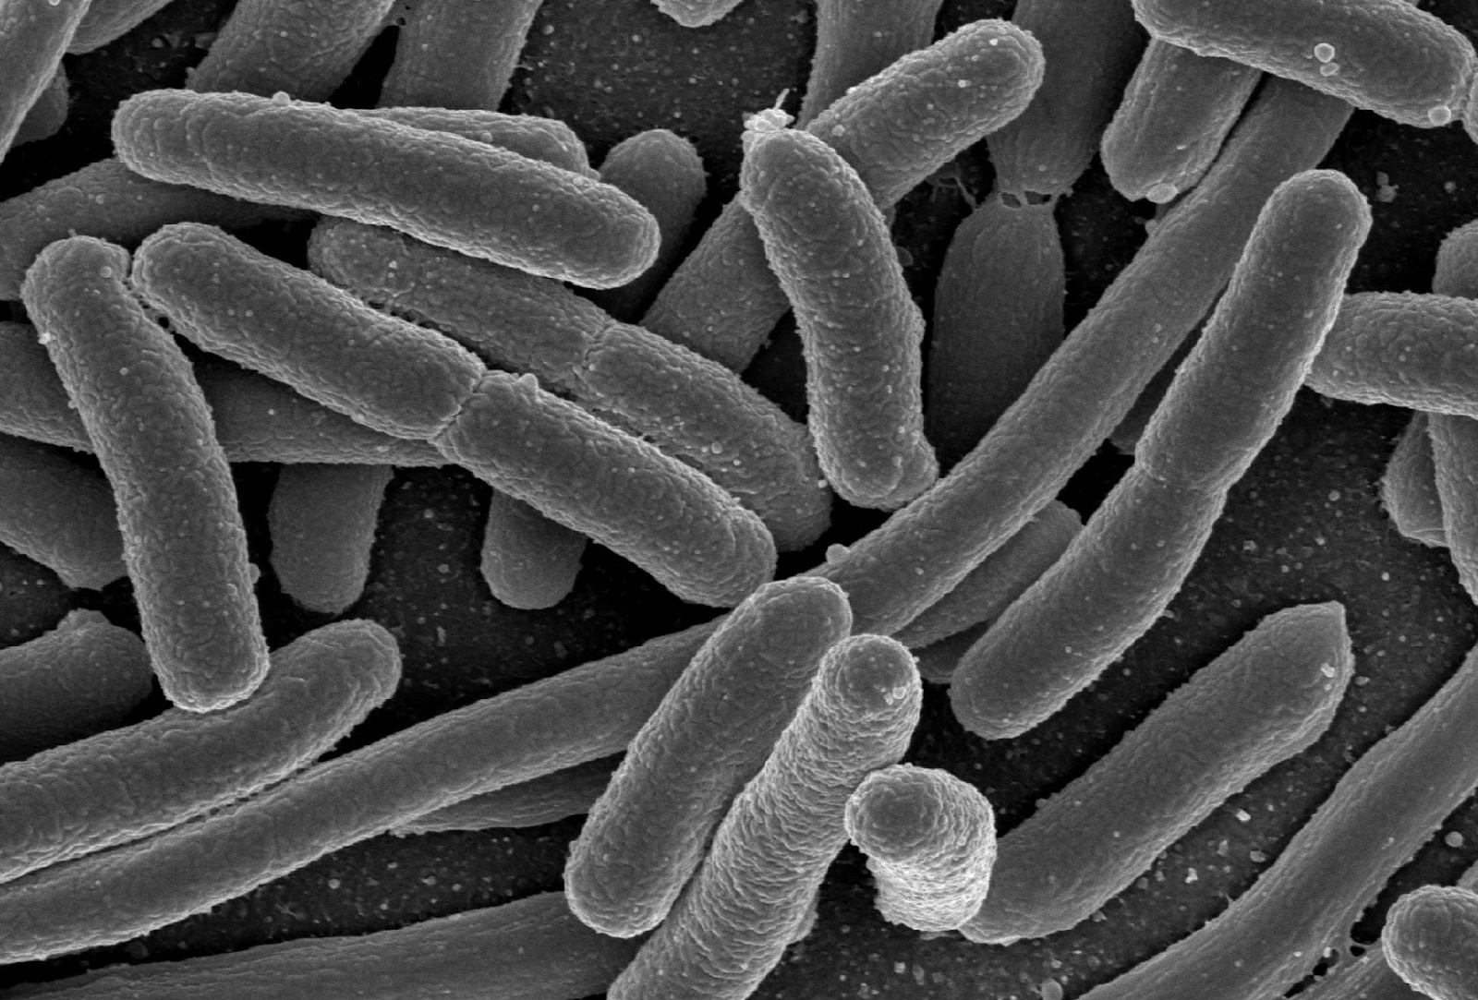
CACAO
Notes:
Community Assessment of Community Annotation with Ontologies (CACAO)
competition for teams of undergrads around the world to improve the functional annotation of genes.
CACAO was developed and is currently run at by Jim Hu at Texas A&M University
Annotations are checked and submitted to the GO db

Slide 24
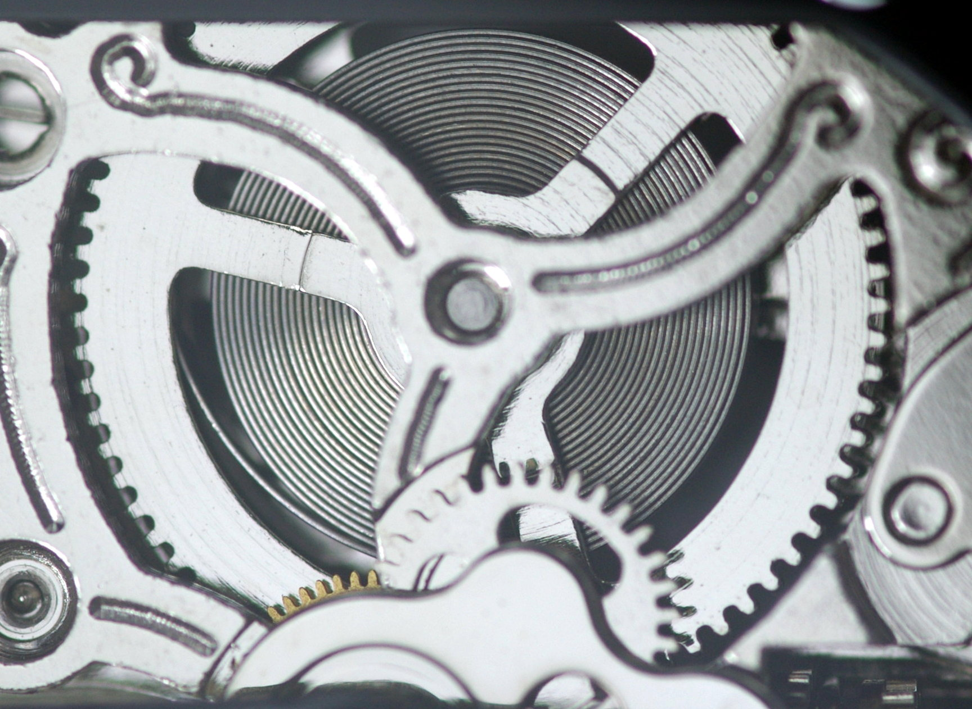
automatic annotation
Notes:
Electronically derived, by a whole series of different methodologies
Differs according to group
Often via a mapping to some pre-exisitng system (EC, Reactome, KEGG, Metacyc)

Slide 25
interpro2go
Notes:
Provides automatic prediction of for uncharacterized sequence
Predicts membership of protein families and presence of domains and features
manually curated mapping of families and domains to GO terms
High-level – has to be true for all (or most) members of a family – can add downstream filters
Incorrect annotations when spotted and fed back to improve the mapping – changing the mapping or adding QC filtering downstream e.g. taxon constraints
Mapping of domains has recently been improved – used to be to the whole protein that contained the domain, now just to the domain itself. Much more accurate.

Slide 26
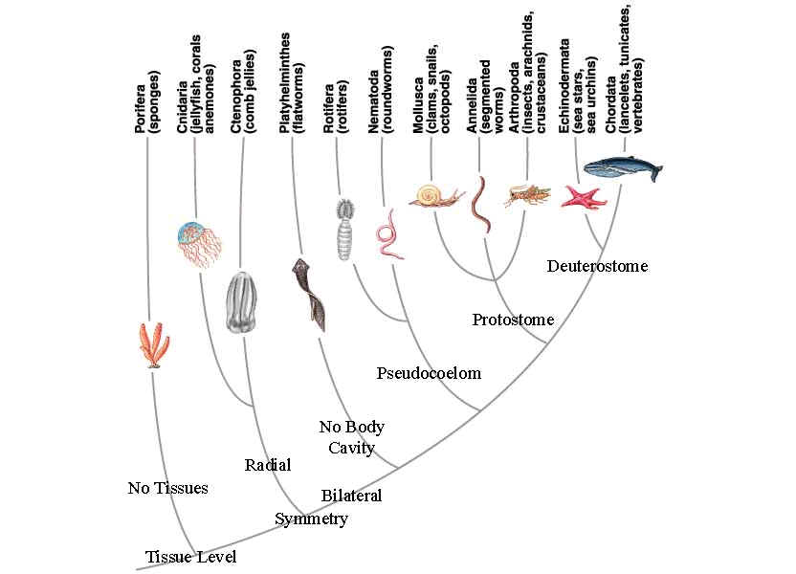
taxon constraints

Slide 27
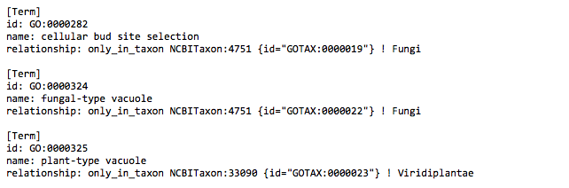
http://viewvc.geneontology.org/viewvc/GO-SVN/trunk/quality_control/annotation_checks/taxon_checks/taxon_go_triggers.obo

Slide 28
annotation extensions
Notes:
Or ‘column 16’ as it’s somewhat more mysteriously known.
this has arisen from the frustration of annotators working with the simplistic annotation model.
There are some pieces of information that are not easily captured in the current GO annotation model, so an annotation extension was created whereby
So you can make a statement e.g. gene product X is involved in apoptosis in cell type Y
The extension have defined semantics and allow a large range of additional information to be captured
But many things are still not possible e.g annotation lines are unrelated statements – you can say the same gp participates in a process and is located in a given cell component but not that those things happen together

Slide 29
http://www.pombase.org/spombe/result/SPBC211.04c

Slide 30

OWL v/s OBO
Notes:
Which leads me on to the future

Slide 31
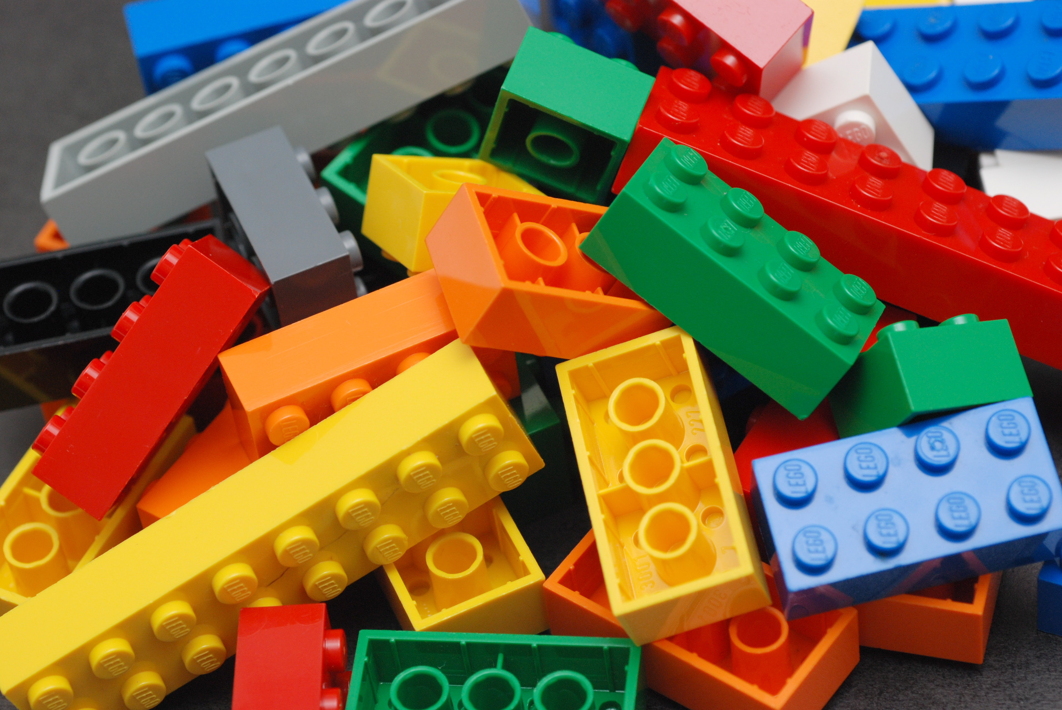
new annotation model
Notes:
One of the projects we’ve been working on is an enhanced annotation model, which has the working name LEGO because it by a series of modular blocks that can be fitted together

Slide 32
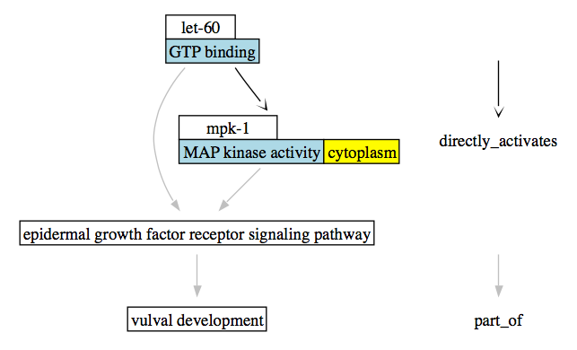
Notes:
This is an example from C. elegans
So the idea is that an annotator builds up a picture, or story of the biological events at the level of the individual proteins
The terms in blue are the ontology terms.

Slide 33
common annotation framework
Notes:
In order to implement this, ideally the dbs need to submit GO annotations via a common tool.
This is no easy feat given the diversity of the contributing DBs
Such a framework is under investigation, and in the interim many dbs are switching to using protein2go, the EBI’s annotation tool
So far WormBase, DictyBase in process SGD

Slide 34
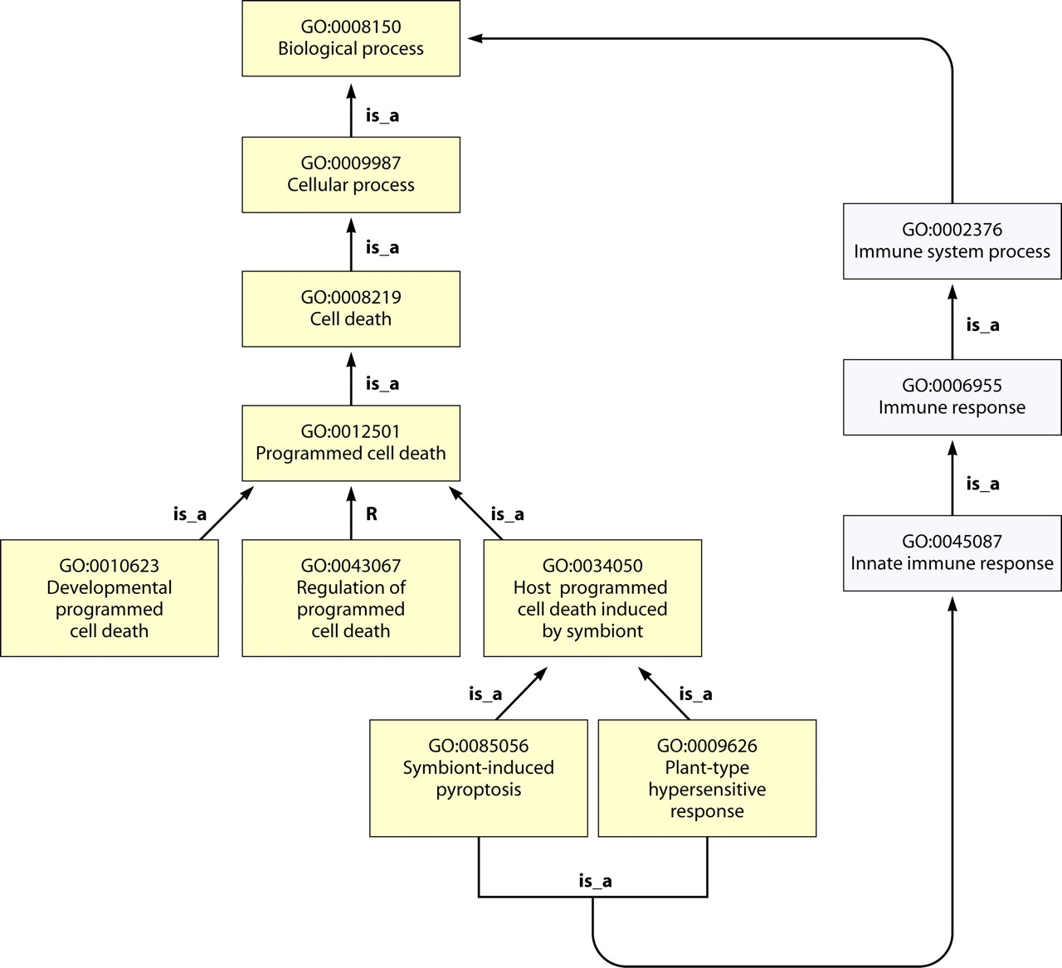
ontology

Slide 35
ontology formalization
Notes:
When GO started, it was a very simple ontology and this in many ways was an advantage: it allowed us to expand it very quickly in line with what was needed for annotation, without worrying too much about whether terms were in exactly the right place or what exactly they meant.
However, as GO got larger and more complex with new relationships and new branches, it became increasingly difficult to manage manually.
We realized we needed some automation to help out.
GO terms given formal ‘logical’ defintions

Slide 36
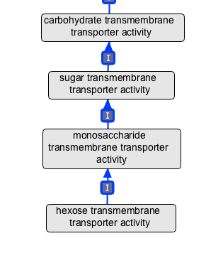
Notes:
For example, some GO terms can be described in GO processes + chemical
We leveraged CHEBI, the chemical ontology, to formally describe these GO processes
Allows automatic placement of new terms in graph based on CHEBI, error detection, improved integration etc

Slide 37

TermGenie
Notes:
One of the bottlenecks we have is that all terms need to be added by a small group of ontology developers
To help ameliorate this, we have developed a system for adding new terms that conform to specific templates.
Called TermGenie because the prototype versions used to say “your request has been granted”

Slide 38
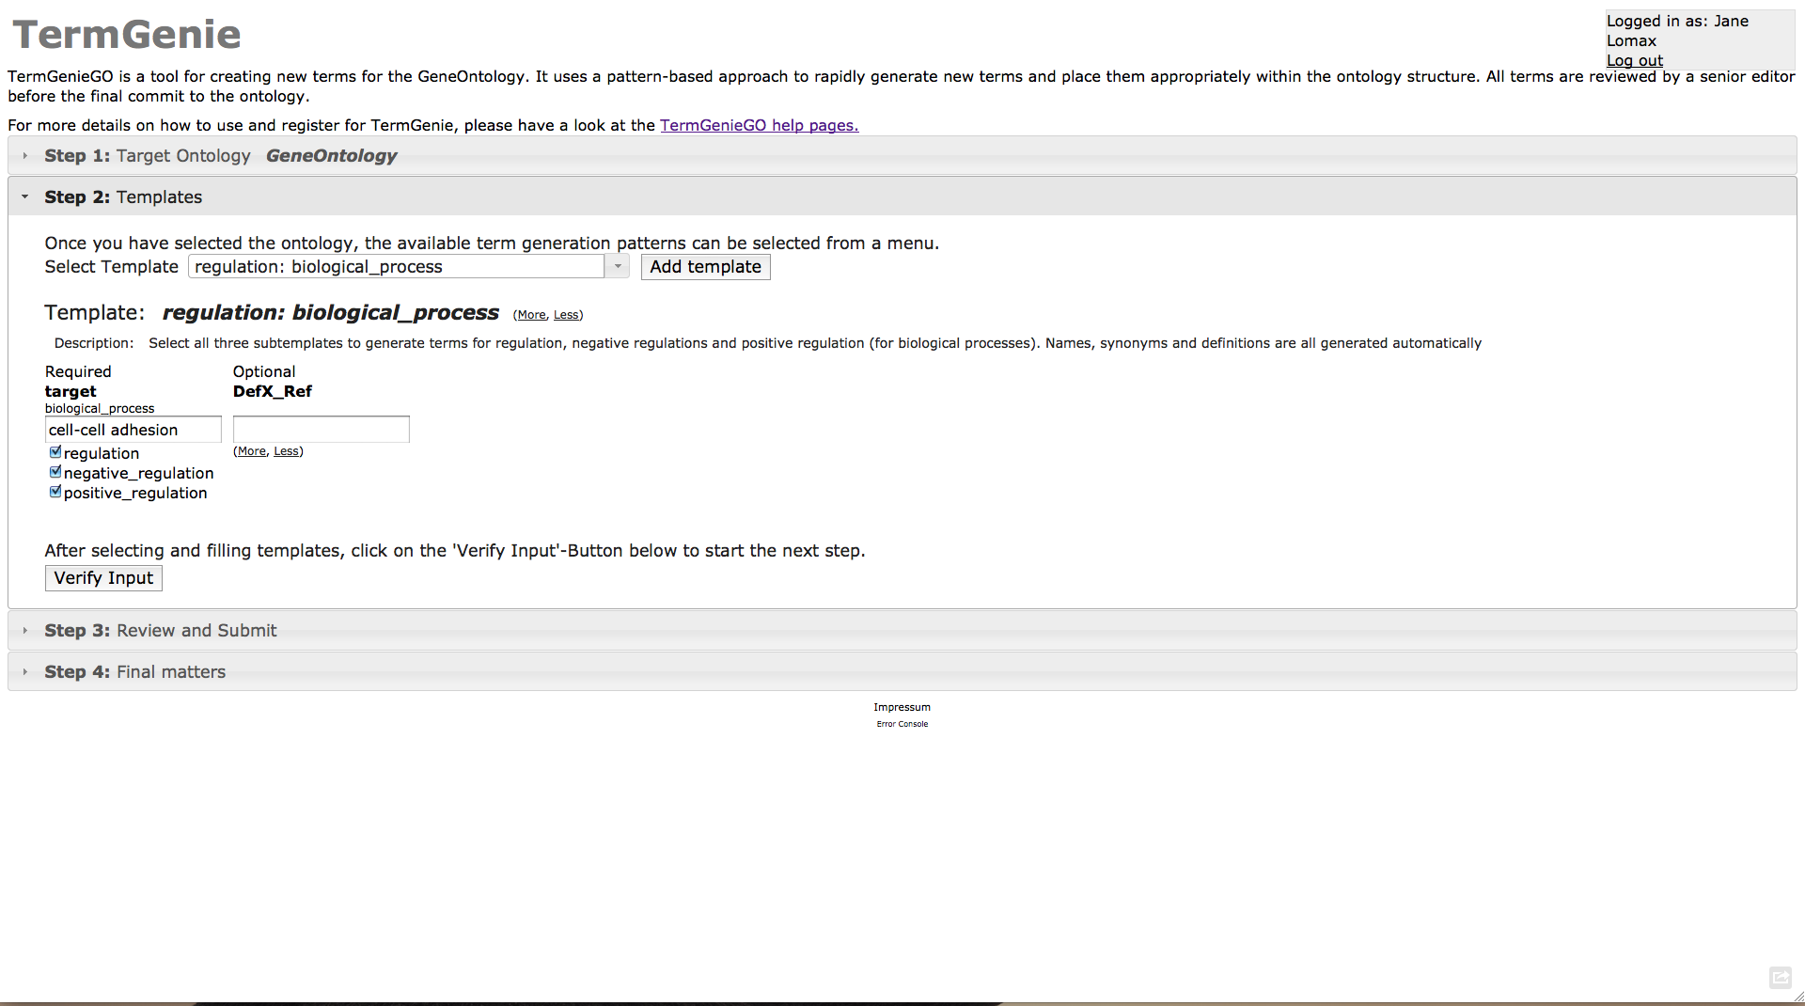
http://go.termgenie.org/
Notes:
Users are given a login and choose a specific template.
They build the term they need based on existing terms. The term is placed in the ontology based on its logical constraints.
Users are given an id for their new term immediately.
Terms are given a final review by an expert curator and then deployed directly in to the ontology.
If it’s a bad term (unusual if it conforms to a template) it’s obsoleted in the usual way.

Slide 39
OWL v/s OBO
Notes:
Not a kung-fu style
GO has been developed in OBO format – a human-readable ontology format developed by the GOC
For a long time this worked okay. In tandem we also developed an ontology editor that reads OBO files called OBO-Edit.
OWL – the Web Ontology Language – is a language for representing ontologies with more formal semantics and allow the use of semantic reasoners - a piece of software able to infer logical consequences from a set of asserted facts or axioms.
It became clear that we needed the reasoning power that these reasoners could provide, and when the mappings between OBO and OWL became advanced enough, we were able to switch over to an editing model where we go between the formats, reasoning in OWL/Protégé and editing in OBO/OBO-Edit

Slide 40
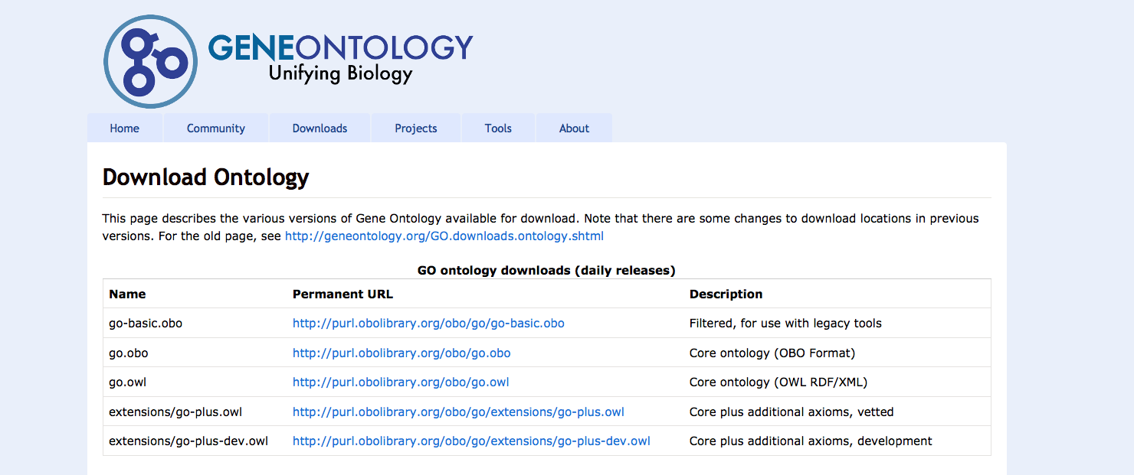
http://beta.geneontology.org/page/download-ontology
Notes:
One of the other ways we use Oort is to create all of the different ‘cuts’ of GO
The main editing version of GO is fairly rich in terms of logical constraints, relationship types etc and is pretty large.
Not all users need this level of complexity or detail, so we use Oort to generate a simple file, with only a few relationship types and no logical definitions, various subsets – GO slims as well as the OWL version of GO

Slide 41
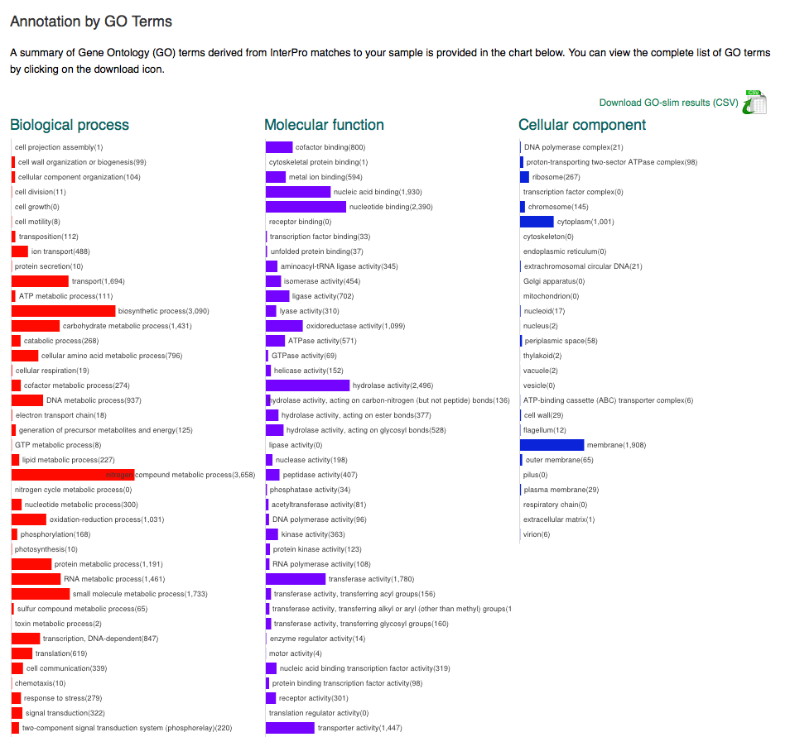
GO slims
Notes:
Metagenomics GO slim developed with InterPro

Slide 42
Rolf Apweiler
Rebecca Foulger
Paola Roncaglia
Susan Tweedie
Rachael Huntley
Tony Sawford
Prudence Mutowo
Mike Cherry
Suzi Lewis
Paul Thomas
Paul Sternberg
Judy Blake
Chris Mungall
Heiko Dietze
David Hill
Tanya Berardini
Harold Drabkin
+ the rest of the GO Consortium

