Slide 1
Benefits of a GO integrated analysis environment

Slide 2
Problem 1: Selecting and effectively using tools
Enrichment analysis is a ‘killer app’ for GO
Should be more central to what we do
Also other tools: e.g. function prediction
Problem:
Multiple tools with different characteristics
Statistical method
Environment / customizability
Visualization
Can we better help users:
Select the right tool(s) for the job
Run their analysis
Build scalable workflows that allow replication
Notes:
Pre-processing data (e.g. IDs should be mapped beforehand)
Running the analysis (installation, parameter selection, etc.)
Interpreting and visualizing results
Comparing outputs of two or more tools
Replicate analysis

Slide 3
Problem 2: Evaluating improvements in GO
How do we know how well we’re doing?
Progress in GO difficult to quantify
Same enrichment analysis may give completely different results one year to the next

Slide 4
Solution: GO Tools Environment
Tools:
Selecting the right tool
Solution: Detailed, accurate, up-to-date metadata on each tool
Galaxy: A standard platform for running analyses
‘operating system’ for bioinformatics analyses
allows plug and play
Combining tools
Common community interchange standards for GO analysis tools
Common term enrichment result format plus converters
Evaluation of GO:
Use Term Enrichment Analyses (TEAs) and standard gene sets to evaluate GO

Slide 5
Tool metadata: background
We have ~130 GO tools registered
~50 TEA tools
We don’t have all of them
Some info out of date
We need to capture more metadata
We want to be able to quickly answer queries like
Find an EA tool that
uses hypergeometric tests
can be used for <my species>
has not updated their annotation sets in > 6 mo
has visualization
I can use for my RNAseq data

Slide 6
Tool metadata: progress/tasks
Progress:
Infrastructure migration:
Migrated from custom tool metadata format and web infrastructure
using curated NIF registry
Built on semantic mediawiki
Ongoing tasks:
Add more fields (curated and automated)
Recommendations?
Integrate with go-help
Improve integration with main GO website
seamlessness
allow intuitive filtering of tools
See Seth’s presentation

Slide 7
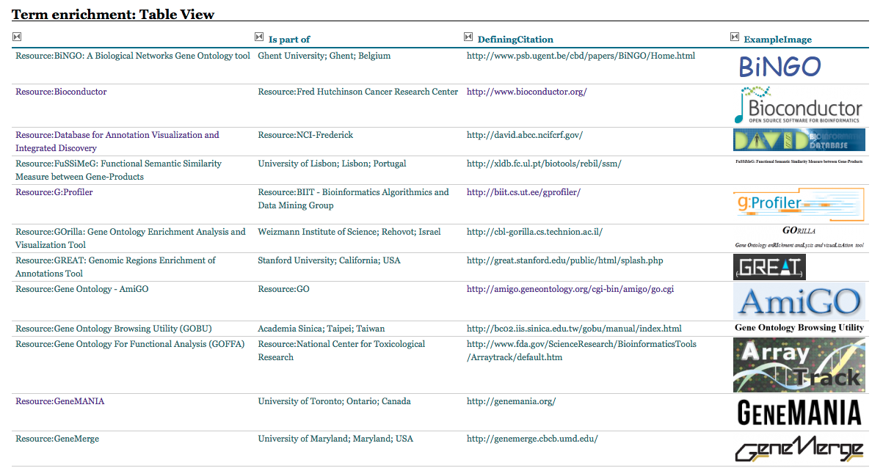
New Tools Registry

Slide 8
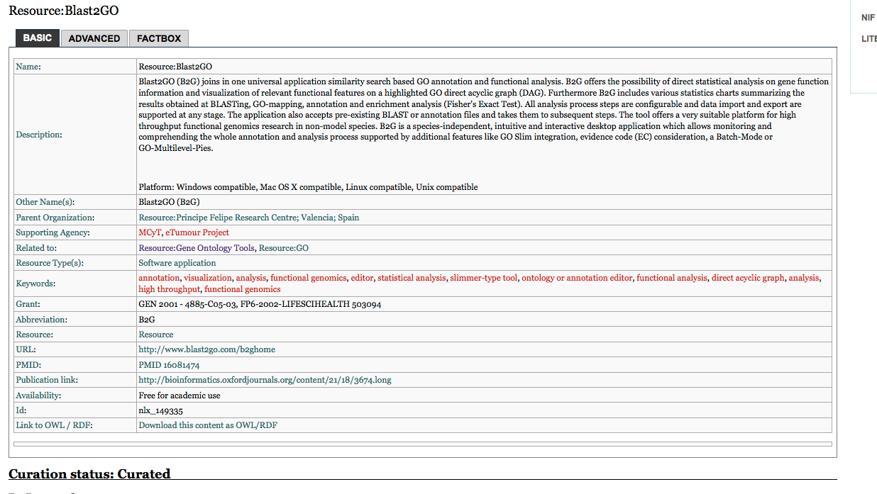
Example

Slide 9
Standard Term Enrichment Analysis Platform: background
Tools run in their own environment
Difficult to
Compare
Integrate into larger workflows
Provide uniform interface
Solution:
Standard workflow environment
Variety of workflow systems
Kepler
Galaxy
Taverna
Galaxy has a number of advantages
Simple to set up and extend
heavily used for next-gen analyses
Tools for intermine etc

Slide 10
Standard Term Enrichment Analysis Platform: progress/tasks
Progress
proof of concept prototype of GO environment
http://galaxy.berkeleybop.org
Ongoing tasks
Stabilize environment
Add more enrichment tools
Seamless integration with GO website
Outreach
User documentation
Bio-curators 2013 presentation
ONTO-ToolKit: enabling bio-ontology engineering via Galaxy
E Antezana, A Venkatesan, C Mungall, V Mironov, M Kuiper
BMC bioinformatics 11 (Suppl 12), S8 2010

Slide 11
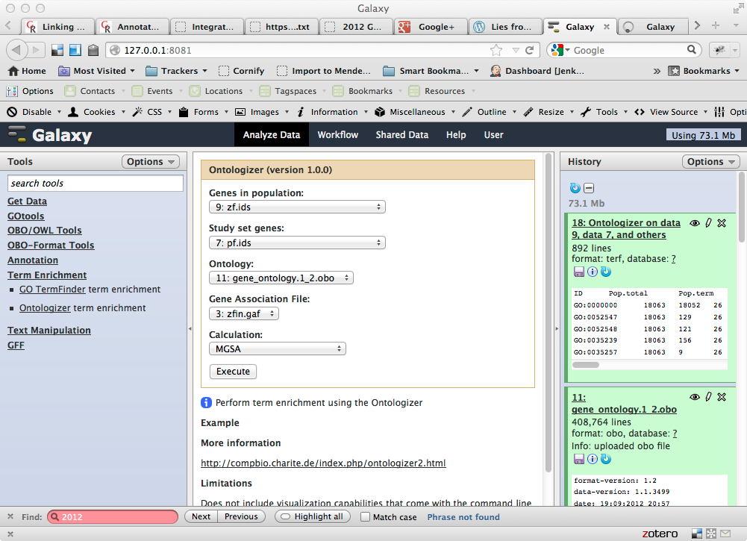
Screenshot

Slide 12
Interchange Standards: Outline
We need a Term Enrichment Result Format (TERF)
Standard output format for TE tools
Compliant tools will export TERF
We will write wrappers for non-compliant tools
Allows capture of detailed metadata about each result set
Example of use:
User runs gene set through tool X
User takes output of tool X and feeds it into visualizer Y

Slide 13
Interchange Standards: progress/tools
Progress
google code project created
http://code.google.com/p/terf/
preliminary format specified
TSV form and RDF/turtle form
some converters written
ermine/J, ontologizer
Ongoing tasks:
complete specification
public working draft for comments
incorporate comments
final specification
Outreach
work with tool developers
write additional converters
target command-line tools that provide diverse capabilities

Slide 14
GO evaluation: background
How do changes in the GO affect user’s queries and analyses?
We would hope that concerted ontology and annotation improvements would yield more complete and informative results
But we don’t know!
Notes:
If we had a repository of gene sets we could systematically re-analyze these with different variables
version of GO, version of annotations
different tools
If these gene sets were annotated with ‘expected’ results we could systematically determine if GO was delivering expected answers
danger of overfitting, but still useful

Slide 15
GO evaluation: background
How do changes in the GO affect queries and analyses?
We don’t know!
We would hope that concerted ontology and annotation improvements would yield more informative results
TE results are frequently reported in papers but rarely replicated
If we had a repository of gene sets we could systematically re-analyze these with different variables
version of GO, version of annotations
different tools
If these gene sets were annotated with ‘expected’ results we could systematically determine if GO was delivering expected answers
danger of overfitting, but still useful
ESlvaluation
Slide + analysis by:
Erik Clarke (Su Group)

Slide 16
GO evaluation: plan
Collect gene sets
Others can help us here
Select subset of tools
Analyze gene sets with this tool set and previous versions of GO + annotations
Cache results in TERF
Every month/quarter re-analyze gene sets
Can be done in Jenkins or Galaxy
Investigate anomalies
Explore as metric for GO

Slide 17
Conclusions
An integrated analysis environment can help
Users
The GOC
More work to be done
Need to dedicate resources

Slide 19
Example user scenario
User (optionally) specifies their problem. E.g.
species
specific hypothesis; e.g. immune system
identifier type (e.g. ensembl IDs)
User is given a list of appropriate tools
Either:
link to external web interface
link to download, install and run tool
ability to run tool(s) in GO analysis environment
User chooses to run ontologizer in GO environment
ensembl IDs are mapped using external ID mapper
GO immune subset is created on-the-fly
annotations filtered
subset, filtered annotations, mapped IDs fed to ontologizer
ontologizer results translated to common format
results can be plugged into choice of visualization tool

