Slide 1

Community Ontology Development
Lessons from the Gene Ontology
Notes:
GO is a long-standing ontology
Learned lessons, and continue to learn lessons about the best way to develop and annotate to ontologies in a distributed manner
Might be useful for emerging efforts

Slide 2
Ontology:
Sets of classes (terms) with relationships between them that describe a given domain

Slide 3
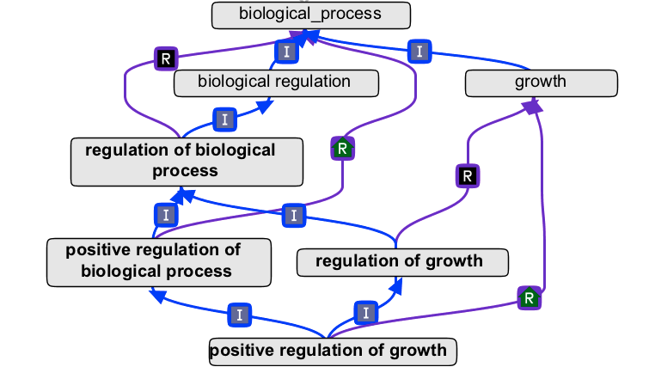

Slide 4
Annotation
Associating some object (e.g. protein, gene, experiment) with ontology terms with some evidence

Slide 5
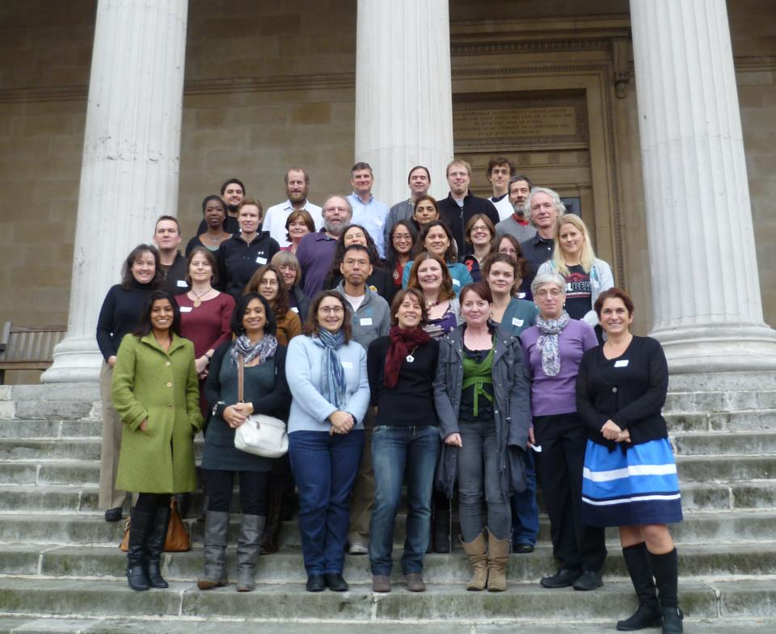
Gene Ontology Consortium
Notes:
GO was first developed in 1998
Initiated as a collaboration amongst several genome DBs, continued in that model
More than 20 sites now involved in collaboration
Co-ordination effort fairly immense
One of the members of OBO Foundry

Slide 6
OBO Foundry
http://www.obofoundry.org/
“a suite of orthogonal interoperable reference ontologies in the biomedical domain”

Slide 7
Overview
Scope
Users
Development mechanism
Standards
Community input
Publicize
Feedback cycle
Document

Slide 8
1. Define your scope
Notes:
Critical because difficult to do retrospectively
GO didn’t do a bad job: scope was determined from very outset
MF, BP, CC - specific
But still having problems with e.g. how MF relates to BP and others – under specified

Slide 9
Related efforts
Make contact
Know what’s out there
Notes:
Identify related efforts, make contact
Know what’s out there
collaborat
ereuse

Slide 10
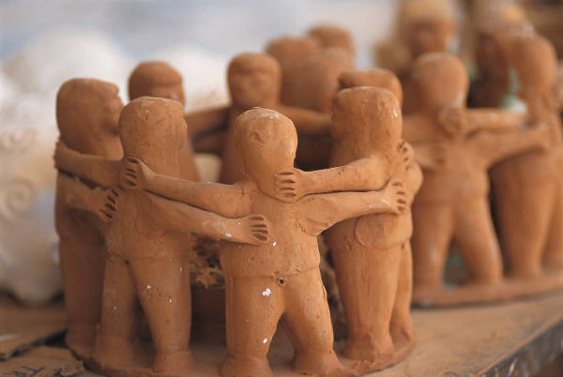
2. Have a user community
Notes:
Let that drive development – bottom-up
For GO this is the annotators – those people associating ontology terms with genes and proteins
if no-one is using your ontology its difficult to tell if it’s any good
Ontologies that are not being used are atrifacts

Slide 11
3. Decide on a mechanism for development
Notes:
Deliberately not dwelt on the technological aspects

Slide 12
Editors
Who can edit the ontology?
Notes:
The more people the more difficult to impose standards, too few creates a bottleneck and slows development

Slide 13
How
Versioning system or database
Critical that you know what others are working on

Slide 14
Remember – no system is a replacement for communication between developers!

Slide 15
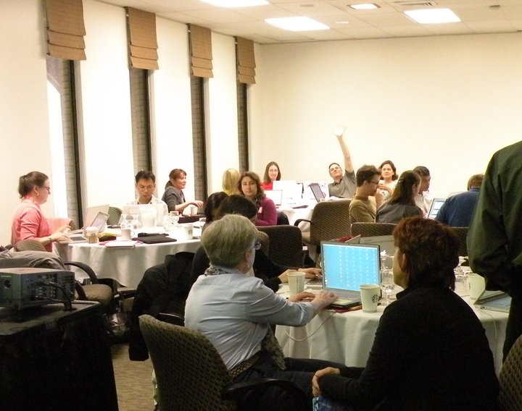
Meet regularly
Notes:
can and should be virtual – skype, conference calls, shared desktops
also needs to be face to face sometimes
some things can only be resolved face to face

Slide 16
Developing GO
Core editors
  5-10 editors
  Communicate extensively
  Distributed globally
  Only these people are direct editors
Notes:
All meet weekly for 1 hour
+ email

Slide 17
Developing GO
Per term requests
Major overhauls
Systematic changes
Notes:
Per term
Submitted into a tracking system
Worked on in isolation or grouped into a larger project
Major overhauls
In conjunction with experts
Often externally funded
Systematic Changes
addition of new relations, major alignment projects

Slide 18
4. Define and use standards
Notes:
Allows interaction & alignment between ontologies
CHEBI example - benzenes

Slide 19
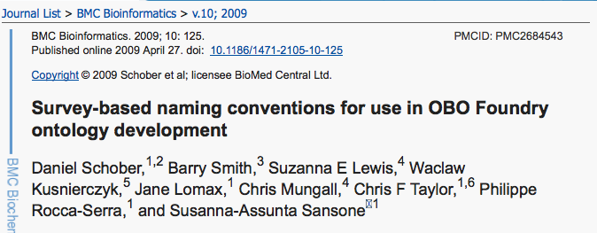
Naming conventions
Notes:
e.g. use of plurals - CHEBI

Slide 20
Relationships
Use standard where possible
Define where not

Slide 21
Good ontology design
rubbish in = rubbish out
modularity
pragmatism v/s perfectionism

Slide 22
5. Use your community

Slide 23
Community input to GO
Public tracker, email discussion lists
Involvement in specific development projects
Direct term submission
Community annotation tools

Slide 24
6. Publicize

Slide 25
Make sure people know you’re there
OBO Foundry, Ontology Lookup Service, BioPortal
Publish
Advertise
Notes:
The more the input, the better the ontology

Slide 26
7. Development cycle

Slide 27
Ontologies should be developed interatively
  need mechanism to communicate changes to users
  Static ontologies are not useful
  Don’t wait until it’s finished before you start using it

Slide 28
8. Document

Slide 29
It’s boring, but you’ll thank yourself in the long run
Document how and why you made decisions, how you think terms should be used

Slide 30
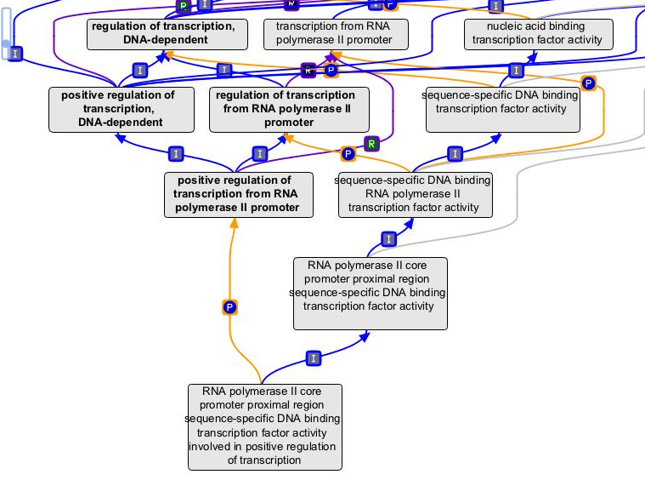
9. Other considerations
post- v/s pre-composition
Notes:
Some of this complexity could instead be captured at annotation level
annotation format should be extendable

Slide 31
Adding logical constraints to terms
Adds valuable reasoning power
Automatic term placement, definition generation etc.
Requires more thought per term

