Slide 1
Selecting condition and phenotype terms for submissions
Using MEdGen for ClinVar and GTR

Slide 2
Background
ClinVar and GTR frequently receive questions about how to select values that represent medical conditions or observed phenotypes in order to submits those values to the databases
There is no simple answer, because submitters often want to represent phenotypes with different specificity, or submitters have different levels of access to clinical information
Use of standardized terms and identifiers is strongly encouraged
NCBI developed MedGen (http://www.ncbi.nlm.nih.gov/medgen/) to organize medical genetic information, including terms and their relationships, with stable identifiers termed concept unique identifiers (CUI)
When multiple authorities contribute terms to the same CUI, ClinVar/GTR/MedGen chose the default as summarized here (http://www.ncbi.nlm.nih.gov/clinvar/nomenclature/)

Slide 3
More Background
Representation in MedGen is based on the data model of UMLS
Each term from each source is assigned a unique identifier
Related terms from one or more sources are grouped into concepts and assigned a concept unique identifier or CUI
Concepts are organized into what are termed semantic types, so that terms that may be used both for a clinical feature (e.g. finding) and for a disorder name (e.g. disease or syndrome) can be differentiated
Multiple types of relationships among concepts are represented, including parent-child, sibling, manifestation of
MedGen includes terms not in the UMLS, to support data flows for GTR and ClinVar
Such terms may be listed as vocabulary source GTR, Human Phenotype Ontology (HPO)
If from UMLS, the CUI starts with a C followed by numerals
If from NCBI, the CUI starts with CN
Maintenance
If a new release of UMLS now provides concept previously generated by NCBI
The CUI beginning with CN are deprecated
The history of the CUI changes is reported for transfer by ftp ftp://ftp.ncbi.nlm.nih.gov/pub/clinvar/ConceptID_history.txt
Terms are added daily from ClinVar, GTR, and OMIM

Slide 4
Scope of this presentation
What questions to ask (or categories of information to consider) when making the decision about what term or identifier to submit
Using content in MedGen, OMIM, Orphanet, NCBI gene to identify the term or terms to use
Considering hierarchies
Making choices based on how the terms will be used by GTR and ClinVar
NOTE: This is not a tutorial on use of MedGen. Please refer to MedGen’s help document: www.ncbi.nlm.nih.gov/medgen/docs/help/

Slide 5
Questions to ASK
Am I selecting a term describing a genetic disorder or a pharmacological response?
Am I selecting terms describing the [set of] case(s) I am studying/evaluating?
Do I want the term to be general or specific?
Do I want to use more than one term?
If none of the above applies, do I have the name(s) of the tests in which the variants were identified, or the purpose of the study?
Is there a term from an accepted authority that is appropriate based on associated genes or relationships to other disorders?

Slide 6
Scenario: report to clinvar the scope of a genetic test or report the interpretation of clinical significance
Options
Use a group term describing multiple disorders
Use the name of a specific disease or condition
Use the gene-specific subtype of a disease or condition
Report the accession of the test assigned by GTR as the method
Possible sources
Name and MIM numbers from OMIM
Usually gene-specific sub-types
Use if the scope is a single gene
Orphanet
Usually not gene-specific
Provides group terms
Terms in disease categories of UMLS / MedGen
Can be general or gene-specific subtypes
Provides cross-references to OMIM and Orphanet, among others
Represents hierarchies for selection of group terms

Slide 7
Options for selecting the name of a condition
Single-gene disorders If the gene-disease relationship is well-understood, and you are representing testing for GTR or variations from one gene for ClinVar, you may want to review OMIM, Orphanet, or Gene to select the identifier for the condition based on a query by gene.
Example: CFTR
OMIM
Orphanet
Gene

Slide 8
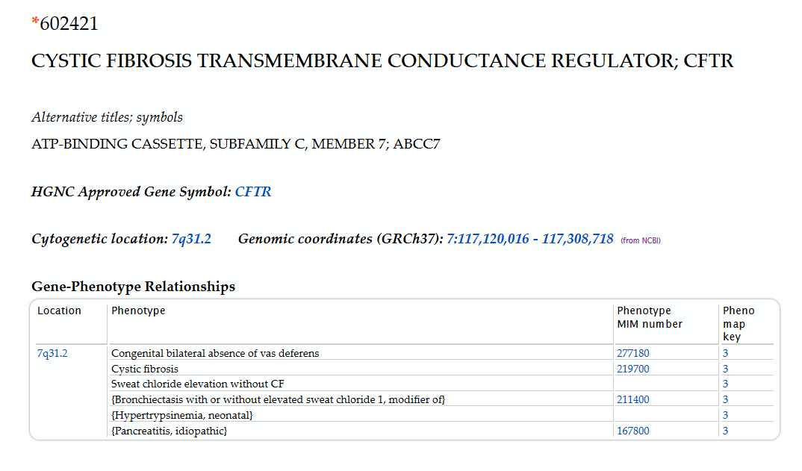
OMIM®
Note the list of Phenotypes, with MIM numbers listed in the Gene-Phenotype Relationships section

Slide 9
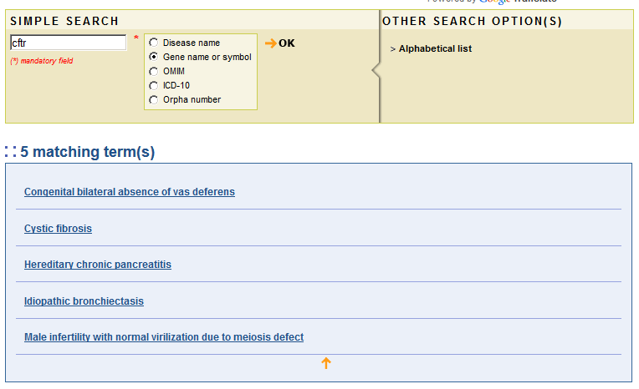
Orphanet: List of disorders matching the CFTR gene search

Slide 10
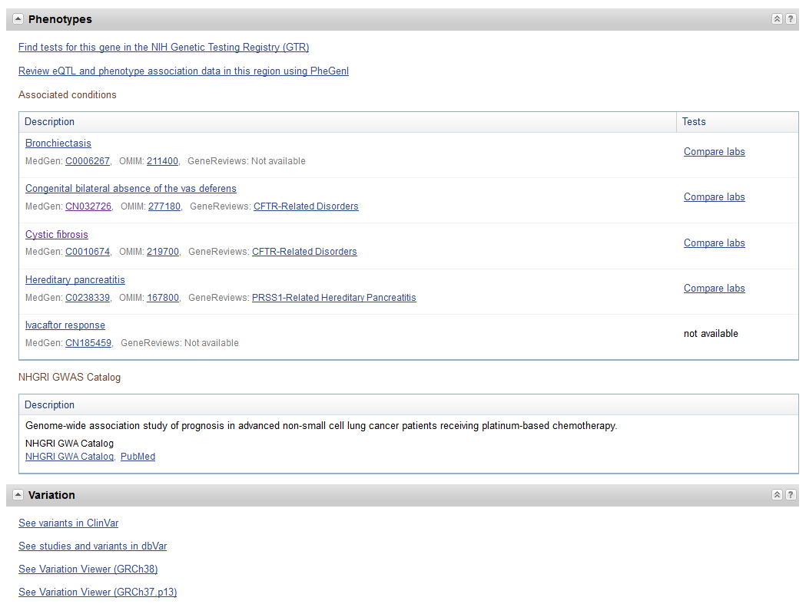
NCBI Gene
Gene integrates gene-disease relationships from multiple sources, and reports them in the phenotype section with links to those sources.

Slide 11
When to use A general term, i.e. one that applies to a family of conditions
For GTR, select a general term if a test is relevant for a category of disorders, e.g. deafness or cardiomyopathy
We encourage you to submit more than one condition for each test. This can include specific ‘children’ of a parent term, such as conditions that are gene-specific.
For ClinVar, select a general term when specificity is not possible, e.g. when you are a laboratory with limited phenotype information from a test requisition or when no gene-specific term is appropriate

Slide 12
How to find A general term , i.e. one that applies to a family of conditions
GTR and ClinVar use the hierarchies represented in MedGen (Term Hierarchy section)
These relationships can be provided from UMLS (MedGen tab) , or curated by NCBI staff (GTR tab)
MedGen is phasing in use of the relationships reported by Orphanet
Try several queries in MedGen and investigate the hierarchies to select your term
http://www.ncbi.nlm.nih.gov/medgen/2881#Term_Hierarchy

Slide 13
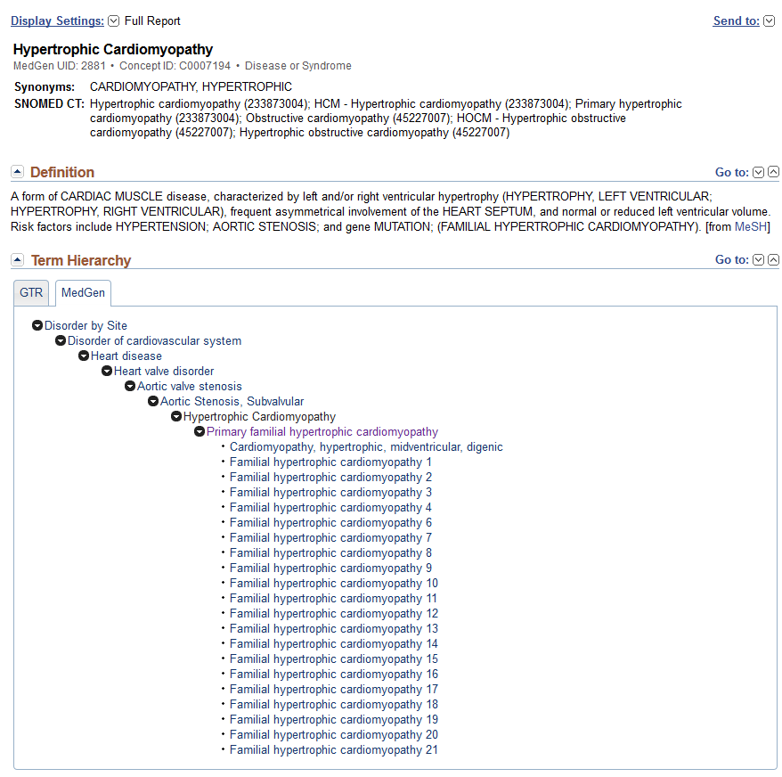
MedGen tab in the Term Hierarchy section
If you want to restrict to familial conditions, select
Primary familial hypertrophic cardiomyopathy
If you want to review, click on Primary familial hypertrophic cardiomyopathy to evaluate those details
Click to expand

Slide 14
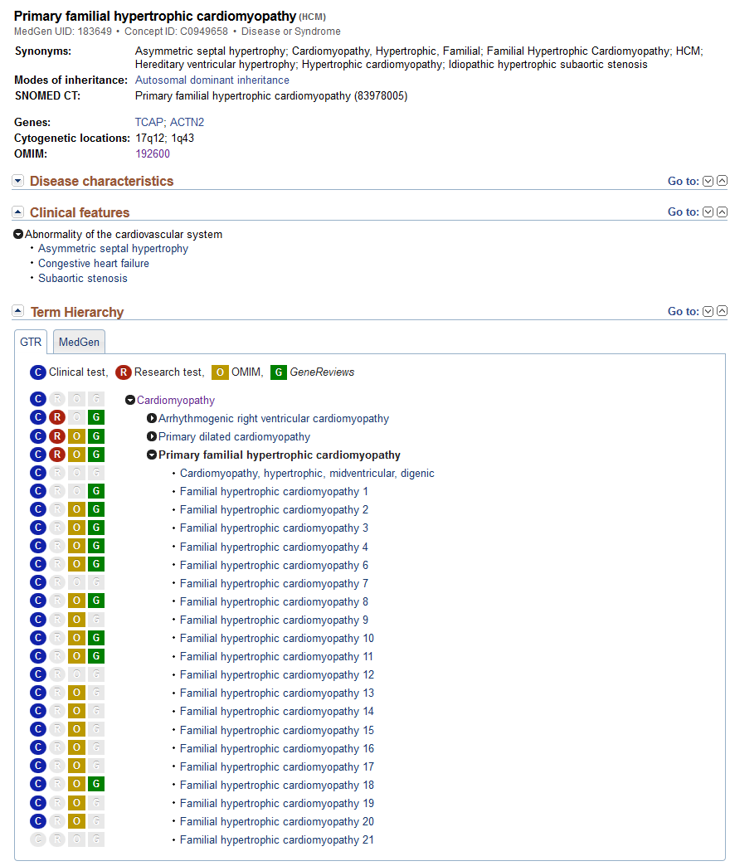
GTR tab in the Term Hierarchy section
Click to expand
Use the Clinical features hierarchies to explore other conditions with the same feature
Note there are several groupings available under Term Hierarchy

Slide 15
How to find pharmacogenetic response terms
MedGen includes terms for pharmacogenetic responses that are generally in the format [generic drug name][response] or [drug class][response].
Immune-mediated adverse drug reactions are structured as [Generic drug name] [‘hypersensitivity’]
Additional terms from OMIM are included, which generally do not have a structured format.
Use the Advanced test search feature in GTR to review available pharmacogenetic response terms more efficiently. See Help link below.
GTR submitters should select one or more pharmacogenetic response terms as the indication/phenotype for pharmacogenetic tests (e.g., ‘Amitriptyline response’), rather than the indication for use of the drug (e.g. a medication to treat ‘Depression’).
http://www.ncbi.nlm.nih.gov/gtr/docs/advanced_search/#PGxAS

Slide 16
observed phenotypes in a case or study (ClinVAr only)
Term(s) described as findings in UMLS/MedGen
Term(s) from phenotype ontologies such as HPO
To support aggregation of data from multiple submitters, ClinVar strongly encourages use of terms from a defined ontology. These data should be submitted as Clinical features, will be displayed in the Evidence tab on the web page, and reported as TraitSets in the ObservedIn element of the XML report.

Slide 17
How should phenotype be submitted if the interpretation of clinical significance is ‘Benign’? (clinvar only)
Use a general or specific disease term/identifier if an assertion is being made that a variant is benign in a limited context
Use ‘not specified’ in the ‘Phenotype description/Preferred phenotype name’ column if an assertion is being made that a variant is benign in any context

Slide 18
Terms to represent Indications for a test
GTR
the choice is one of specificity
Term for a single gene
Term for a category of disorders
ClinVar
An indirect representation of the condition or phenotype that may be related to the variant
To be used only by submitters from testing laboratories
Submitted separately so as not to suggest that the [set of] case[s] with the variant actually had the reported phenotype
In addition to names of conditions or phenotypes, may also be terms such as ‘family history’

Slide 19
Summary
There are multiple types of phenotypic information that can be represented, based on specificity
Group of related disorders
Gene-specific subtype
Observed phenotype or clinical feature
Indication
Select the one that best represents what describes the scope of your test (GTR) or the disease for which an interpretation of clinical significance is being submitted (ClinVar) or observed phenotypes (ClinVar)
If you have any question, or suggestion for improvement or correction, please contact staff at ClinVar or GTR
clinvar@ncbi.nlm.nih.gov
http://www.ncbi.nlm.nih.gov/projects/gtr_feedback/

